Slide 1
Using a letter to represent unknowns
KS3 Mastery PD Materials: Exemplified Key Ideas
Materials for use in the classroom or to support professional development discussions
(From 1.4 Simplifying and manipulating expressions, equations and formulae)
Summer 2021

Slide 2
About this resource
These slides are designed to complement the 1.4 Simplifying and manipulating expressions, equations and formulae Core Concept document and its associated Theme Overview document 1 The Structure of the number system, both found in the Secondary Mastery Professional Development pages.
These slides re-present the key examples from the Core Concept document so that the examples can be used either directly in the classroom or with a group of teachers. There are prompt questions alongside the examples, and further clarification in the notes.
These slides do not fully replicate the Core Concept document, so should be used alongside it. Reference to specific page numbers, and to other useful NCETM resources, can be found in the notes for each slide.
This slide deck is not designed to be a complete PD session, rather it is a selection of resources that you can adapt and use as needed when planning a session with a group of teachers.

Slide 3


About this resource
The slides are structured as follows:
  The big picture:
    Where does this fit in?
    What do students need to understand?
    Why is this key idea important?
  Prior learning
  Misconceptions
  Exemplified key ideas
  Reflection questions
  Appendices:
    Key vocabulary
    Representations and structure
    Previous and Future learning
    Useful links
The exemplified key idea slides have the following symbols to indicate how they have been designed to be used:
Into the classroom
The examples are presented on these slides so that they could be used in PD, but also directly in the classroom. The notes feature suggested questions and things teachers might consider when using with students.
PD discussion prompts
These slides look at the examples in more detail, with question prompts to promote discussion among maths teachers. The notes feature reference to further information and guidance within the Core Concepts document.

Slide 4
Where does this fit in?
The NCETM has identified a set of six ‘mathematical themes’ within Key Stage 3 mathematics that bring together a group of ‘core concepts’.
The first of these themes is The structure of the number system, which covers the following interconnected core concepts:
    1.1 Place value, estimation and rounding
    1.2 Properties of number
    1.3 Ordering and comparing
    1.4 Simplifying and manipulating expressions, equations and formulae
Notes:
Linked on this slide is the Theme Overview document of The structure of the number system. This document includes why it is important, the key underpinning knowledge and links to prior and future learning. There is also guidance about how the five big ideas of Teaching for Mastery relate specifically to this theme.

Slide 5
Where does this fit in?
Within this core concept, 1.4 Simplifying and manipulating expressions, equations and formulae, there are three statements of knowledge, skills and understanding.
These, in turn, are broken down into seventeen key ideas. The highlighted key idea is exemplified in this slide deck.
Notes:
For key ideas marked with an asterisk, we exemplified the common difficulties and misconceptions that students might have and included elements of what teaching for mastery may look like. We have provided examples of possible student tasks and teaching approaches.
Within these slides are ‘classroom-ready’ versions of the examples for the key idea that has been highlighted. There are also slides that may be useful for discussion in a professional development session.

Slide 6
What do students need to understand?
1.4.1.4 Understand and recognise that a letter can be used to represent a specific unknown value or a variable
Understand that unknown quantities can be named and operated on.
Understand that a letter stands for a variable and can take a range of values.
  What prior knowledge might your students already have?
  What language might they use to describe this key idea?
  What questions might you want to ask to assess their prior learning?

Slide 7
Why is this key idea important?
The fundamental understanding in this set of key ideas is that a letter can be used to represent a generalised number and that algebraic notation is used to generalise number properties, structures and relationships. Students should have a clear understanding of the particular number relationships before generalising using algebra.
One of the ways in which students interpret algebraic expressions and equations is to work from the general to the particular. For example, to interpret the meaning of an algebraic statement, such as 3x + 5 or x² – 2, it is important that students consider the questions:
  ‘How does the value of the expression change as the value of x changes?’
  ‘When does the expression take a particular value?’
Students should realise that there is a difference between situations where a letter represents a variable which can take any value across a certain domain and where, because of some restriction being imposed (e.g. 3x + 5 = 7, x² – 2 = 9 or 3x + 5 = x² – 2), it has a particular value (which may be as yet unknown).
Notes:
A more detailed overview of the core concept of Simplifying and manipulating expressions, equations and formulae can be found on page 2 of the 1.4 Core Concept document.
The background to each key idea is also explored in more detail on the following pages:
1.4.1 Understand and use the conventions and vocabulary of algebra, including forming and interpreting algebraic expressions and equations – page 5
1.4.2 Simplify algebraic expressions by collecting like terms to maintain equivalence – pages 5 and 6
1.4.3 Manipulate algebraic expressions using the distributive law to maintain equivalence – pages 6 and 7
1.4.4 Find products of binomials – pages 7 and 8
1.4.5 Rearrange formulae to change the subject – pages 8 and 9

Slide 8
Prior learning
Upper Key Stage 2 Learning Outcome
Use their knowledge of the order of operations to carry out calculations involving the four operations
Use Simple formulae
Express missing number problems algebraically
Find pairs of numbers that satisfy an equation with two unknowns
Enumerate possibilities of combinations of two variables
Be introduced to the use of symbols and letters to represent variables and unknowns in mathematical situations that they already understand (non-statutory guidance)
  What prior knowledge might your students already have?
  What language might they use to describe this key idea?
  What questions might you want to ask to assess their prior learning?
Notes:
You may find it useful to speak to your partner schools to see how the above has been covered and the language used.
You can find further details regarding prior learning in the following segments of the NCETM primary mastery professional development materials (linked on final slide):
Year 5: 1.28 Common structures and the part–part–whole relationship
Year 6: 1.31 Problems with two unknowns
Within the 1 The structure of the number system Theme Overview document, you can also find a broader description of students’ potential previous learning (page 4), alongside further information about key underpinning knowledge (page 2).

Slide 9
Checking prior learning
The following slides contain questions for checking prior learning.
  What representations might students use to support their understanding of these questions?
  What variation might you put in place for these questions to fully assess students’ understanding of the concept?
  How might changing the language of each question change the difficulty?
  Why are these such crucial pre-requisites for this key idea?

Slide 10
Checking prior learning (1)
Which of the following statements do you agree with? Explain your decisions.
The value 5 satisfies the symbol sentence
The value 7 satisfies the symbol sentence
The value 6 solves the equation 20 – x = 10
The value 5 solves the equation 20 ÷ x = x - 1
+ 2 = 17
× 2 = 10 +
Notes:
References to the questions (links on final slide):
a) NCETM primary assessment materials: Year 6, page 29

Slide 11
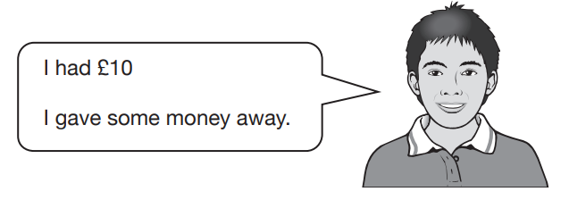
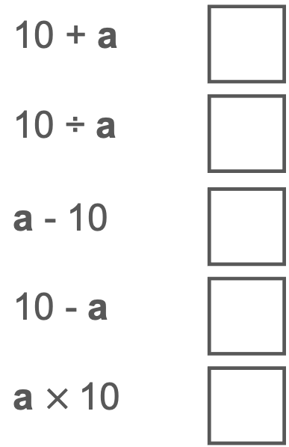
Checking prior learning (2)
Dev says,
10 + a
10 ÷ a
a - 10
10 - a
a $×$10
a is the amount of money, in pounds, that Dev gave away.
Which expression shows how much money Dev has left?
Notes:
References to the questions (links on final slide):
b) 2019 Key Stage 2 Mathematics Paper 3: Reasoning, question 3

Slide 12
Common difficulties and misconceptions
What aspects of this key idea might pupils find challenging?
What misconceptions might pupils have?
When teaching this topic, you may find students encounter difficulties with…
use of letters in mathematics
More information, and some suggestions for overcoming these challenges, can be found on the following slides.

Slide 13
Common difficulties and misconceptions (1)
Dietmar Küchemann (1978) identified the following six categories of letter usage by students (in hierarchical order):
  Letter evaluated: the letter is assigned a numerical value from the outset, e.g. a = 1.
  Letter not used: the letter is ignored, or at best acknowledged, but without given meaning, e.g. 3a taken to be 3.
  Letter as object: shorthand for an object or treated as an object in its own right, e.g. a = apple.
  Letter as specific unknown: regarded as a specific but unknown number and can be operated on directly.
  Letter as generalised number: seen as being able to take several values rather than just one.
  Letter as variable: representing a range of unspecified values, and a systematic relationship is seen to exist between two sets of values.
The first three offer an indication of the difficulties and misconceptions students might have. The last three outline the progression that students need to make as they develop an increasingly sophisticated view of the way letters are used to represent number.
Notes:
More detail can be found on page 10 of the 1.4 Core Concept document.

Slide 14
Understand that unknown quantities can be named and operated on
Example 1
For each of the following statements, use a letter to represent the number Isla is thinking of and write the statement using letters and numbers.
a) ‘I am thinking of a number and I add three.’
b) ‘I am thinking of a number and I multiply by two and add three.’
c) ‘I am thinking of a number and I add three and multiply by two.’
d) ‘I am thinking of a number and I multiply by three and add two.’
Notes:
Suggested questioning:
What is the same and what is different about each of these questions?
Do your expressions for b) and c) mean the same thing?
How can you show algebraically the different order of operations in parts b) and c)?
How many possible values are there for your number?
What could the value of your expressions be? Which is the largest? Will this always be the case?
Things for you to think about:
In Example 1, the numbers are deliberately kept the same in order for students to focus on the order of operations and how algebraic symbolism is used to represent the different order of operations, using brackets where necessary.
A key purpose of variation is to support students’ awareness of what can change, and it can be useful to ask them to make up some examples like these for themselves. For example, you could ask: ‘Using the numbers two and three, make up some different “I am thinking of a number” statements and set them for your partner.’
Students’ thinking can be deepened by asking more probing questions at intervals throughout this example. For example, after working on parts b) and c), you could ask: ‘Do the two expressions (2x + 3 and 2(x + 3)) mean the same? Do they give the same answers for given values of x?’
While this example is a useful precursor to solving equations, the central purpose here is to understand that letters can have a range of values and to get a sense of how the value of expressions can change with these different values. Students should be encouraged to offer a number of possible values for x.
This is a good opportunity to introduce the language of ‘variable’ and encourage students to use this term while discussing their answers and their reasoning. For example, ‘In the expression 2x + 3, x is a variable because it can take a range of different values.’

Slide 15
Understand that unknown quantities can be named and operated on
Example 1
  What is the effect of the variation in this example?
  What language might you want to introduce to support students in discussing this example?
  How might you model the similarities and differences between each expression?
For each of the following statements, use a letter to represent the number Isla is thinking of and write the statement using letters and numbers.
a) ‘I am thinking of a number and I add three.’
b) ‘I am thinking of a number and I multiply by two and add three.’
c) ‘I am thinking of a number and I add three and multiply by two.’
d) ‘I am thinking of a number and I multiply by three and add two.’
Notes:
Due to space constraints, the image on this PD discussion slide is very small. PD Leads might like to use or print the ‘in the classroom’ version of this slide for teachers to access during discussions.
This example can be found on pages 10 and 11 of the 1.4 Core Concept document.

Slide 16
Understand that unknown quantities can be named and operated on
Example 1 (cont’d)
  What other ways might there be of helping students to see that unknown quantities can be worked on?
  You could try this activity with a group of teachers:
    Ask two people to each think of a number, one has to think of a two-digit integer, and one has to think of a three-digit integer.
    Find the difference between the two numbers, but first ask the two people to add 1 to each of their numbers. What effect will this have on the difference?
    What about if they added 1 to one of the numbers and took 1 from the other, etc.?
For each of the following statements, use a letter to represent the number Isla is thinking of and write the statement using letters and numbers.
a) ‘I am thinking of a number and I add three.’
b) ‘I am thinking of a number and I multiply by two and add three.’
c) ‘I am thinking of a number and I add three and multiply by two.’
d) ‘I am thinking of a number and I multiply by three and add two.’
Notes:
Due to space constraints, the image on this PD discussion slide is very small. PD Leads might like to use or print the ‘in the classroom’ version of this slide for teachers to access during discussions.
This example can be found on pages 10 and 11 of the 1.4 Core Concept document.

Slide 17
Understand that unknown quantities can be named and operated on
Example 2
For each of the following statements, use a letter to represent the number Isla is thinking of, write the statement using letters and numbers, and find the number she is thinking of.
a) ‘I am thinking of a number; I add four and the answer is 12. What number am I thinking of?’
b) ‘I am thinking of a number; I add four, multiply by three and the answer is 12. What number am I thinking of?’
c) ‘I am thinking of a number; I add four, multiply by three, subtract six and the answer is 12. What number am I thinking of?’
d) ‘I am thinking of a number; I add four, multiply by three, divide by two and the answer is 12. What number am I thinking of?’
Notes:
Suggested questioning:
What is the same and different about this example and example 1?
How many possible values are there for your number?
Things for you to think about:
The focus of Example 2 is to make students aware of the fact that, when constraints are put on a situation, the unknown will take a particular value.
The numbers have been chosen in Example 2 to keep the given answer of ‘12’ the same and to build the operations in sequence. The example will best be tackled by offering and discussing each part individually.
Students can be encouraged to make up their own examples for their partners. This will support their realisation that, when they put constraints on a situation like this, their partner will always be able to figure out their number.
You could encourage students to use the term ‘specific unknown’ when talking about these examples, as in, ‘When I am told that 3(x + 4) – 6 = 12, there is only one value that will make this true and so the letter x stands for a specific unknown’.

Slide 18
Understand that unknown quantities can be named and operated on
Example 2
For each of the following statements, use a letter to represent the number Isla is thinking of, write the statement using letters and numbers, and find the number she is thinking of.
a) ‘I am thinking of a number; I add four and the answer is 12. What number am I thinking of?’
b) ‘I am thinking of a number; I add four, multiply by three and the answer is 12. What number am I thinking of?’
c) ‘I am thinking of a number; I add four, multiply by three, subtract six and the answer is 12. What number am I thinking of?’
d) ‘I am thinking of a number; I add four, multiply by three, divide by two and the answer is 12. What number am I thinking of?’
  What is the effect of the variation in this example?
  How might you use this example, in conjunction with example 1, to explore the difference between variables and specific unknowns? Is this distinction always made explicit to students?
Notes:
Due to space constraints, the image on this PD discussion slide is very small. PD Leads might like to use or print the ‘in the classroom’ version of this slide for teachers to access during discussions.
This example can be found on pages 11 and 12 of the 1.4 Core Concept document.

Slide 19
Understand that a letter stands for a variable and can take a range of values
Example 3
Which is bigger 3n or n + 3?
Notes:
Suggested questioning:
When is 3n bigger? When is n+3 bigger? Could they ever be the same?
What is your initial reaction? Can you create an example that confirms this? Can you create a counter-example?
Does multiplication always make numbers bigger than addition?
What happens when n=0, n=1, n=2, n=3 etc? What do you notice?
Things for you to think about:
Example 3 is a context for exploring how the value of a variable can change. Students may have an intuition about which is bigger and say, for example, ‘3n because multiplication always makes numbers bigger than addition’. You could then challenge students and encourage them to prove or disprove the statement.
You could encourage students to record their explorations using different representations, for example, in a table or a graph. You could also invite students to draw a rectangle with sides 3n and n + 3 and ask, ‘Will this rectangle be short and fat or tall and thin?’. This may provide another context in which to think about the problem.
Exploring a range of examples (e.g. 2n or n + 2, 4n or n + 4, 5n or n + 5) can provide opportunities for discussions about when the two expressions are the same, and help secure a deeper understanding of the relationships between the expressions (i.e. 2n and n + 2 have the same value when n = 2; 4n and n + 4 have the same value when n = 4/3, etc.) and why this might be so.

Slide 20
Understand that a letter stands for a variable and can take a range of values
Example 3
  What representations might you use to model these expressions?
  What would you hope to include in discussing this task with students?
  What follow-up activities might you do to deepen students’ understanding after exploring this task?
Which is bigger 3n or n + 3?
Notes:
This example can be found on page 12 of the 1.4 Core Concept document.

Slide 21
Understand that a letter stands for a variable and can take a range of values
Example 3
  Consider some KS3 students you teach. How might they respond? What misconceptions might they have?
  Watch the video of this task on Mathematical Prompts for Deeper Thinking videos | NCETM. How do these students’ responses compare to your predictions?
  In the example, one student described ‘working up the number line’. What might this suggest about her understanding of variables? How does it compare to the other students’ ideas?
Which is bigger 3n or n + 3?
Notes:
This example can be found on page 12 of the 1.4 Core Concept document.
A downloadable PowerPoint, which includes some more prompts for reflections as well as links to research, is also available on the Mathematical Prompts for Deeper Thinking videos | NCETM page.

Slide 22
Understand that a letter stands for a variable and can take a range of values
Example 4
Arrange these cards in order.
x
2x
x²
x + 3
x² – 5
3x – 2
Notes:
Suggested questioning:
To deepen students’ thinking and awareness of the nature of the variables, you could ask questions that probe their thinking and prompt them to reason. For example:
• ‘Will x always be smaller than x + 3? Why or why not?’
• ‘Will x always be smaller than 2x? Why or why not?’
• ‘How are 2x and x² different? When is one bigger than the other? Could they ever have the same value?’
• ‘What is the largest value that each expression could have? What is the smallest?’
• ‘When might other expressions have the same value?’
Things for you to think about:
For Example 4, you could give one card each to a group of students and ask them to come to the front of the class and line themselves up (holding the card in front of them) in order from smallest to largest. As the statements on the cards are expressions involving variables, it is not possible to agree an order. This activity is intended to bring to the surface the students’ current thinking (including misconceptions) and to engage them in discussion about the possible values these expressions can take.

Slide 23
Understand that a letter stands for a variable and can take a range of values
Example 4
  How might you manage this activity in the classroom?
  What discussion points might be generated by the different orders that students create?
Arrange these cards in order.
x
2x
x²
x + 3
x² – 5
3x – 2
Notes:
This example can be found on pages 12 and 13 of the 1.4 Core Concept document.

Slide 24
Reflection questions
What other mathematical concepts will be supported by students’ stronger understanding of this key idea?
What mathematical language will you continue to use to support pupils to make connections with other areas?
Which representations might you continue to use to further develop students’ understanding?

Slide 26
Appendices
You may choose to use the following slides when planning or delivering a PD session. They cover:
  Key vocabulary
  Representations and structure
  Previous learning
  Future learning
  Library of links

Slide 27
Key vocabulary (1)
Term | Definition
binomial | An algebraic expression of the sum or difference of two terms.
equation | A mathematical statement showing that two expressions are equal. The expressions are linked with the symbol = Examples: 7 – 2 = 4 + 1 4x = 3 x² − 2x + 1 = 0
expression | A mathematical form expressed symbolically. Examples: 7 + 3 a² + b²
factorise | To express a number or a polynomial as the product of its factors. Example 1: Factorising 12: 12 = 1 × 12 = 2 × 6 = 3 × 4 The factors of 12 are 1, 2, 3, 4, 6 and 12. 12 may be expressed as a product of its prime factors: 12 = 2 × 2 × 3 Example 2: Factorising x² − 4x − 21: x² − 4x – 21 = (x + 3)(x − 7) The factors of x² − 4x – 21 are (x + 3) and (x − 7).

Slide 28
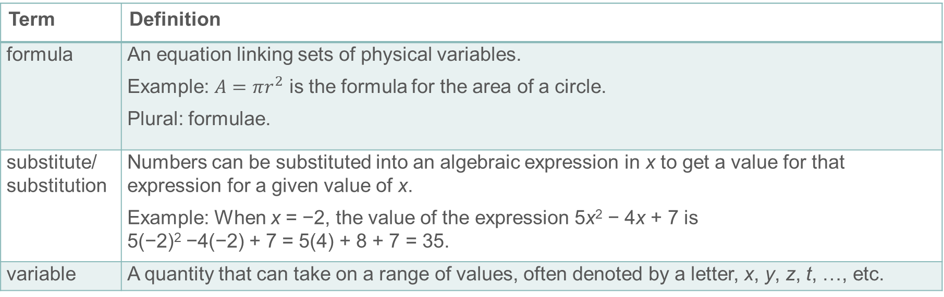
Key vocabulary (2)
Term | Definition
formula | An equation linking sets of physical variables. Example: $A=πr^{2}$ is the formula for the area of a circle. Plural: formulae.
substitute/ substitution | Numbers can be substituted into an algebraic expression in x to get a value for that expression for a given value of x. Example: When x = −2, the value of the expression 5x² − 4x + 7 is 5(−2)² −4(−2) + 7 = 5(4) + 8 + 7 = 35.
variable | A quantity that can take on a range of values, often denoted by a letter, x, y, z, t, …, etc.

Slide 29
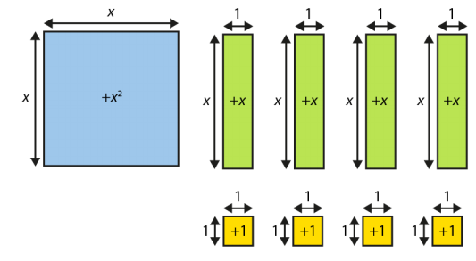
Representations and structure
There are a number of different representations that you may wish to use to support students’ understanding of this key idea. These might include:
Bar models
  Bar models can be very useful to support students in representing (literally, re-presenting) problems to reveal additive and multiplicative structures, including those involving unknown values.
Algebra tiles
  Although not offering a generalised image of a variable (x is represented by an actual length and will necessarily be seen as a particular length relative to the ‘1’), algebra tiles can provide a useful representation for expressions and give meaning to certain symbolic manipulations.
Notes:
More information about the representations and structure involved in this key idea can be found:
On page 8 of the The Structure of the number system Theme Overview document
Within the NCETM’s Using Mathematical Representations at KS3 documents
Links to all of these can be found on the final slide.

Slide 30
Previous learning
From Upper Key Stage 2, students will bring experience of:
reading, writing, ordering and comparing numbers up to 10 000 000 and determining the value of each digit
rounding any whole number to a required degree of accuracy
using negative numbers in context
identifying the value of each digit in numbers given to three decimal places and multiplying and dividing numbers by 10, 100 and 1 000, giving answers up to three decimal places
using, reading, writing and converting between standard units, converting measurements of length, mass, volume and time from a smaller unit of measure to a larger unit and vice versa, using decimal notation up to three decimal places
using symbols and letters to represent variables and unknowns in mathematical situations that they already understand, such as:
  missing numbers, lengths, coordinates and angles
  formulae in mathematics and science
Notes:
Theme 1 The structure of the number system

Slide 31
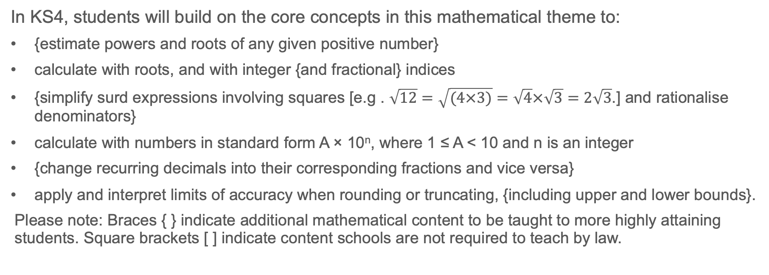
Future learning
In KS4, students will build on the core concepts in this mathematical theme to:
{estimate powers and roots of any given positive number}
calculate with roots, and with integer {and fractional} indices
{simplify surd expressions involving squares [e.g . $\sqrt{12}=\sqrt{(4×3)}=\sqrt{4}×\sqrt{3}=2\sqrt{3}$.] and rationalise denominators}
calculate with numbers in standard form A × 10^{n}, where 1 ≤ A < 10 and n is an integer
{change recurring decimals into their corresponding fractions and vice versa}
apply and interpret limits of accuracy when rounding or truncating, {including upper and lower bounds}.
Please note: Braces { } indicate additional mathematical content to be taught to more highly attaining students. Square brackets [ ] indicate content schools are not required to teach by law.
Notes:
Theme 1 The structure of the number system

Slide 32
Library of links
The following resources from the NCETM website have been referred to within this slide deck:
  NCETM Secondary Mastery Professional Development
    1 The Structure of the number system Theme Overview Document
    1.4 Simplifying and manipulating expressions, equations and formulae Core Concept Document
  Using mathematical representations at KS3 | NCETM
  Mathematical Prompts for Deeper Thinking videos | NCETM
  NCETM primary mastery professional development materials
  NCETM primary assessment materials
There are also references to:
  Standards & Testing Agency’s past mathematics papers

