Slide 1
3.10 Linking fractions, decimals and percentages
Representations | Year 6
Fractions

Slide 2
How to use this presentation
You can find the teacher guide 3.10 Linking fractions, decimals and percentages by following the link below.

Slide 3
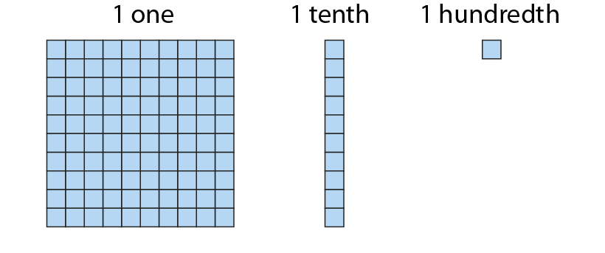
3.10 Fractions, decimals and percentages
Step 1:1

Slide 4
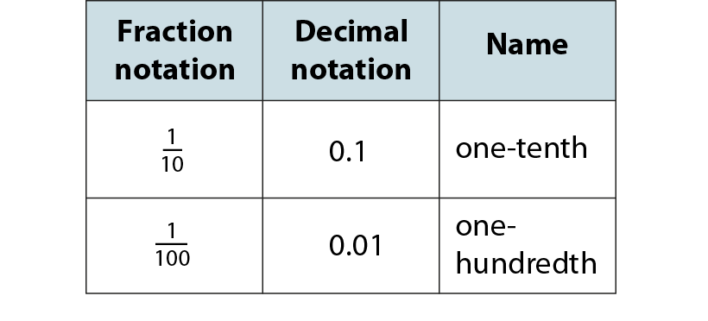
3.10 Fractions, decimals and percentages
Step 1:1

Slide 5
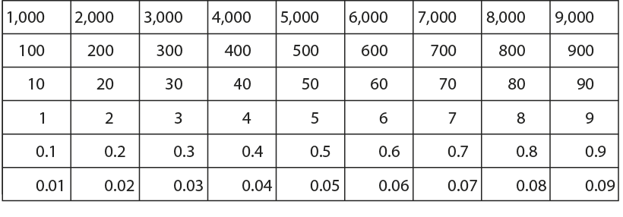
3.10 Fractions, decimals and percentages
Step 1:1

Slide 6
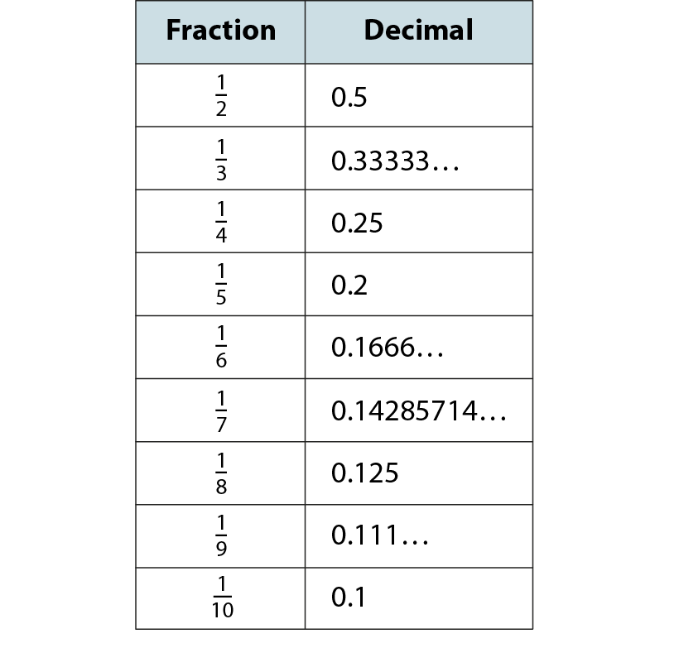
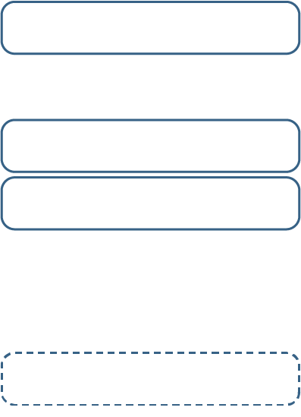
3.10 Fractions, decimals and percentages
Steps 1:2–1:3

Slide 7
3.10 Fractions, decimals and percentages
Step 1:4
Notes:
What do you notice about these decimals in the ‘4 parts’ number line?

Slide 8
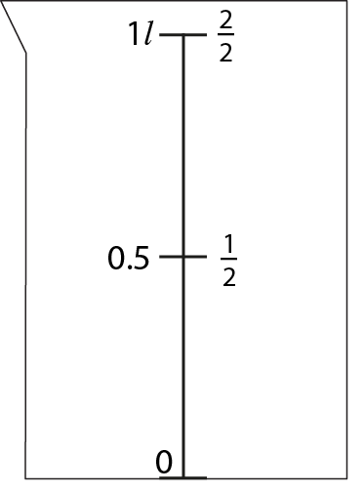
3.10 Fractions, decimals and percentages
Step 1:5

Slide 9
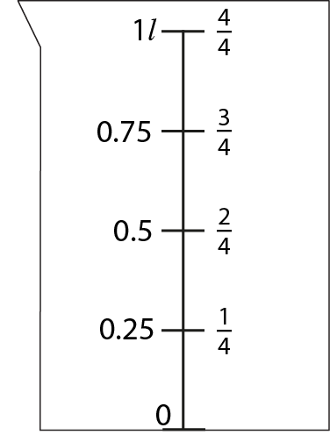
3.10 Fractions, decimals and percentages
Step 1:5

Slide 10
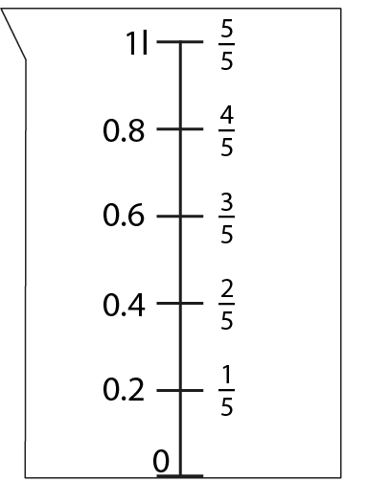
3.10 Fractions, decimals and percentages
Step 1:5

Slide 11
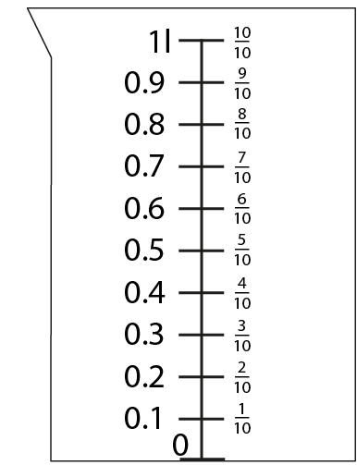
3.10 Fractions, decimals and percentages
Step 1:5

Slide 12
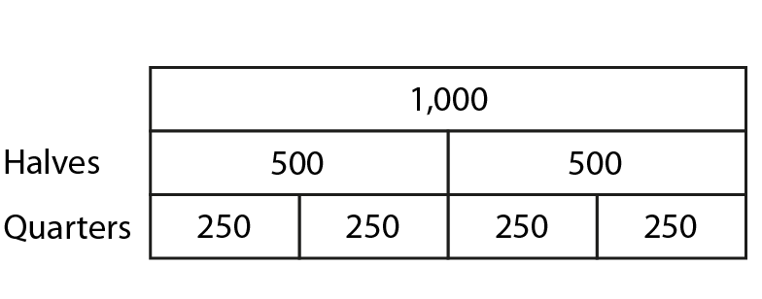
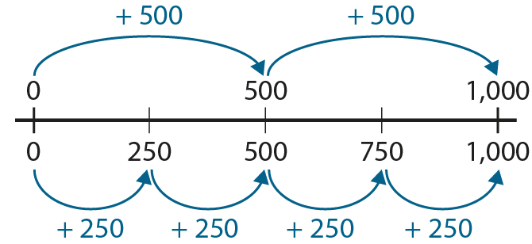
3.10 Fractions, decimals and percentages
Step 1:6
Notes:
What patterns can you see?
Why are these repeated through the number system?

Slide 13
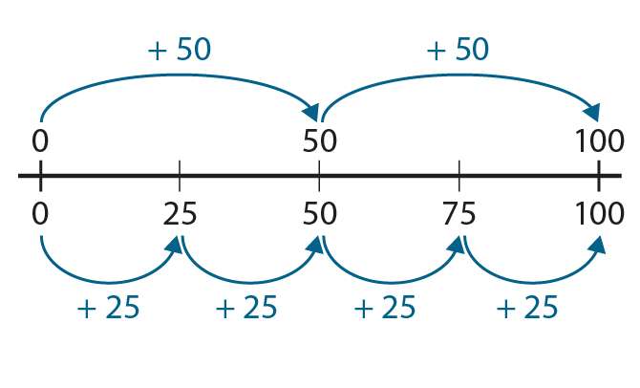
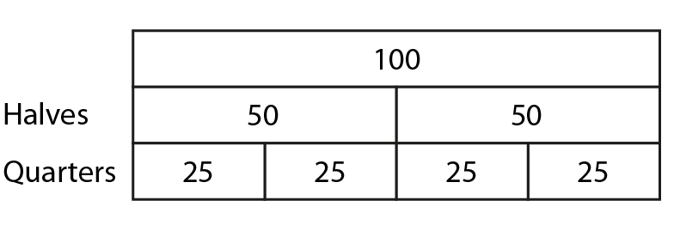
3.10 Fractions, decimals and percentages
Step 1:6
Notes:
What patterns can you see?
Why are these repeated through the number system?

Slide 14
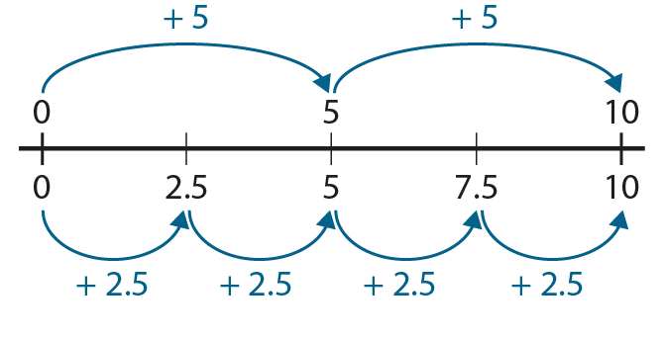
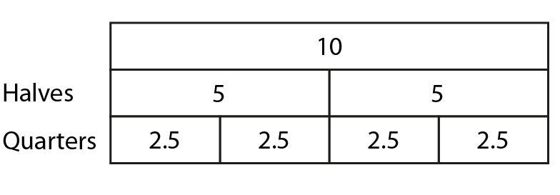
3.10 Fractions, decimals and percentages
Step 1:6
Notes:
What patterns can you see?
Why are these repeated through the number system?

Slide 15
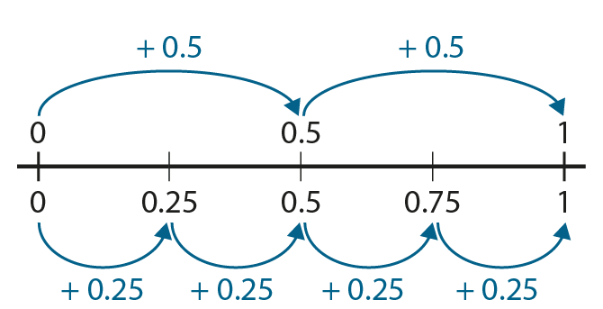
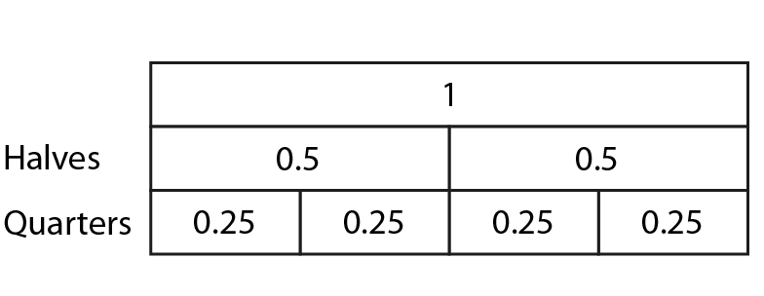
3.10 Fractions, decimals and percentages
Step 1:6
Notes:
What patterns can you see?
Why are these repeated through the number system?

Slide 16
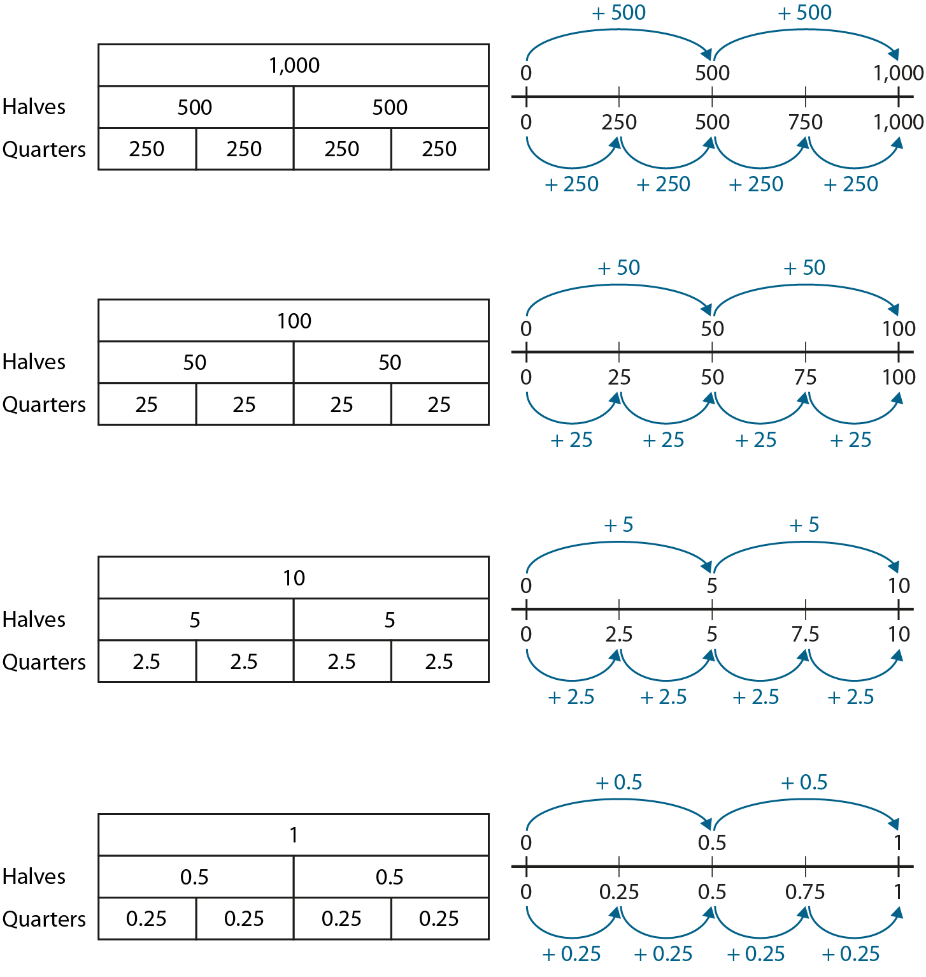
3.10 Fractions, decimals and percentages
Step 1:6
Notes:
What patterns can you see?
Why are these repeated through the number system?

Slide 17
3.10 Fractions, decimals and percentages
Step 1:7

Slide 18
3.10 Fractions, decimals and percentages
Step 1:7

Slide 19
3.10 Fractions, decimals and percentages
Step 1:7

Slide 20
3.10 Fractions, decimals and percentages
Step 1:7

Slide 21
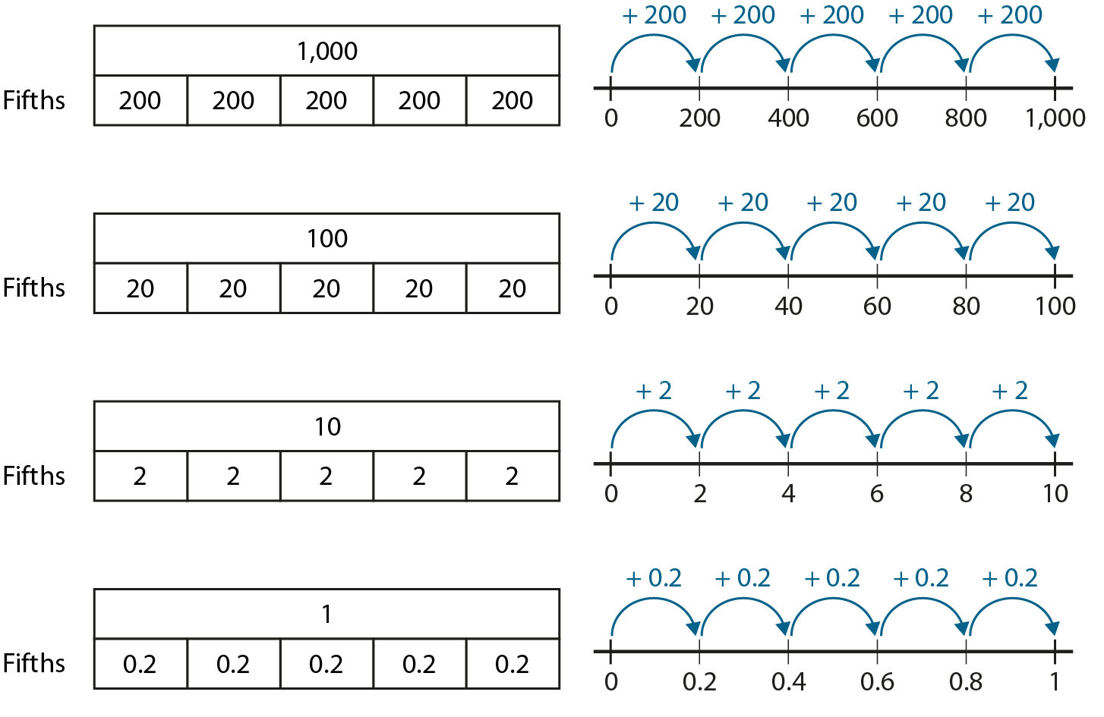
3.10 Fractions, decimals and percentages
Step 1:7

Slide 22
3.10 Fractions, decimals and percentages
Step 1:7

Slide 23
3.10 Fractions, decimals and percentages
Step 1:7

Slide 24
3.10 Fractions, decimals and percentages
Step 1:7

Slide 25
3.10 Fractions, decimals and percentages
Step 1:7

Slide 26
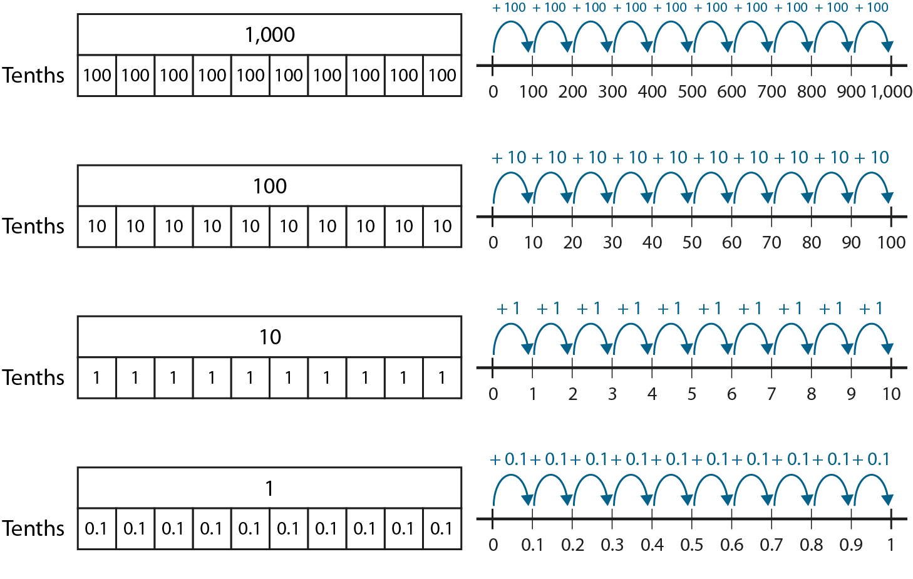
3.10 Fractions, decimals and percentages
Step 1:7

Slide 27
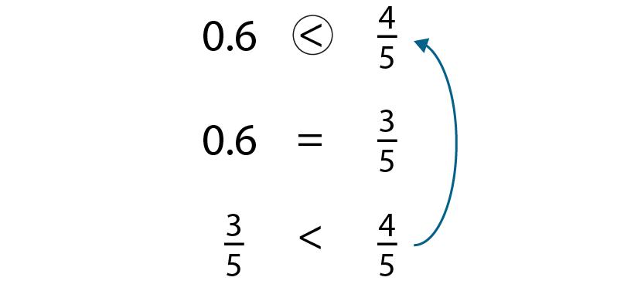
3.10 Fractions, decimals and percentages
Step 1:9

Slide 28
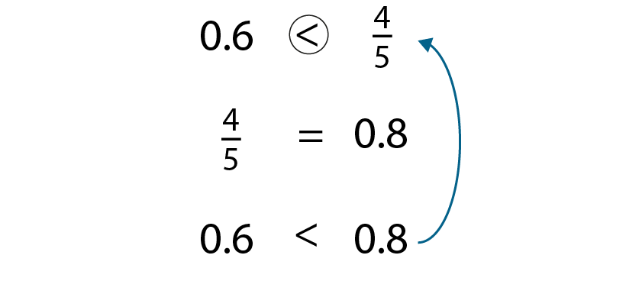
3.10 Fractions, decimals and percentages
Step 1:9

Slide 29
3.10 Fractions, decimals and percentages
Step 2:1

Slide 30
3.10 Fractions, decimals and percentages
Step 2:2

Slide 31
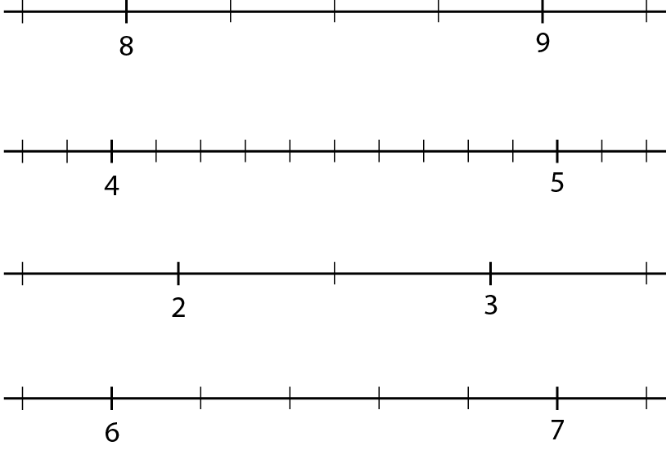
3.10 Fractions, decimals and percentages
Step 2:3

Slide 32
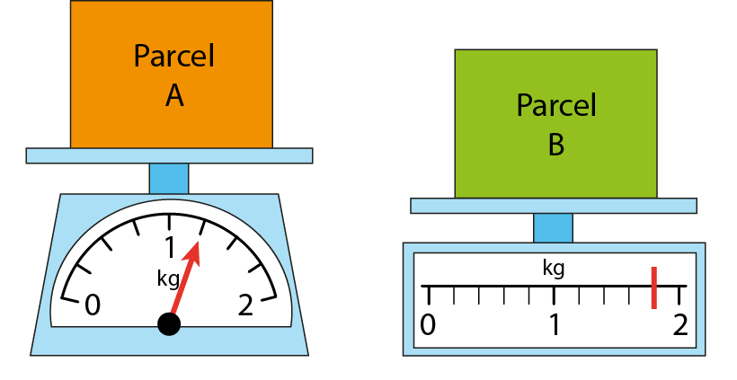
3.10 Fractions, decimals and percentages
Step 2:5
Notes:
What is the total combined weight of the parcels?

Slide 33
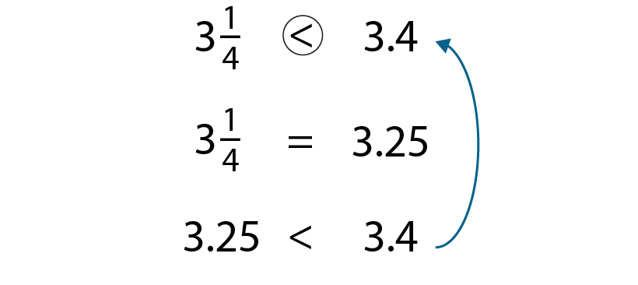
3.10 Fractions, decimals and percentages
Step 2:6
Notes:
Method 1 – Convert to decimals

Slide 34
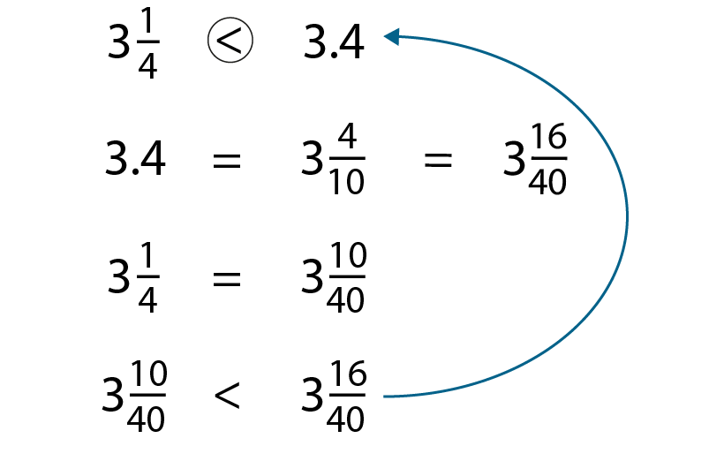
3.10 Fractions, decimals and percentages
Step 2:6
Notes:
Method 2 – Convert to fractions with a common denominator

Slide 35
3.10 Fractions, decimals and percentages
Step 2:6
Notes:
Method 3 – Position on number line

Slide 36
3.10 Fractions, decimals and percentages
Step 2:6

Slide 37
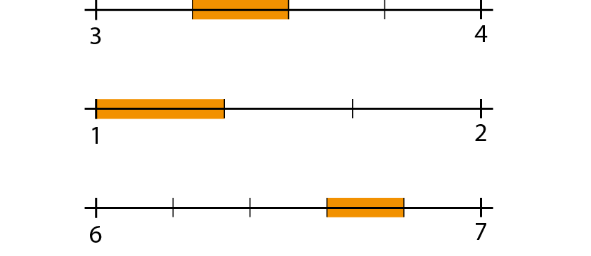
3.10 Fractions, decimals and percentages
Step 2:7

Slide 38
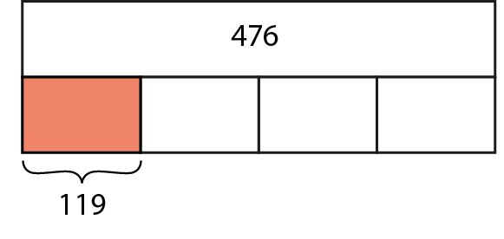
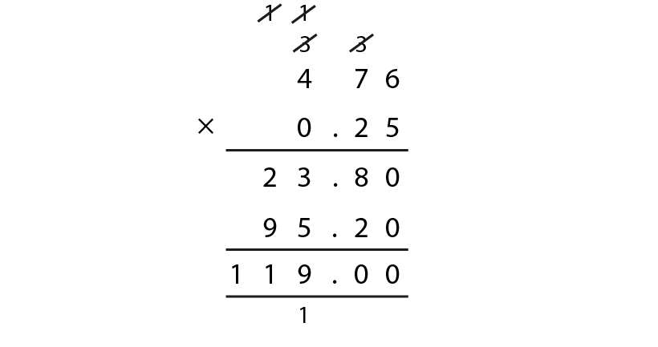
3.10 Fractions, decimals and percentages
Steps 3:1–3:2
Notes:
What is the whole?
How many equal parts is 476 being divided into?
How many parts do we have?

Slide 39
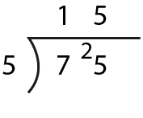
3.10 Fractions, decimals and percentages
Step 3:4

Slide 40
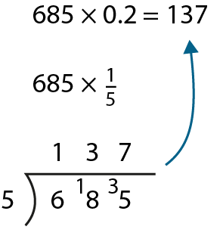
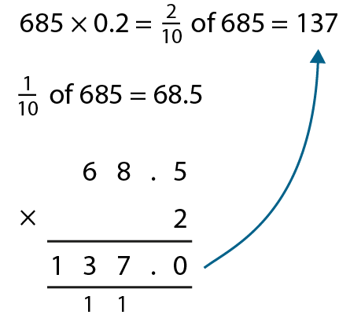
3.10 Fractions, decimals and percentages
Step 3:6

Slide 41
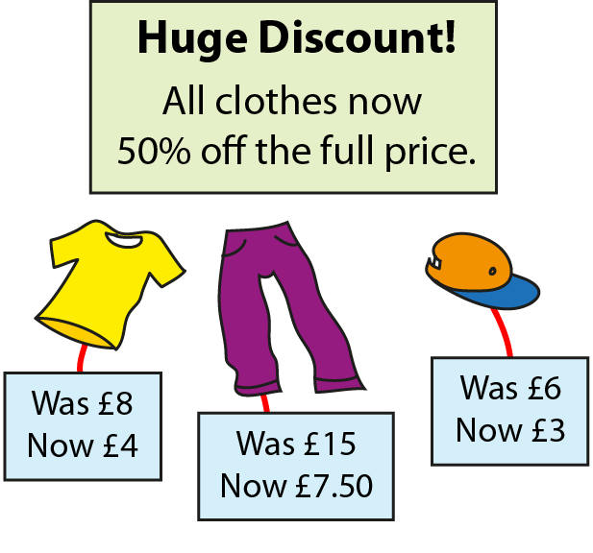
3.10 Fractions, decimals and percentages
Step 4:1

Slide 42
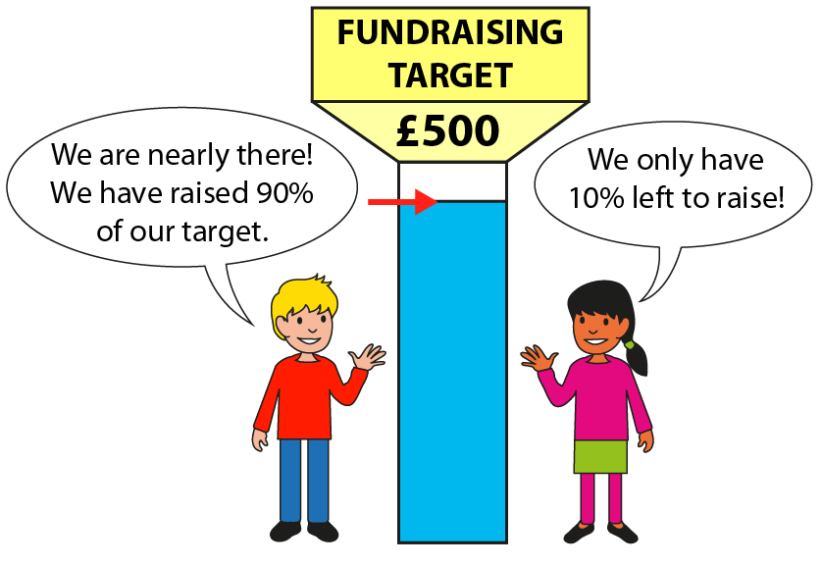
3.10 Fractions, decimals and percentages
Step 4:1

Slide 43
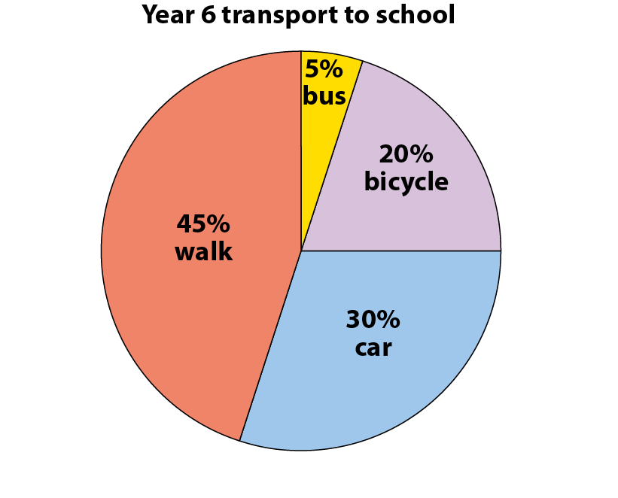
3.10 Fractions, decimals and percentages
Step 4:1

Slide 44
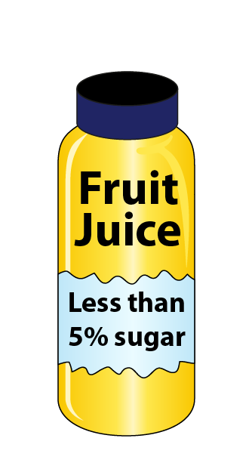
3.10 Fractions, decimals and percentages
Step 4:1

Slide 45
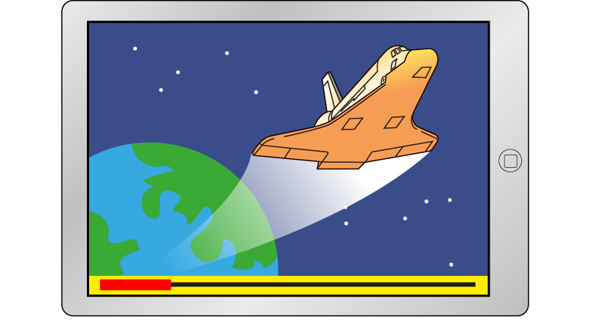
3.10 Fractions, decimals and percentages
Step 4:2
Notes:
Nevaeh is watching a film on her tablet. Estimate the percentage of the film that she has watched so far.
Can we tell how long it will take to watch the rest of the film?

Slide 46
3.10 Fractions, decimals and percentages
Step 4:2
Notes:
This icon shows how much power Evie has left in her phone battery. Approximately what percentage of the power remains?

Slide 47
3.10 Fractions, decimals and percentages
Step 4:2
Notes:
The diagram shows the percentage of a race that Finn has run so far. About what percentage of the race has Finn already run?

Slide 48
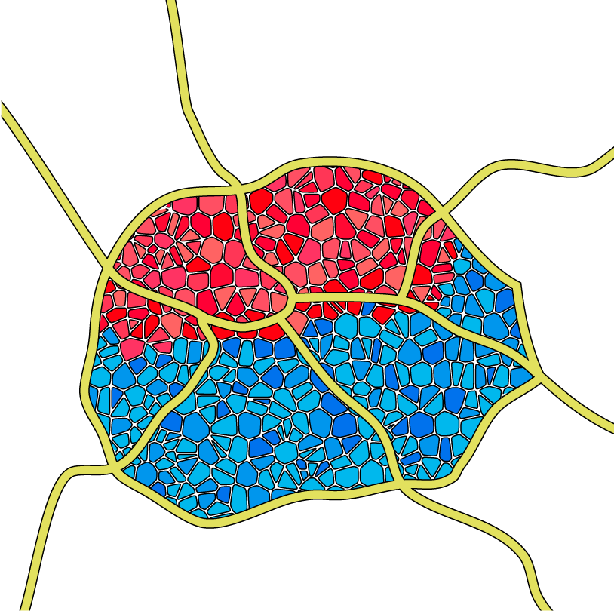
3.10 Fractions, decimals and percentages
Step 4:2
Notes:
This plan shows the part of a city where buildings have been damaged by an earthquake. Estimate the percentage of the city that has suffered earthquake damage.

Slide 49
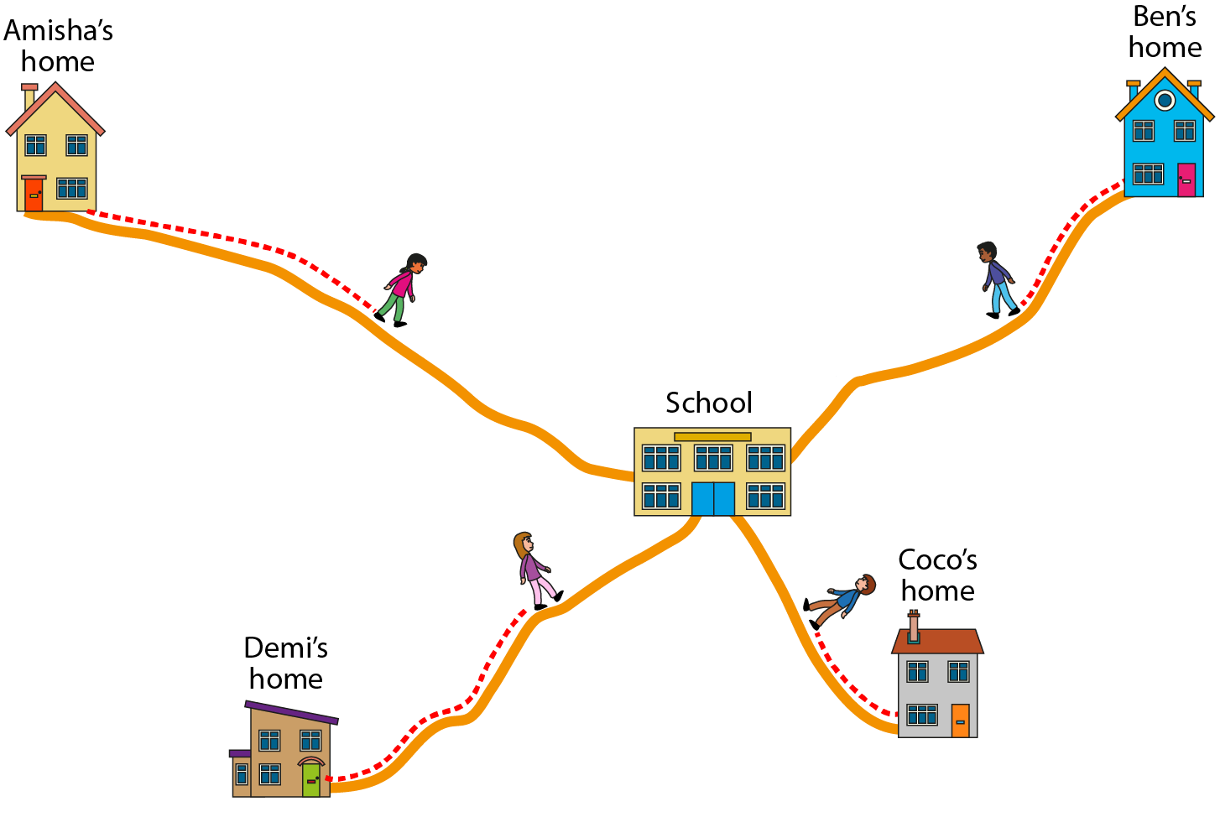
3.10 Fractions, decimals and percentages
Step 4:3
Notes:
Which two children have walked about the same distance so far?
Which two children have walked about the same percentage of their journey?
Who has walked the furthest?
Who has completed the greatest percentage of their walk?
Who is less than 50% of the way through their walk to school?
Who has walked the shortest distance so far?

Slide 50
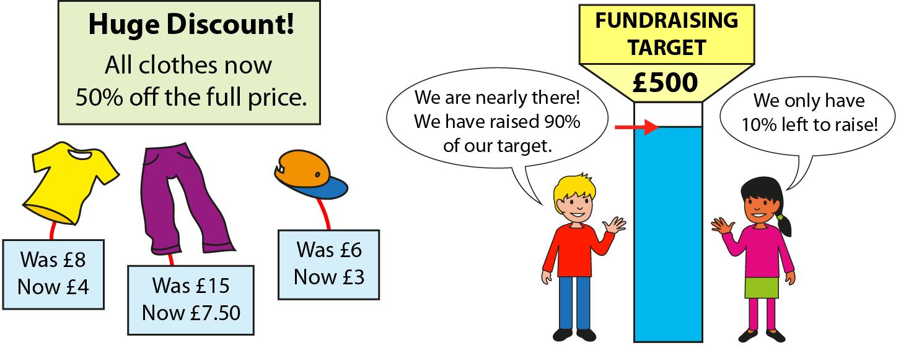
3.10 Fractions, decimals and percentages
Step 5:1

Slide 51
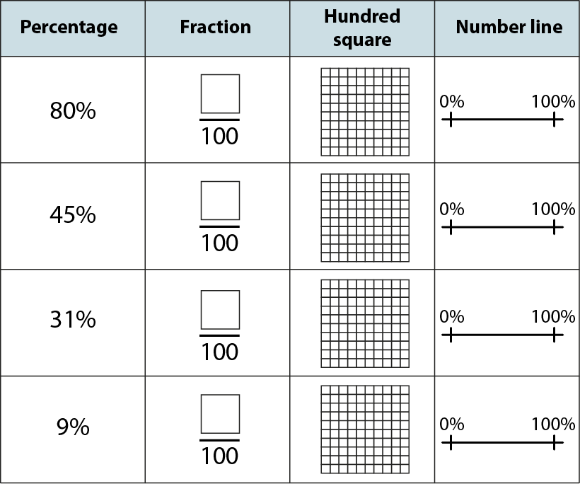
3.10 Fractions, decimals and percentages
Step 5:2

Slide 52
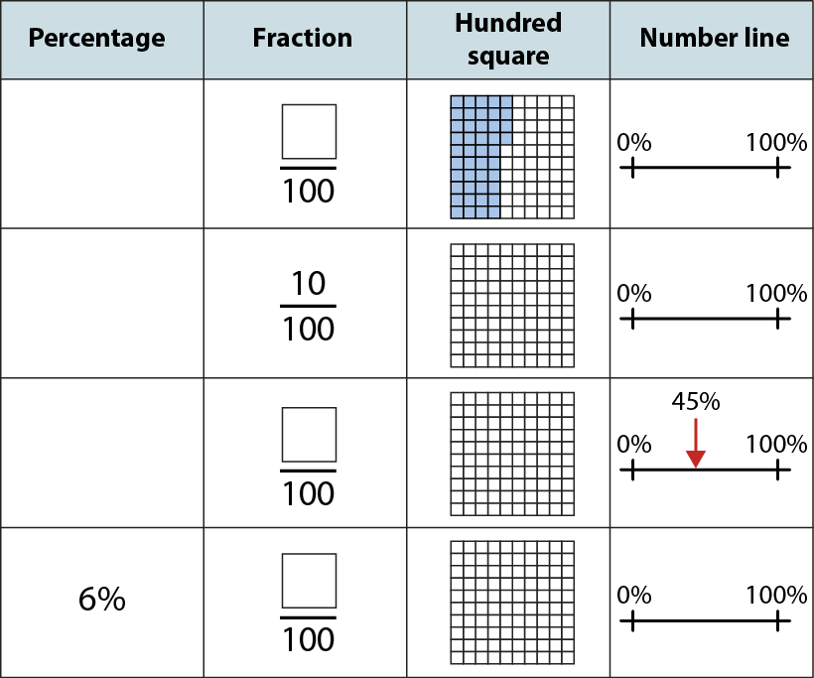
3.10 Fractions, decimals and percentages
Step 5:3

Slide 53
3.10 Fractions, decimals and percentages
Step 5:4

Slide 54
3.10 Fractions, decimals and percentages
Step 5:5

Slide 55
3.10 Fractions, decimals and percentages
Step 5:5

Slide 56
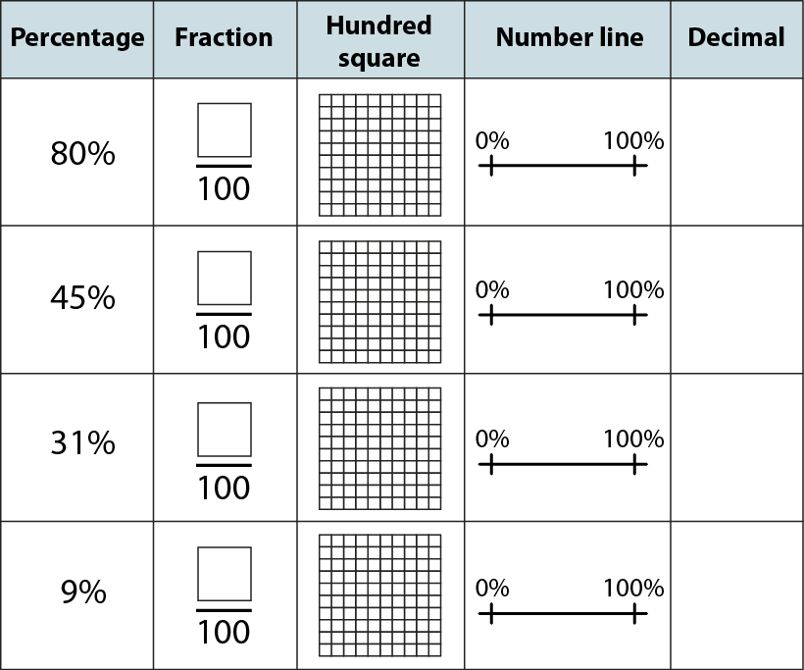
3.10 Fractions, decimals and percentages
Step 5:6

Slide 57
3.10 Fractions, decimals and percentages
Step 5:7

Slide 58
3.10 Fractions, decimals and percentages
Step 5:8

Slide 59
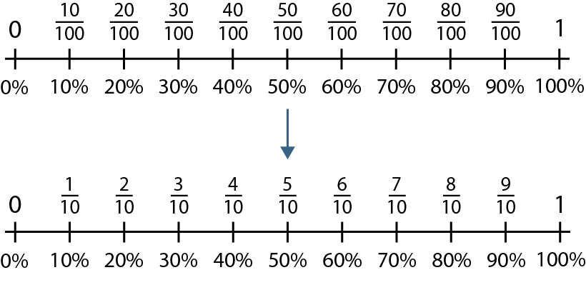
3.10 Fractions, decimals and percentages
Step 5:9

Slide 60
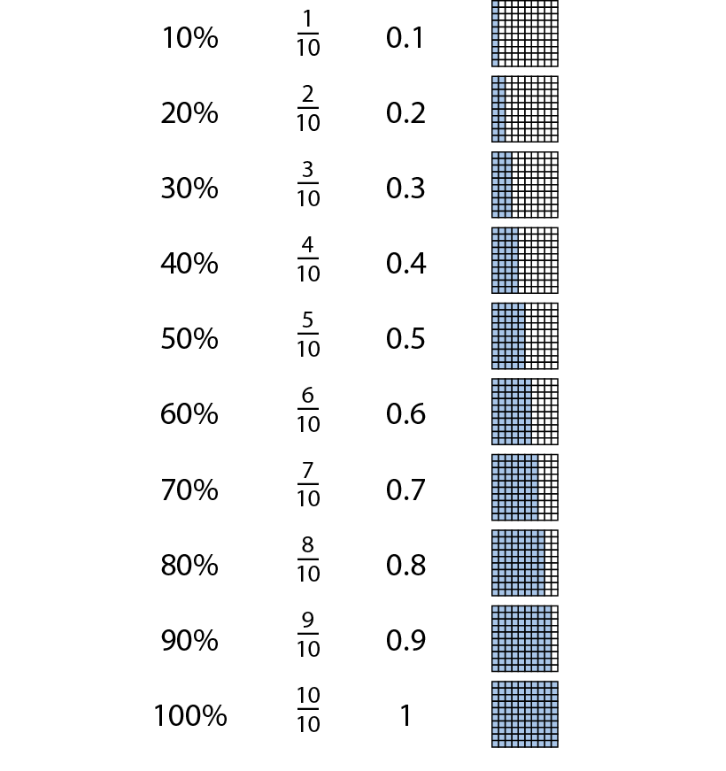
3.10 Fractions, decimals and percentages
Step 5:9

Slide 61
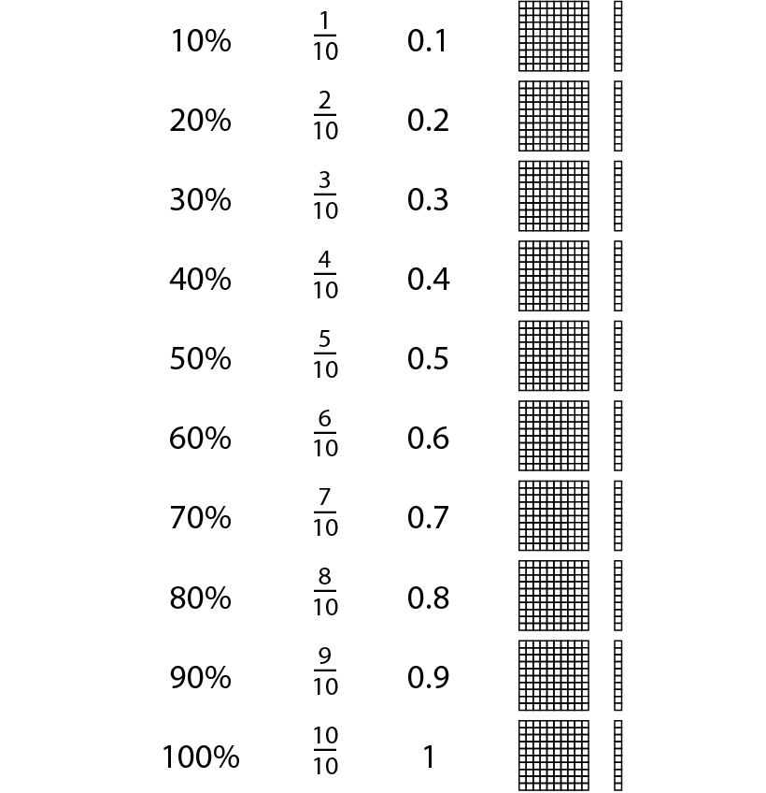
3.10 Fractions, decimals and percentages
Step 5:9

Slide 62
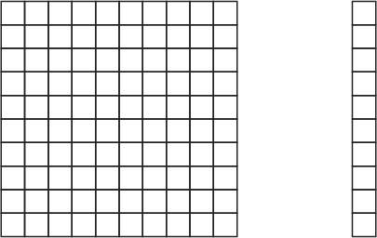
3.10 Fractions, decimals and percentages
Step 5:10
Notes:
Shade 70% of each of these shapes.

Slide 63
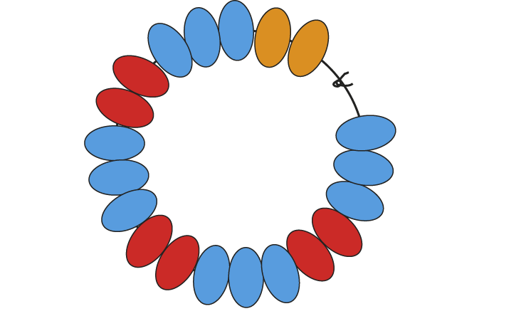
3.10 Fractions, decimals and percentages
Step 5:10
Notes:
What percentage of the beads in this bracelet are red?

Slide 64
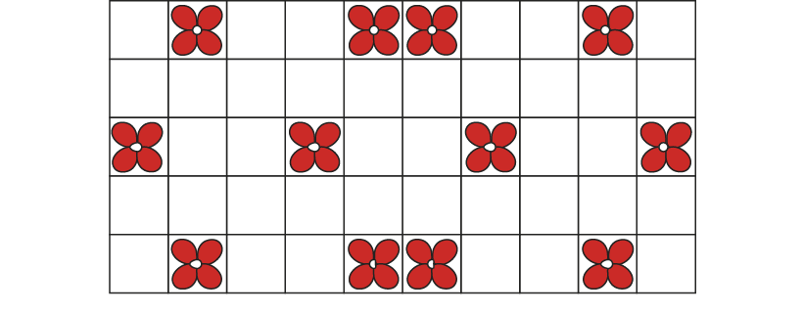
3.10 Fractions, decimals and percentages
Step 5:10
Notes:
Here is a pattern of tiles on a bathroom wall. Clare says, ‘12% of the tiles have flowers on them.’ Explain why Clare’s reasoning is incorrect.

Slide 65
3.10 Fractions, decimals and percentages
Step 6:1
Notes:
Zara is doing a 420 km charity bike ride. So far, she has completed 50% of the route. How far has she cycled?

Slide 66
3.10 Fractions, decimals and percentages
Step 6:2
Notes:
Rishi has completed 10% of the same bike ride. How far has Rishi cycled?

Slide 67
3.10 Fractions, decimals and percentages
Step 6:3
Notes:
James has completed 1% of the same bike ride. How far has he cycled?

Slide 68
3.10 Fractions, decimals and percentages
Step 6:4

Slide 69
3.10 Fractions, decimals and percentages
Step 6:4

Slide 70
3.10 Fractions, decimals and percentages
Step 6:6

Slide 71
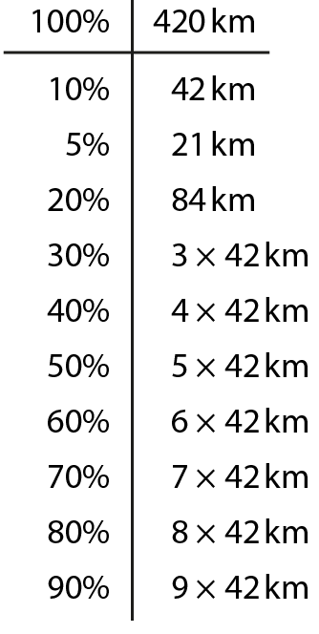
3.10 Fractions, decimals and percentages
Step 6:7

Slide 72
3.10 Fractions, decimals and percentages
Step 6:9

Slide 73
3.10 Fractions, decimals and percentages
Step 6:9
Notes:
When might a ‘subtracting from’ method be more efficient than an ‘adding to’ method?

Slide 74
3.10 Fractions, decimals and percentages
Step 6:10
Notes:
There are 120 children in Year 6.
Calculate how many children use each mode of transport to get to school.

Slide 75
3.10 Fractions, decimals and percentages
Step 6:10
Notes:
The pie chart shows what 60 Year 6 children voted to do for their end-of-year treat.
Construct a bar chart to show the number of children who voted for each activity.

Slide 76
3.10 Fractions, decimals and percentages
Step 6:11
Notes:
Begin with ‘I have made 300 minutes of calls so far this month. This is 60% of my monthly ‘free call’ allowance.
How many minutes of free calls do I get each month?’

Slide 77
3.10 Fractions, decimals and percentages
Step 6:11

Slide 78
3.10 Fractions, decimals and percentages
Step 6:11

Slide 79
3.10 Fractions, decimals and percentages
Step 6:12
Notes:
I am thinking of a number. 10% of my number is 15. What is the number I am thinking of?

Slide 80
3.10 Fractions, decimals and percentages
Step 6:12
Notes:
I am thinking of a number. 20% of my number is 15. What is the number I am thinking of?

Slide 81
3.10 Fractions, decimals and percentages
Step 6:12
Notes:
I am thinking of a number. 25% of my number is 15. What is the number I am thinking of?

Slide 82
3.10 Fractions, decimals and percentages
Step 6:12
Notes:
I am thinking of a number. 25% of my number is 30. What is the number I am thinking of?

Slide 83
3.10 Fractions, decimals and percentages
Step 6:14
Notes:
A coat has 10% off in a sale. The price is now £45. What was the original price?

Slide 84
3.10 Fractions, decimals and percentages
Step 6:14

Slide 85
3.10 Fractions, decimals and percentages
Step 6:14

