Slide 1
Using prime factorisation for HCF
KS3 Mastery PD Materials: Exemplified Key Ideas
Materials for use in the classroom or to support professional development discussions
(from 1.2 Properties of number)
Summer 2021

Slide 2
About this resource
These slides are designed to complement the 1.2 Properties of number Core Concept document and its associated Theme Overview document 1 The Structure of the number system, both found in the Secondary Mastery Professional Development pages.
These slides re-present the key examples from the Core Concept document so that the examples can be used either directly in the classroom or with a group of teachers. There are prompt questions alongside the examples, and further clarification in the notes.
These slides do not fully replicate the Core Concept document, so should be used alongside it Reference to specific page numbers, and to other useful NCETM resources, can be found in the notes for each slide.
This slide deck is not designed to be a complete PD session, rather it is a selection of resources that you can adapt and use as needed when planning a session with a group of teachers.

Slide 3


About this resource
The slides are structured as follows:
  The big picture:
    Where does this fit in?
    What do students need to understand?
    Why is this key idea important?
  Prior learning
  Misconceptions
  Exemplified key ideas
  Reflection questions
  Appendices:
    Key vocabulary
    Representations and structure
    Previous and Future learning
    Useful links
The exemplified key idea slides have the following symbols to indicate how they have been designed to be used:
Into the classroom
The examples are presented on these slides so that they could be used in PD, but also directly in the classroom. The notes feature suggested questions and things teachers might consider when using with students.
PD discussion prompts
These slides look at the examples in more detail, with question prompts to promote discussion among maths teachers. The notes feature reference to further information and guidance within the Core Concepts document.

Slide 4
Where does this fit in?
The NCETM has identified a set of six ‘mathematical themes’ within Key Stage 3 mathematics that bring together a group of ‘core concepts’.
The first of these themes is The structure of the number system, which covers the following interconnected core concepts:
    1.1 Place value, estimation and rounding
    1.2 Properties of number
    1.3 Ordering and comparing
    1.4 Simplifying and manipulating expressions, equations and formulae
Notes:
Linked on this slide is the Theme Overview document of The structure of the number system. This document includes why it is important, the key underpinning knowledge and links to prior and future learning. There is also guidance about how the five big ideas of Teaching for Mastery relate specifically to this theme.

Slide 5
Where does this fit in?
Within this core concept, 1.2 Properties of number, there are three statements of knowledge, skills and understanding.
These, in turn, are broken down into eleven key ideas. The highlighted key idea is exemplified in this slide deck.
Notes:
For key ideas marked with an asterisk, we exemplified the common difficulties and misconceptions that students might have and included elements of what teaching for mastery may look like. We have provided examples of possible student tasks and teaching approaches.
Within these slides are ‘classroom-ready’ versions of the examples for the key idea that has been highlighted. There are also slides that may be useful for discussion in a professional development session.

Slide 6
What do students need to understand?
1.2.3.4 Use the prime factorisation of two or more positive integers to efficiently identify the highest common factor
Find the highest common factor of two numbers when they have been written as the product of their prime factors.
Find the highest common factor of two numbers when they have been written as the product of their prime factors and simplified using indices.
Find the highest common factor of a set of numbers when they have been written as the product of their prime factors in simplified form.
Find the highest common factor of a pair of numbers when their prime factors are shown in a Venn diagram.
Explore the most efficient methods of finding the highest common factor.
Use prime factorisation to solve problems involving the highest common factor.
  What prior knowledge might your students already have?
  What language might they use to describe this key idea?
  What questions might you want to ask to assess their prior learning?

Slide 7
Why is this key idea important? (1)
Students who have a deep understanding of the structure of numbers, who can partition numbers, recombine them and represent them in different ways, are more fluent and flexible when it comes to calculating. As students learn about the mathematical structures that underpin numbers and the number system, the need to generalise these structures will arise.
Finding factors of a number will be familiar from Key Stage 2. Students should be able to find factor pairs for a given number and know that a number which has exactly two factors is prime. Students are expected to recall prime numbers up to 19 and be able to establish prime numbers up to 100.
The focus in this set of key ideas is to be able to identify factors and prime numbers based on a deep understanding of number structure. Where rules for divisibility are used to help these processes, the focus should be on understanding why these rules work.
Notes:
A more detailed overview of the core concept of Properties of number can be found on page 2 of the 1.2 Core Concept document.
The background to each key idea is also explored in more detail on the following pages:
1.2.1 Understand multiples – page 7
1.2.2 Understand integer exponents and roots – pages 7 and 8
1.2.3 Understand and use the unique prime factorisation of a number – page 8

Slide 8
Why is this key idea important? (2)
Students’ experience of highest common factors and multiples at Key Stage 2 is likely to be limited to their work on simplifying fractions and checking to see if they have found the greatest number that is a factor of both the numerator and denominator. Similarly, when expressing fractions in the same denomination in order to compare them, for example, students may have identified the least common multiple of the two denominators even if this formal term has not been used.
In Key Stage 3, students will come across the unique prime factorisation property for the first time. Students will need to recognise that any positive integer greater than one is either a prime number itself or can be expressed as a product of prime numbers, and that there is only one way of writing a number in this way. It is this property that will help students to identify efficiently the highest common factor and lowest common multiple for two or more positive integers.
Notes:
A more detailed overview of the core concept of Properties of number can be found on page 2 of the 1.2 Core Concept document.
The background to each key idea is also explored in more detail on the following pages:
1.2.1 Understand multiples – page 7
1.2.2 Understand integer exponents and roots – pages 7 and 8
1.2.3 Understand and use the unique prime factorisation of a number – page 8

Slide 9
Prior learning
Upper Key Stage 2 Learning Outcome
Identify multiples and factors, including finding all factor pairs of a number, and common factors of two numbers
Know and use the vocabulary of prime numbers, prime factors and composite numbers (non-prime, greater than one)
Establish whether a number up to 100 is prime and recall prime numbers up to 19
Solve problems involving multiplication and division, including using their knowledge of factors and multiples, squares and cubes
Identify common factors, common multiples and prime numbers
  What prior knowledge might your students already have?
  What language might they use to describe this key idea?
  What questions might you want to ask to assess their prior learning?
Notes:
You may find it useful to speak to your partner schools to see how the above has been covered and the language used.
You can find further details regarding prior learning in the following segments of the NCETM primary mastery professional development materials (linked on final slide):
Year 5: 2.21 Factors, multiples, prime numbers and composite numbers
Within the The structure of the number system Theme Overview document, you can also find a broader description of students’ potential previous learning (page 4), alongside further information about key underpinning knowledge (page 2).

Slide 10
Checking prior learning
The following slides contain questions for checking prior learning.
  What representations might students use to support their understanding of these questions?
  What variation might you put in place for these questions to fully assess students’ understanding of the concept?
  How might changing the language of each question change the difficulty?
  Why are these such crucial pre-requisites for this key idea?

Slide 11
Checking prior learning
a)
b)
Tick the numbers that are common factors of both 12 and 18.
2
3
6
9
12
8 | is a multiple of | 4 | and a factor of | 16
6 | is a multiple of | 3 | and a factor of
 |  | 5
 | is a multiple of | 5 | and a factor of
 | is a multiple of |  | and a factor of
c)
Write three factors of 30 that are not factors of 15.
Notes:
References to the questions (links on final slide):
a) NCETM Primary assessment materials, Year 5 page 15
b) 2018 Key Stage 2 Mathematics Paper 3: reasoning, Question 5
c) 2017 Key Stage 2 Mathematics Paper 3: reasoning, Question 8

Slide 12
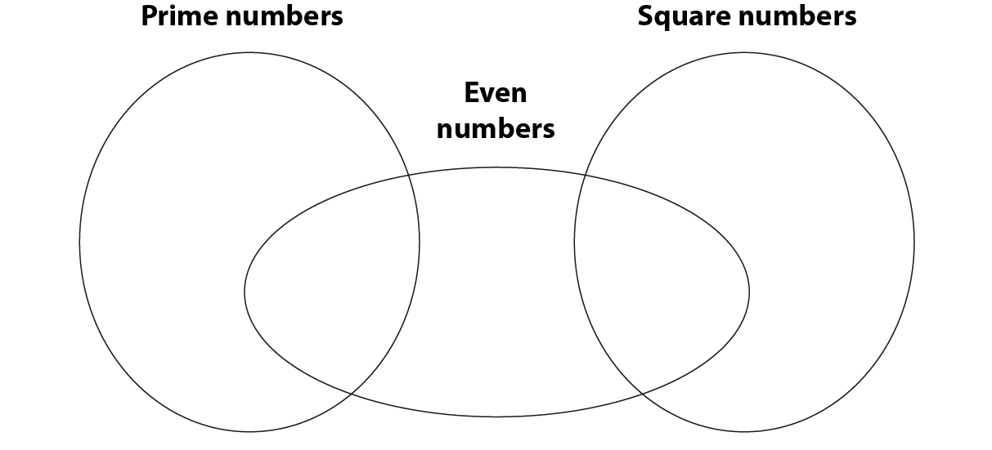
Checking prior learning
d)
Write each number in its correct place on the diagram.
16 17 18 19
Notes:
References to the questions (links on final slide):
d) 2016 Key Stage 2 Mathematics Paper 2: reasoning, Question 5

Slide 13
Common difficulties and misconceptions
What aspects of this key idea might pupils find challenging?
What misconceptions might pupils have?
When teaching this topic, you may find students encounter difficulties with…
Understanding the prime factor decomposition is just another way of writing a number
Identifying the highest common factor
Interpreting index notation
More information, and some suggestions for overcoming these challenges, can be found on the following slides.

Slide 14
Common difficulties and misconceptions (1)
Fundamental to this concept is that students are at ease with the idea that 2 × 3 × 5 is just another way of expressing the number 30 and does not need to be calculated. In fact, by leaving it in this form, it is much easier to discern factors and (when there are two numbers expressed in this way) to discern their common factors.
However, students often struggle with this idea. When asked whether 2 × 3 × 5 is a multiple of ten or not, it is not uncommon for students to multiply the three factors together to obtain 30 before they are able to say that it is a multiple of ten.
Notes:
More detail can be found on page 16 of the 1.2 Core Concept document.

Slide 15
Common difficulties and misconceptions (2)
An important awareness in this key idea is that when two numbers are written as the product of two or more factors, looking for overlaps between the two products helps to find a common factor.
For example, by writing 30 = 5 × 6 and 105 = 5 × 21, it is easily seen that five is a common factor.
However, we cannot be sure that five is the highest common factor unless each number is written as the product of prime factors, e.g. 30 = 2 × 3 × 5 and 105 = 3 × 5 × 7. When written in this format, it is clear that 3 × 5 = 15 is the highest common factor.
Students will have already experienced Venn diagrams in Key Stage 2; however, using them to record prime factors, and for revealing that the highest common factor is the product of the prime factors in the intersection, is likely to be an unfamiliar idea. (See example on next slide).
Notes:
More detail, including an example of a Venn diagram to identify the HCF, can be found on page 16 of the 1.2 Core Concept document.

Slide 16
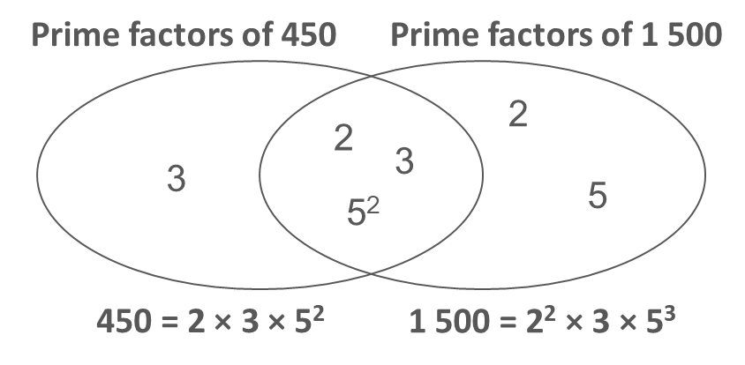
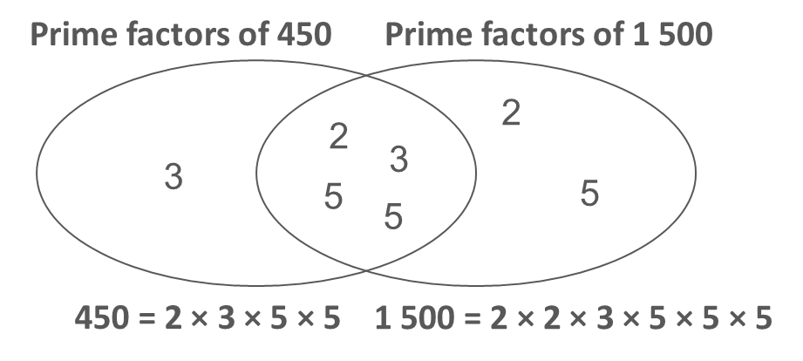
Common difficulties and misconceptions (3)
Students may experience difficulties when the product of repeated prime factors is expressed using index notation (e.g. 450 = 2 × 3² × 5² and 1 500 = 2² × 3 × 5³), as it may be harder to detect the common factor of 2 × 3 × 5² in this form.
It is important for students to have experience of discerning highest common factors from both the index and non-index form to help avoid this difficulty. The two Venn diagrams below model this distinction.
Notes:
More detail can be found on page 16 of the 1.2 Core Concept document.

Slide 17
Find the highest common factor of two numbers when they have been written as the product of their prime factors
Example 1
Find the highest common factor of these pairs of numbers.
a)
10 = 2 × 5
6 = 2 × 3
12 = 2 × 2 × 3
20 = 2 × 2 × 5
30 = 2 × 3 × 5
70 = 2 × 5 × 7
d)
60 = 2 × 2 × 3 × 5
90 = 2 × 3 × 3 × 5
42 = 2 × 3 × 7
210 = 2 × 3 × 5 × 7
29 = 29
16 = 2 × 2 × 2 × 2
b)
e)
c)
f)
Notes:
Suggested questioning:
How many different ways can you find the HCF? What is the easiest way?
Why is writing the numbers as a product of primes first helpful?
How can you use the common prime factors to find the highest common factor?
What is the highest common factor for part f? What do you notice about the product of primes in this case?
Things for you to think about:
Choosing small numbers allows students to find the highest common factor using multiple methods (both by listing factors of each number and by considering prime factors). In Example 1, the numbers have already been written as a product of their prime factors so that students can focus on finding the highest common factor and not on prime factorisation, although they should realise that this is a previous step in this method. Part of the purpose of an exercise like this is for students to explore the most efficient method and understand why, when numbers are written as product of prime factors, the combination of their common prime factors will generate the highest common factor.
Part a) has been written so that the numbers only share one common prime factor (two).
Part b) is designed to ensure that students can identify and understand that the numbers share two common prime factors. Comparing the repeated common prime factor of two, to the common factors from the lists (two and four), is also worthwhile so that students understand that it is the combination of the prime factors that is important.
In part c), the two common prime factors are different and lead to a highest common factor of ten. Again, comparison with common factors of two, five and ten from their list of factors is important.
The numbers in part d) have been chosen as they share three common prime factors.
In part e), the highest common factor is one of the numbers in its entirety.
Part f) has been chosen to facilitate discussion about what to do if the highest common factor is one, as this is not always apparent when numbers are written as the product of their prime factors.
Asking students to identify all common factors and then linking this to all common prime factors, before progressing to find the highest common factor, may be helpful in supporting their understanding.
How could you connect the learning in this key idea to previous work on factors?
Exploring the efficiency of different methods is a significant element of developing fluency. Encouraging students to share their methods and discuss the advantages and disadvantages of each, as well as when to select an appropriate method, will help prevent the blind application of a procedure without conceptual consideration.

Slide 18
Find the highest common factor of two numbers when they have been written as the product of their prime factors
Example 1
  How could you connect the learning in this key idea to previous work on factors?
  Exploring the efficiency of different methods is a significant element of developing fluency. To what extent do you already provide opportunities to discuss the advantages and disadvantages of different methods in your classrooms?
  How and when is best to facilitate classroom discussion?
Find the highest common factor of these pairs of numbers.
a)
10 = 2 × 5
6 = 2 × 3
12 = 2 × 2 × 3
20 = 2 × 2 × 5
30 = 2 × 3 × 5
70 = 2 × 5 × 7
d)
60 = 2 × 2 × 3 × 5
90 = 2 × 3 × 3 × 5
42 = 2 × 3 × 7
210 = 2 × 3 × 5 × 7
29 = 29
16 = 2 × 2 × 2 × 2
b)
e)
c)
f)
Notes:
Due to space constraints, the image on this PD discussion slide is small. PD Leads might like to use or print the ‘in the classroom’ version of this slide for teachers to access during discussions.
This example can be found on page 17 of the 1.2 Core Concept document.

Slide 19
Find the highest common factor of two numbers when they have been written as the product of their prime factors
Example 2
Find the highest common factor of this pair of numbers, where p, q, r, s and t are prime:
    x = p × q × r
    y = p × r × s × t
Why do p, q, r, s and t have to be prime for this to work?
Notes:
Suggested questioning:
Is r a common factor of both numbers? How do you know? How about p? etc
Can you write an algebraic example that mirrors the questions in example 1? Which are the hardest to do?
Things for you to think about:
Asking students to apply a procedure to algebraic examples is a good way to assess the depth of their understanding. Encouraging students to generalise a concept is beneficial in supporting them in dealing with problems that are based on the same concept but presented differently, for example, finding the highest common factor of three numbers.
Challenging students to write an algebraic example which mirrors Example 1 part f) may also be a useful addition here.

Slide 20
Find the highest common factor of two numbers when they have been written as the product of their prime factors
Example 2
  What are the advantages of encouraging students to generalise a concept?
  What are the challenges?
  How might you structure this activity to overcome these challenges?
Find the highest common factor of this pair of numbers, where p, q, r, s and t are prime:
    x = p × q × r
    y = p × r × s × t
Why do p, q, r, s and t have to be prime for this to work?
Notes:
This example can be found on page 18 of the 1.2 Core Concept document.

Slide 21
Find the highest common factor of two numbers when they have been written as the product of their prime factors and simplified using indices
Example 3
Gosia thinks the highest common factor of 72 and 180 is 6. Her working is below:
Do you agree with Gosia? Justify your answer.
x = a² × b × c²
y = a × b³ × c²
where a, b and c are prime.
Harrison thinks the highest common factor of
x and y is a × b × c².
Do you agree with Harrison? Justify your answer.
72 = 2³ × 3²
180 = 2² × 3² × 5
HCF = 2 × 3 = 6
Notes:
Suggested questioning:
What has Gosia done wrong? How can you explain this to her?
What has Harrison realised? What mistakes might it be easy to make here?
Challenge students to think deeply about the concept by asking them to create questions of their own that meet specific criteria. For example:
Write down two numbers which have a highest common factor of …
Write down two numbers which have a highest common factor of one.
72 = 2³ × 3², 180 = 2² × 3² × 5. What is the highest common factor of 72 and 180?
Find an additional number so that the highest common factor of the three numbers (72, 180 and the new number) remains the same.
Write down the prime factorisation of a third number so that all three numbers have a highest common factor that is less than 12.
Write down a number with a highest common factor of 12 when paired with 72, but a highest common factor that is greater than 12 when paired with 180.
Things for you to think about:
In part a), the numbers are large enough to encourage students to move away from listing factors and instead compare prime factors to find the highest common factor. Asking students to find all common prime factors by deconstructing the simplified products may support them in finding the highest common factor.
In part b), the concept has been applied to algebraic prime factors. Having discussed part a), students then have the opportunity to demonstrate understanding in a more generalised form.

Slide 22
Find the highest common factor of two numbers when they have been written as the product of their prime factors and simplified using indices
Example 3
Gosia thinks the highest common factor of 72 and 180 is 6. Her working is below:
Do you agree with Gosia? Justify your answer.
x = a² × b × c²
y = a × b³ × c²
where a, b and c are prime.
Harrison thinks the highest common factor of x and y is a × b × c².
Do you agree with Harrison? Justify your answer.
  How would you justify your answers here? How might students’ justifications differ?
  Can you construct other ‘what it’s not’ examples that might highlight the importance of the use of indices?
72 = 2³ × 3²
180 = 2² × 3² × 5
HCF = 2 × 3 = 6
Notes:
Due to space constraints, the image on this PD discussion slide is very small. PD Leads might like to use or print the ‘in the classroom’ version of this slide for teachers to access during discussions.
This example can be found on pages 18 and 19 of the 1.2 Core Concept document.

Slide 23
Find the highest common factor of a set of numbers when they have been written as the product of their prime factors in simplified form
Example 4
Find the highest common factor of these sets of numbers.
20 = 2² × 5
30 = 2 × 3 × 5
96 = 2⁵ × 3
120 = 2³ × 3 × 5
216 = 2³ × 3³
144 = 2⁴ × 3²
x = a³ × b³ × c³
y = a⁴ × b³ × c
z = a² × b² × c²
where a, b and c are prime
x = a³ × b³ × c³
y = a⁴ × b³ × c
z = a² × b² × c²
where a, b and c are integers (i.e. may be prime or not prime)
120 = 2³ × 3 × 5
132 = 2² × 3 × 11
315 = 3² × 5 × 7
24 = 2³ × 3
105 = 3 × 5 × 7
22 = 2 × 11
Notes:
Suggested questioning:
What does 2² mean? How else can you write this?
How are these questions getting a little more challenging each time?
What is the difference between part f and part g?
Things for you to think about:
In Example 4, students are being asked to extend the concept of finding the highest common factor, firstly with two numbers and then extending to three numbers, including when indices have been used.
In part a), students need to recognise that 20 = 2 × 2 × 5.
In part b), the index values of two have been increased.
In part c), students extend to two factors having index values greater than one.
In part d), there are three expressions to consider.
In part e), there is no common factor other than one.
When thinking about the algebraic examples in parts f) and g), students are forced to examine the structure of such expressions, reminding them that the factors involved must be prime and, therefore, we simply do not know what the answer is for part g).
For part g), students may need to be convinced that we do not know the answer to this by finding values for a, b and c so that the highest common factor is not a² × b² × c. One example would be a = 5, b = 4, c = 2. Why is this the case?

Slide 24
Find the highest common factor of a set of numbers when they have been written as the product of their prime factors in simplified form
Example 4
Find the highest common factor of these sets of numbers.
  Consider the progression of challenge in these questions: what new element is being introduced each time?
  What mistakes might students make at each stage? What might you want to do to address these?
20 = 2² × 5
30 = 2 × 3 × 5
96 = 2⁵ × 3
120 = 2³ × 3 × 5
216 = 2³ × 3³
144 = 2⁴ × 3²
120 = 2³ × 3 × 5
132 = 2² × 3 × 11
315 = 3² × 5 × 7
24 = 2³ × 3
105 = 3 × 5 × 7
22 = 2 × 11
x = a³ × b³ × c³
y = a⁴ × b³ × c
z = a² × b² × c²
where a, b and c are prime
x = a³ × b³ × c³
y = a⁴ × b³ × c
z = a² × b² × c²
where a, b and c are integers (i.e. may be prime or not prime)
Notes:
Due to space constraints, the image on this PD discussion slide is very small. PD Leads might like to use or print the ‘in the classroom’ version of this slide for teachers to access during discussions.
This example can be found on page 20 of the 1.2 Core Concept document.

Slide 25
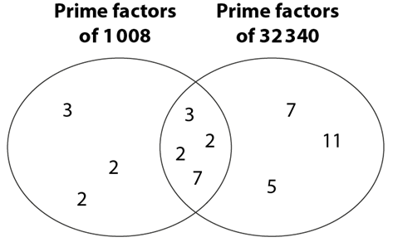
Find the highest common factor of a pair of numbers when their prime factors are shown in a Venn diagram
Example 5a & b
a) | (i) | Use the Venn diagram to write 1 008 and 32 340 as products of their prime factors.
 | (ii) | Use the Venn diagram to find the highest common factor of 1 008 and 32 340.
b) | (i) | 1 575 = 3² × 5² × 7 2 310 = 2 × 3 × 5 × 7 × 11 Show the prime factors of 1 575 and 2 310 in a Venn diagram.
 | (ii) | Use this Venn diagram to find the highest common factor of 1 575 and 2 310.
Notes:
Suggested questioning:
Which part of the Venn represents 1 008? Which part represents 32 340?
What does the intersection of the Venn diagram represent?
How would my Venn diagram change if I used __ instead of 1 008?
Things for you to think about:
In part a), students are given a completed Venn diagram and asked to use the information shown to write two numbers as products of prime factors. By doing this, students are demonstrating that they know what the Venn diagram is showing. Students then need to find the highest common factor using the product of the common prime factors shown in the intersection.
In part b), students are given the numbers in prime factorisation form, but not given the Venn diagram – they must construct it from the information provided and then go on to find the highest common factor.
Part c) progresses to ask students to draw a Venn diagram from scratch and then use it to find the highest common factor.
Part d) asks students to find the highest common factor of three numbers using a Venn diagram.
This scaffolding should support students to ensure that all can progress together through each step as a class.

Slide 26
Find the highest common factor of a pair of numbers when their prime factors are shown in a Venn diagram
Example 5 c & d
Prime factors of 165
Prime factors of 285
c) | (i) | Show the prime factors of 165 and 385 in a Venn diagram.
 | (ii) | Use this Venn diagram to find the highest common factor of 165 and 385.
d) | Use a Venn diagram to find the highest common factor of 150, 60 and 138. | 1 575 = 3² × 5² × 7 2 310 = 2 × 3 × 5 × 7 × 11 Show the prime factors of 1 575 and 2 310 in a Venn diagram.
Notes:
Suggested questioning:
Which part of the Venn represents 165? Which part represents 285?
What does the intersection of the Venn diagram represent?
How can I adapt my Venn diagram to find the HCF of three numbers? How many regions do I need?
Things for you to think about:
In part a), students are given a completed Venn diagram and asked to use the information shown to write two numbers as products of prime factors. By doing this, students are demonstrating that they know what the Venn diagram is showing. Students then need to find the highest common factor using the product of the common prime factors shown in the intersection.
In part b), students are given the numbers in prime factorisation form, but not given the Venn diagram – they must construct it from the information provided and then go on to find the highest common factor.
Part c) progresses to ask students to draw a Venn diagram from scratch and then use it to find the highest common factor.
Part d) asks students to find the highest common factor of three numbers using a Venn diagram.
This scaffolding should support students to ensure that all can progress together through each step as a class.

Slide 27
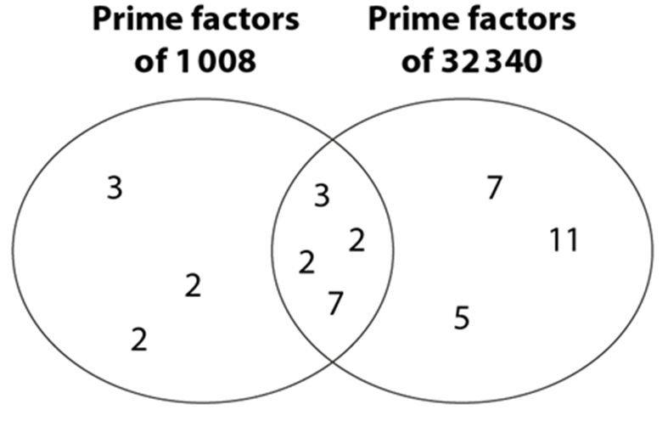
Find the highest common factor of a pair of numbers when their prime factors are shown in a Venn diagram
Example 5
  How does the structure of example 5 provide scaffolding so that students can progress together?
  How can you assess students’ understanding of Venn diagrams?
  Which familiar concepts could you draw upon to recap the use of Venn diagrams to classify elements?
a) | (i) | Use the Venn diagram to write 1 008 and 32 340 as products of their prime factors.
 | (ii) | Use the Venn diagram to find the highest common factor of 1 008 and 32 340.
b) | (i) | 1 575 = 3² × 5² × 7 2 310 = 2 × 3 × 5 × 7 × 11 Show the prime factors of 1 575 and 2 310 in a Venn diagram.
 | (ii) | Use this Venn diagram to find the highest common factor of 1 575 and 2 310.
c) | (i) | Show the prime factors of 165 and 385 in a Venn diagram.
 | (ii) | Use this Venn diagram to find the highest common factor of 165 and 385.
d) | Use a Venn diagram to find the highest common factor of 150, 60 and 138. | 1 575 = 3² × 5² × 7 2 310 = 2 × 3 × 5 × 7 × 11 Show the prime factors of 1 575 and 2 310 in a Venn diagram.
Notes:
Due to space constraints, the image on this PD discussion slide is very small. PD Leads might like to use or print the ‘in the classroom’ version of this slide for teachers to access during discussions.
This example can be found on pages 20 and 21 of the 1.2 Core Concept document.

Slide 28
Explore the most efficient methods of finding the highest common factor
Example 6
How many different ways can you find to calculate the highest common factor of 50 and 54?
Which is the most efficient method, and why?
Consider each of your methods. For each method, write a question for which that method is the most efficient way of finding the highest common factor.
Can you generalise situations when each method is most efficient?
Notes:
Suggested questioning:
How many different ways can you find? Which is the most efficient method?
When might you use each different method?
When is a Venn diagram most useful? When might it not be worth writing numbers as a product of primes?
Things for you to think about:
Students will benefit from being given time to explore different methods, such as listing factors, writing as product of prime factors or using Venn diagrams. By considering each method in turn and discussing when it is likely to be most efficient, students will develop a deeper understanding of when it is most appropriate to select specific methods:
Listing factors is likely to be most efficient when the numbers are small.
Writing as a product of prime factors is likely to be most efficient if the numbers are large and there are no repeated factors (where students might experience misconceptions with indices).
Venn diagrams are likely to be most efficient if the numbers are large and there are lots of repeated factors, as these are easily seen visually on the diagram.

Slide 29
Explore the most efficient methods of finding the highest common factor
Example 6
  How will you manage your classroom to facilitate this discussion?
  What are the benefits of showing students multiple ways to solve a problem? What are the challenges?
How many different ways can you find to calculate the highest common factor of 50 and 54?
Which is the most efficient method, and why?
Consider each of your methods. For each method, write a question for which that method is the most efficient way of finding the highest common factor.
Can you generalise situations when each method is most efficient?
Notes:
This example can be found on page 21 of the 1.2 Core Concept document.

Slide 30
Explore the most efficient methods of finding the highest common factor
Example 7
Find the highest common factor of these sets of numbers using the most efficient method.
24 and 36
48 and 150
240 and 360
ab²c, a²c³ and ab³c⁵
Notes:
Suggested questioning:
Which of these are easiest to do without rewriting the numbers or drawing a Venn? Why?
What makes a Venn diagram useful? When might you use this?
What mistakes might someone make for part d?
Things for you to think about:
Example 7 has been written to encourage students to reflect on which method to select.

Slide 31
Explore the most efficient methods of finding the highest common factor
Example 7
  How will you manage activities like this in your classroom? Is this a task where selected students could come to the board and demonstrate their chosen method to the class, justifying why they have selected it?
  Could students make predictions and reason about the highest common factor for parts b) and c), based on connections to part a), before calculating it?
Find the highest common factor of these sets of numbers using the most efficient method.
24 and 36
48 and 150
240 and 360
ab²c, a²c³ and ab³c⁵
Notes:
This example can be found on page 22 of the 1.2 Core Concept document.

Slide 32
Explore the most efficient methods of finding the highest common factor
Example 8
The highest common factor of x and y is 63.
Which of the following could x and y be?
126 and 189
315 and 126
252 and 126
63 and 441
Notes:
Suggested questioning:
What is the prime factor decomposition of 63?
Is there more than one correct answer?
Could you create another correct answer?
Could you change an incorrect answer to make it correct?
Things for you to think about:
Example 8 is a multiple-choice question with more than one correct answer.
Part a) is possibly the most obvious option, but parts b) and d) are also correct. Part c) has a highest common factor of 126 as both numbers have an additional common factor of two.
This type of question may provide an opportunity for students to realise and discuss the fact that multiple pairs of different numbers can share the same highest common factor.

Slide 33
Explore the most efficient methods of finding the highest common factor
Example 8
  What might you need to consider when writing multiple choice questions?
  What follow-up questions might you ask as part of the discussion of the correct and incorrect answers?
The highest common factor of x and y is 63.
Which of the following could x and y be?
126 and 189
315 and 126
252 and 126
63 and 441
Notes:
This example can be found on page 22 of the 1.2 Core Concept document.

Slide 34
Use prime factorisation to solve problems involving the highest common factor
Example 9
What is the smallest expression that y can take if x = a × b² × c³ and the highest common factor of x and y is b²c?
What is the smallest expression that y can take if x = c × d² × e and the highest common factor of x and y is cde?
What is the smallest expression that y can take if x = c × d² × e and the highest common factor of x and y is def?
If the highest common factor of x and y is ab, how many different pairs of expressions for x and y are there?
Notes:
Suggested questioning:
What does y need to include? How do you know?
How many different answers for part d) can you create? Can you come up with an answer that no one else will?
Are all of these possible? Why or why not?
Things for you to think about:
An important element of fluency is the ability to work flexibly with a concept. In this example, students are given the highest common factor and asked to find expressions for which it is true. Students could discuss the different methods explored previously in this key idea to help support their reasoning.
Students could discuss the different methods explored previously in this key idea to help support their reasoning. Parts b) and c) are identically worded, but with the exception that part c) introduces a factor ‘f’ that is not part of expression x and therefore cannot be common. It is important that students are exposed to non-examples so that they understand where two expressions do not share a common factor.

Slide 35
Use prime factorisation to solve problems involving the highest common factor
Example 9
  Problems such as those in Example 9 provide opportunities for students to practise their understanding of a concept (i.e. intelligent practice rather than mechanical repetition) and to focus on relationships, not just on the procedure.
  At what stage would you want students to work on problems like these? Why?
What is the smallest expression that y can take if x = a × b² × c³ and the highest common factor of x and y is b²c?
What is the smallest expression that y can take if x = c × d² × e and the highest common factor of x and y is cde?
What is the smallest expression that y can take if x = c × d² × e and the highest common factor of x and y is def?
If the highest common factor of x and y is ab, how many different pairs of expressions for x and y are there?
Notes:
Due to space constraints, the image on this PD discussion slide is quite small. PD Leads might like to use or print the ‘in the classroom’ version of this slide for teachers to access during discussions.
This example can be found on page 22 of the 1.2 Core Concept document.

Slide 36
Reflection questions
What other mathematical concepts will be supported by students’ stronger understanding of this key idea?
What mathematical language will you continue to use to support pupils to make connections with other areas?
Which representations might you continue to use to further develop students’ understanding?

Slide 38
Appendices
You may choose to use the following slides when planning or delivering a PD session. They cover:
  Key vocabulary
  Representations and structure
  Previous learning
  Future learning
  Library of links

Slide 39
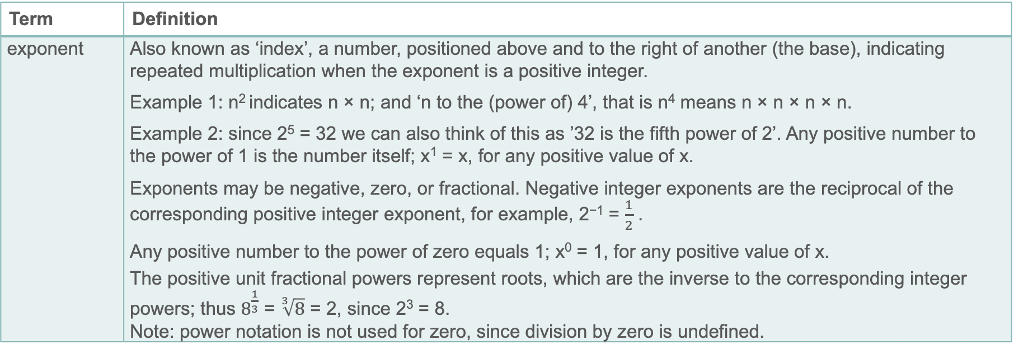
Key vocabulary (1)
Term | Definition
exponent | Also known as ‘index’, a number, positioned above and to the right of another (the base), indicating repeated multiplication when the exponent is a positive integer. Example 1: n² indicates n × n; and ‘n to the (power of) 4’, that is n⁴ means n × n × n × n. Example 2: since 2⁵ = 32 we can also think of this as ’32 is the fifth power of 2’. Any positive number to the power of 1 is the number itself; x¹ = x, for any positive value of x. Exponents may be negative, zero, or fractional. Negative integer exponents are the reciprocal of the corresponding positive integer exponent, for example, 2⁻¹ = $\frac{1}{2}$ . Any positive number to the power of zero equals 1; x⁰ = 1, for any positive value of x. The positive unit fractional powers represent roots, which are the inverse to the corresponding integer powers; thus $8^{\frac{1}{3}}$ = $\sqrt[3]{8}$ = 2, since 2³ = 8. Note: power notation is not used for zero, since division by zero is undefined.

Slide 40
Key vocabulary (2)
Term | Definition
highest common factor (HCF) | The common factor of two or more numbers which has the highest value. Example: 16 has factors 1, 2, 4, 8, 16. 24 has factors 1, 2, 3, 4, 6, 8, 12, 24. 56 has factors 1, 2, 4, 7, 8, 14, 28, 56. The common factors of 16, 24 and 56 are 1, 2, 4 and 8. Their highest common factor is 8.
index | Also known as ‘exponent’, a number, positioned above and to the right of another (the base), indicating repeated multiplication when the index is a positive integer.
lowest common multiple (LCM) | The common multiple of two or more numbers, which has the lowest value. Example: 3 has multiples 3, 6, 9, 12, 15, 18, 21, 24 … 4 has multiples 4, 8, 12, 16, 20, 24 … 6 has multiples 6, 12, 18, 24, 30 … The common multiples of 3, 4 and 6 include 12, 24 and 36. The lowest common multiple of 3, 4 and 6 is 12. Also known as the ‘least common multiple’.

Slide 41
Key vocabulary (3)
Term | Definition
prime factor decomposition | The process of expressing a number as the product of factors that are prime numbers. Example: 24 = 2 × 2 × 2 × 3 or 2³ × 3. Every positive integer has a unique set of prime factors.
Venn diagram | A simple visual diagram used to describe the relationships between two sets. With two or three sets, each set is often represented by a circular region. The intersection of two sets is represented by the overlap region between the two sets. With more than three sets, Venn diagrams can become very complicated. A rectangle is usually drawn around the diagram to represent the universal set, i.e. the overall set of which the 2 (or 3) sets are a subset.

Slide 42
Representations and structure
There are a number of different representations that you may wish to use to support students’ understanding of this key idea. These might include:
Venn diagrams
  Students will have already experienced Venn diagrams in Key Stage 2; however, using them to record prime factors, and for revealing that the highest common factor is the product of the prime factors in the intersection, is likely to be an unfamiliar idea.
Notes:
More information about the representations and structure involved in this key idea can be found:
Within the Theme 1 The number system theme overview document.
Within the examples in the 1.2 Core concept document.
Links to all of these can be found on the final slide.

Slide 43
Previous learning
From Upper Key Stage 2, students will bring experience of:
reading, writing, ordering and comparing numbers up to 10 000 000 and determining the value of each digit
rounding any whole number to a required degree of accuracy
using negative numbers in context
identifying the value of each digit in numbers given to three decimal places and multiplying and dividing numbers by 10, 100 and 1 000, giving answers up to three decimal places
using, reading, writing and converting between standard units, converting measurements of length, mass, volume and time from a smaller unit of measure to a larger unit and vice versa, using decimal notation up to three decimal places
using symbols and letters to represent variables and unknowns in mathematical situations that they already understand, such as:
  missing numbers, lengths, coordinates and angles
  formulae in mathematics and science
Notes:
Theme 1 The structure of the number system

Slide 44
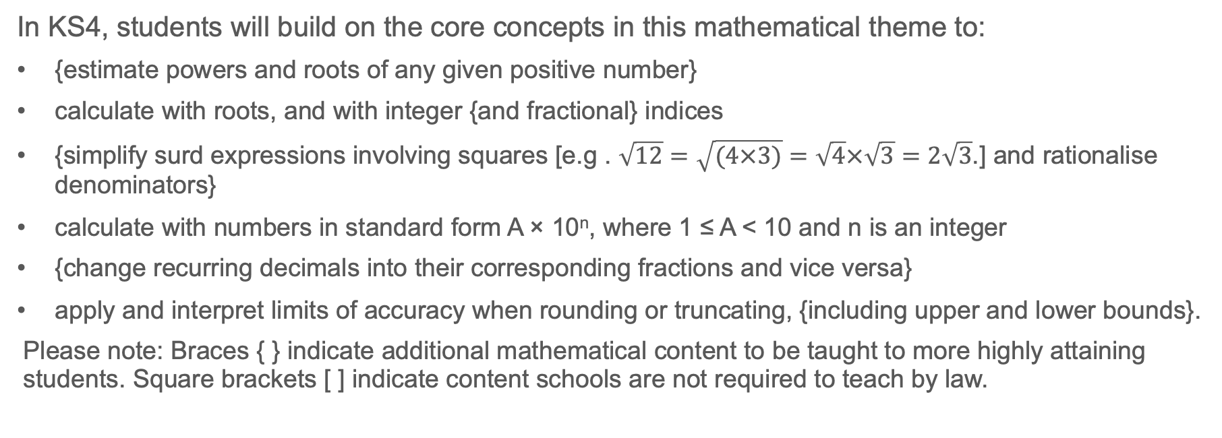
Future learning
In KS4, students will build on the core concepts in this mathematical theme to:
{estimate powers and roots of any given positive number}
calculate with roots, and with integer {and fractional} indices
{simplify surd expressions involving squares [e.g . $\sqrt{12}=\sqrt{(4×3)}=\sqrt{4}×\sqrt{3}=2\sqrt{3}$.] and rationalise denominators}
calculate with numbers in standard form A × 10^{n}, where 1 ≤ A < 10 and n is an integer
{change recurring decimals into their corresponding fractions and vice versa}
apply and interpret limits of accuracy when rounding or truncating, {including upper and lower bounds}.
Please note: Braces { } indicate additional mathematical content to be taught to more highly attaining students. Square brackets [ ] indicate content schools are not required to teach by law.
Notes:
Theme 1 The structure of the number system

Slide 45
Library of links
The following resources from the NCETM website have been referred to within this slide deck:
  NCETM Secondary Mastery Professional Development
    1 The Structure of the number system Theme Overview Document
    1.2 Properties of number Core Concept Document
  Using mathematical representations at KS3 | NCETM
  NCETM primary mastery professional development materials
  NCETM primary assessment materials
There are also references to:
  Standards & Testing Agency’s past mathematics papers

