Slide 1
3.6 Multiplying whole numbers and fractions
Representations | Year 4
Fractions

Slide 2
How to use this presentation
You can find the teacher guide 3.6 Multiplying whole numbers and fractions by following the link below.

Slide 3
3.6 Multiplying whole numbers and fractions
Step 1:1
Notes:
Write addition and multiplication expressions to represent this image.
What does each number represent? (The ‘4’ represents the number of groups, and the ‘2’ represents the size of each group.)

Slide 4
3.6 Multiplying whole numbers and fractions
Step 1:2
Notes:
Write addition and multiplication expressions to represent this image.
What does each number represent? (The ‘$\frac{1}{8}$’ represents the size of each part – an eighth of an orange. The ‘4’ represents the number of parts.)

Slide 5
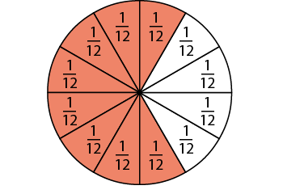
3.6 Multiplying whole numbers and fractions
Step 1:3
Notes:
Use these images to practise writing addition and multiplication expressions.

Slide 6
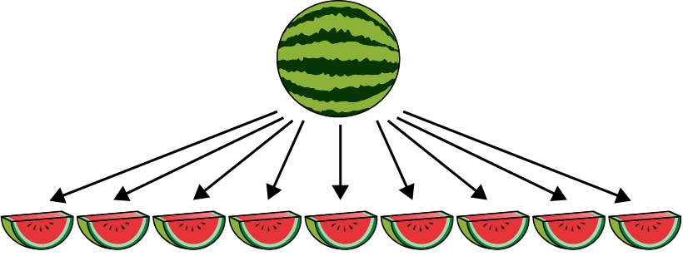
3.6 Multiplying whole numbers and fractions
Step 1:5
Notes:
The whole has been divided into nine equal parts, and one of these parts is $\frac{1}{9}$ .
The slices are arranged into three groups.
What fraction of the whole does each group represent?
Write addition and multiplication expressions to match the image.

Slide 7
3.6 Multiplying whole numbers and fractions
Step 1:6

Slide 8
3.6 Multiplying whole numbers and fractions
3.6 Multiplying whole numbers and fractions
Steps 1:8–1:9
Notes:
Think about how many ninths there are in four lots of $\frac{2}{9}$.
How many ninths is this in total?
Count: ‘Two-ninths, four-ninths, six-ninths, eight-ninths.’
Four lots of $\frac{2}{9}$ is equal to $\frac{8}{9}$.

Slide 9
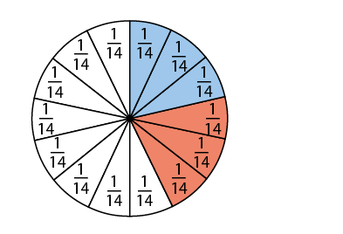
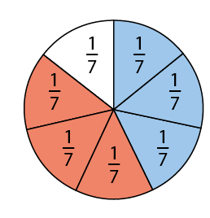
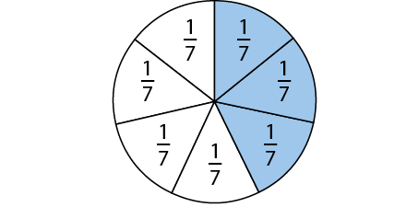
3.6 Multiplying whole numbers and fractions
Step 1:10
✓
✓
Notes:
Imagine: what would it look like if $\frac{3}{7}$ was multiplied by 2?

Slide 10
3.6 Multiplying whole numbers and fractions
Step 1:11

Slide 11
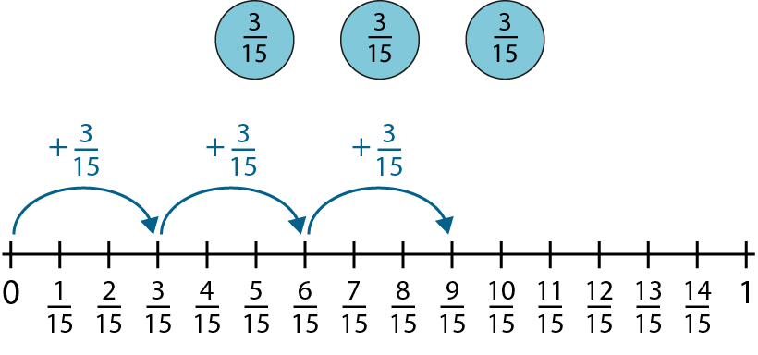
3.6 Multiplying whole numbers and fractions
Step 1:12
Notes:
Three lots of $\frac{3}{15}$ is equal to$\frac{9}{15}$.

Slide 12
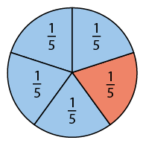
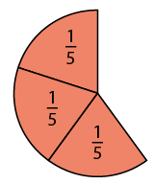
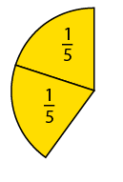
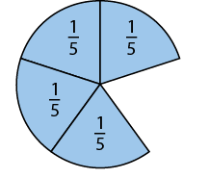
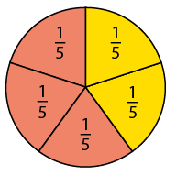
3.6 Multiplying whole numbers and fractions
Step 1:14

Slide 13
3.6 Multiplying whole numbers and fractions
Step 1:15

Slide 14
3.6 Multiplying whole numbers and fractions
Step 1:17

Slide 15
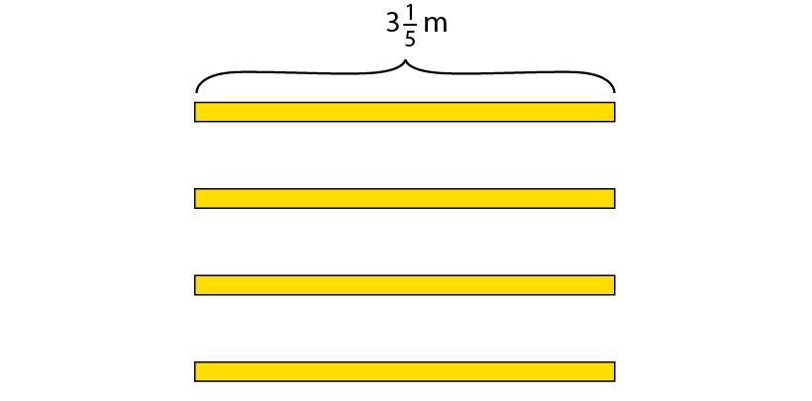
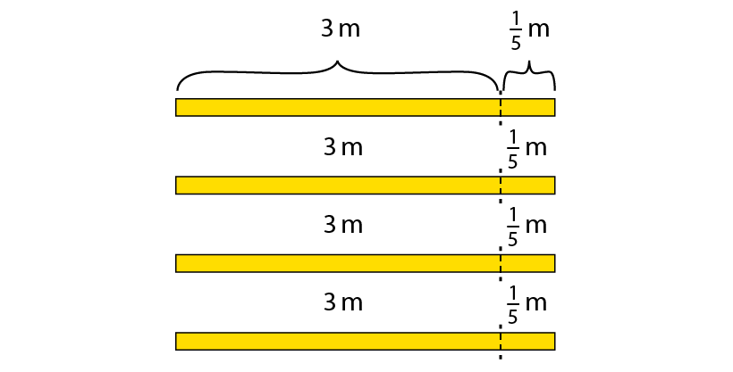
3.6 Multiplying whole numbers and fractions
Step 2:1
Notes:
To decorate a wedding cake, a baker needs 3 $\frac{1}{5}$ m of ribbon. The baker needs to make 4 wedding cakes. How much ribbon does the baker need?
How many 3 m lengths of ribbon are there?
How many $\frac{1}{5}$ m lengths?
What calculation can we do to find the total length?’

Slide 16
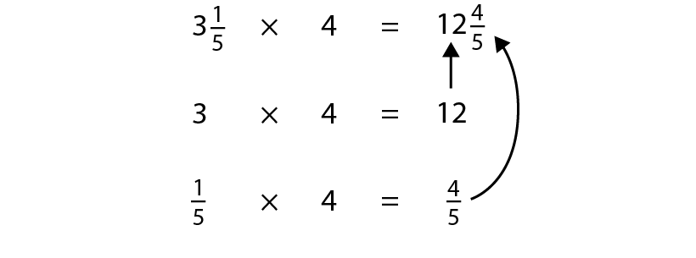
3.6 Multiplying whole numbers and fractions
Step 2:2
Notes:
What is the same?
What is different?

Slide 17
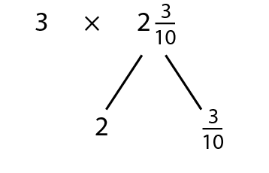
3.6 Multiplying whole numbers and fractions
Step 2:3

Slide 18
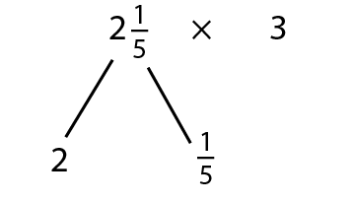
3.6 Multiplying whole numbers and fractions
Step 2:3

Slide 19
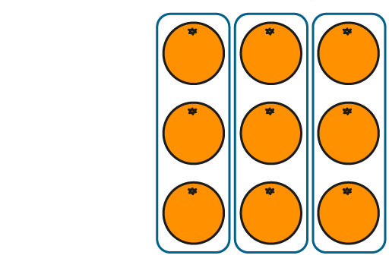
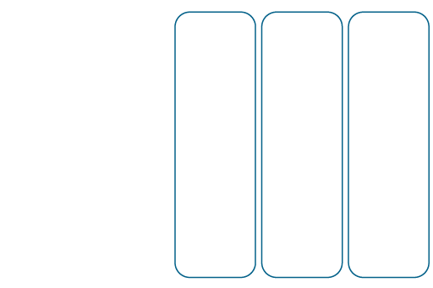
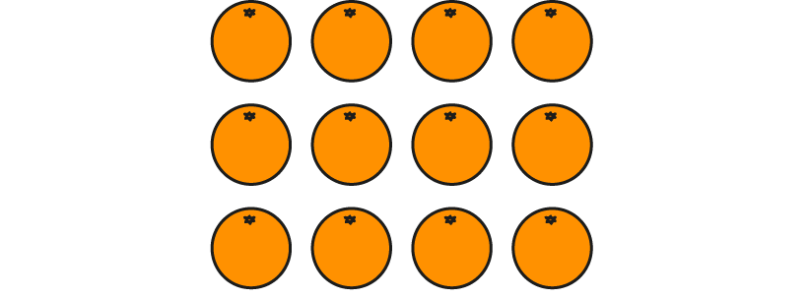
3.6 Multiplying whole numbers and fractions
Step 3:1
Notes:
The whole is divided into four equal parts and we have three of them.

Slide 20
3.6 Multiplying whole numbers and fractions
Step 3:1

Slide 21
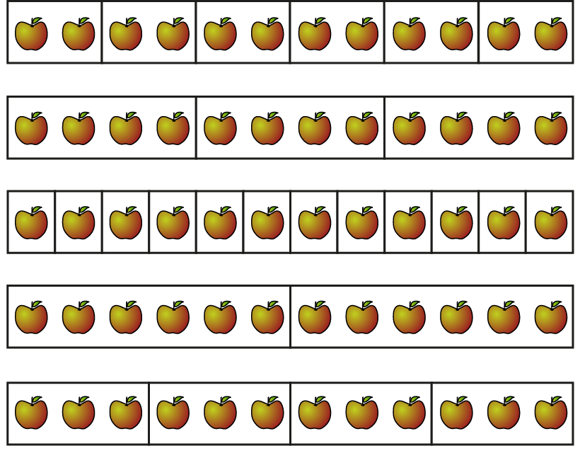
3.6 Multiplying whole numbers and fractions
Step 3:2
Notes:
Use the following stem sentence to identify the fraction that each part is of the whole.
The whole is divided into ___ equal parts.
Each part is ___of the whole.

Slide 22
3.6 Multiplying whole numbers and fractions
Step 3:2
Notes:
What is the whole number of apples in each representation?
What is the number of apples in each part?
Use the stem sentence: When ___ apples are split into ___equal parts, there are ___ apples in each part.

Slide 23
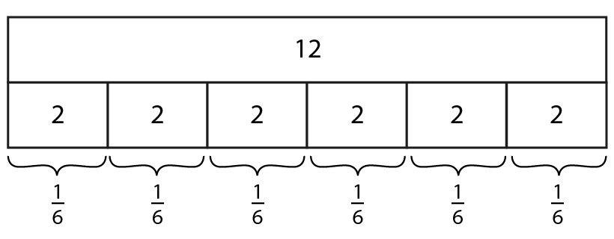
3.6 Multiplying whole numbers and fractions
Step 3:3
Notes:
How many parts has the whole been split into?
What fraction of the whole does each part represent?
Each part is $\frac{1}{6}$ of the whole; $\frac{1}{6}$ of twelve apples is two apples.

Slide 24
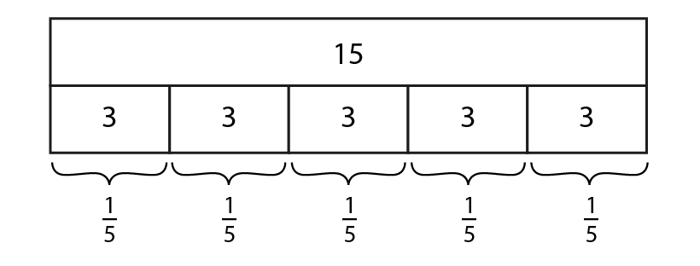
3.6 Multiplying whole numbers and fractions
Step 3:4
Notes:
Each part is $\frac{1}{5}$ of the whole; $\frac{1}{5}$ of 15 is 3.

Slide 25
3.6 Multiplying whole numbers and fractions
Step 3:5
Notes:
Use the stem sentence:
__ is divided into __equal parts; each part is __ of the whole.

Slide 26
3.6 Multiplying whole numbers and fractions
Step 3:5

Slide 27
3.6 Multiplying whole numbers and fractions
Step 3:6
Notes:
$\frac{1}{2}$of 10 = 5
2 lots of 5 = 10

Slide 28
3.6 Multiplying whole numbers and fractions
Step 3:6
Notes:
___of ___ = ____
___lots of ___ = ____

Slide 29
3.6 Multiplying whole numbers and fractions
Step 3:6
Notes:
___of ___ = ____
___lots of ___ = ____

Slide 30
3.6 Multiplying whole numbers and fractions
Step 3:7

Slide 31
3.6 Multiplying whole numbers and fractions
Step 3:7

Slide 32
3.6 Multiplying whole numbers and fractions
Step 3:7

Slide 33
3.6 Multiplying whole numbers and fractions
Step 3:7
Notes:
When a whole number is multiplied by a unit fraction, it makes the whole number smaller.

Slide 34
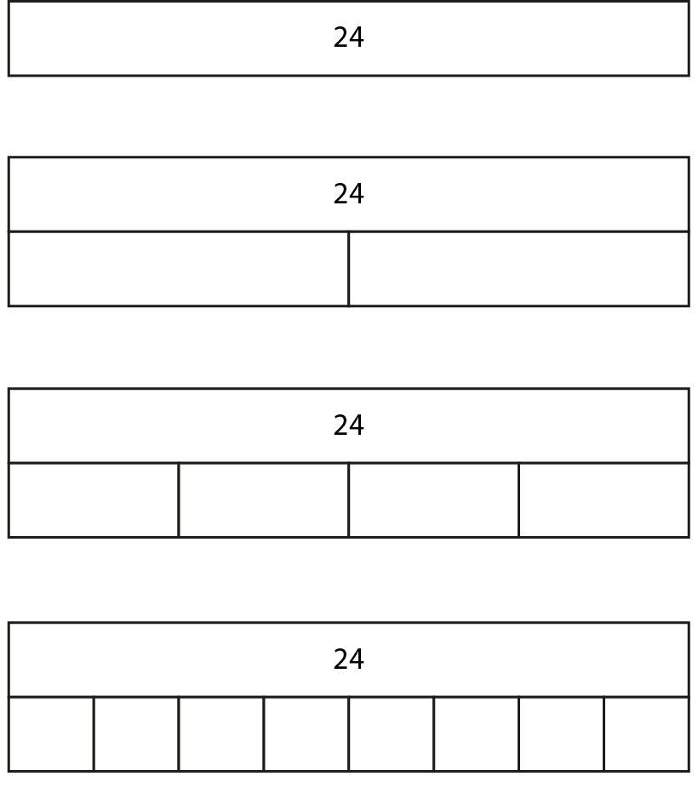
3.6 Multiplying whole numbers and fractions
Step 3:7
Notes:
Complete the missing parts on the bar models and then describe the relationships between the solutions to these calculations.

Slide 35
3.6 Multiplying whole numbers and fractions
Step 3:8

Slide 36
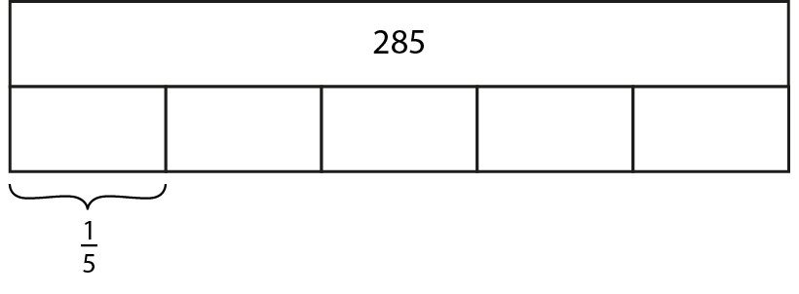
3.6 Multiplying whole numbers and fractions
Step 3:11

Slide 37
3.6 Multiplying whole numbers and fractions
Step 3:12
Notes:
There are 90 children in $\frac{1}{3}$ of the playground.
How many children are in the whole playground, if there are an equal number of children in each part?

Slide 38
3.6 Multiplying whole numbers and fractions
Step 3:12
Notes:
60 children choose their favourite sport.
12 children choose swimming.
What fraction of the children is this?

Slide 39
3.6 Multiplying whole numbers and fractions
Step 4:1
Notes:
How could I find $\frac{3}{5}$ of fifteen?
(To calculate $\frac{3}{5}$ ×15 = 9, find $\frac{1}{5}$ of fifteen and then multiply by three.)

Slide 40
3.6 Multiplying whole numbers and fractions
Step 4:2
Notes:
To calculate a fraction of a quantity, find the unit fraction of the quantity. Then multiply the unit fraction by the numerator.

Slide 41
3.6 Multiplying whole numbers and fractions
Step 4:3
Notes:
To calculate $\frac{3}{4}$ × 24, find $\frac{1}{4}$ of twenty-four and then multiply by three.

Slide 42
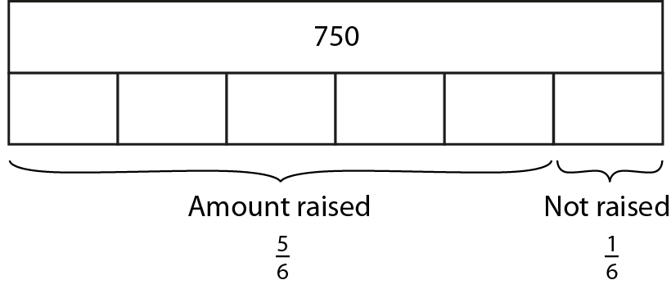
3.6 Multiplying whole numbers and fractions
Step 4:5
Notes:
A school are trying to raise £750 to send Year 5 on school camp.
They have raised $\frac{5}{6}$ of the total.
How much have they raised so far?

Slide 43
3.6 Multiplying whole numbers and fractions
Step 4:6
Notes:
When a whole number is multiplied by a unit fraction, it makes the whole number smaller.

Slide 44
3.6 Multiplying whole numbers and fractions
Step 4:6
Notes:
When a whole number is multiplied by a proper fraction, it makes the whole number smaller.

Slide 45
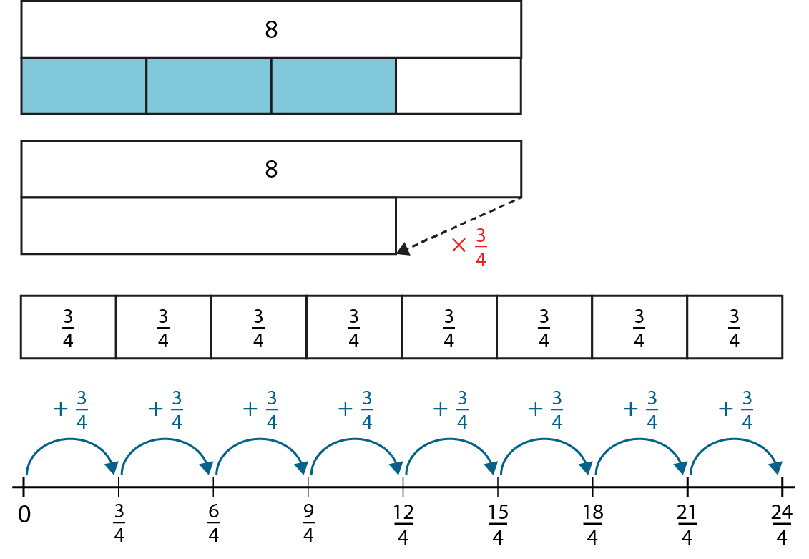
3.6 Multiplying whole numbers and fractions
Step 4:7
Notes:
Discuss the different ways that 8 × $\frac{3}{4}$ could be interpreted and represented pictorially and in written form.

Slide 46
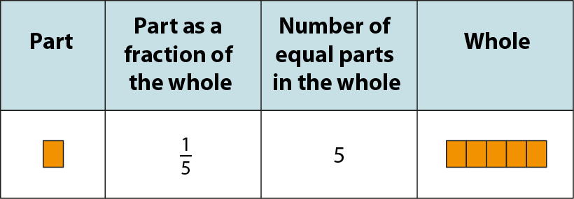
3.6 Multiplying whole numbers and fractions
Step 5:1
Notes:
If we know the size of a unit fraction, we can work out the size of the whole.

Slide 47
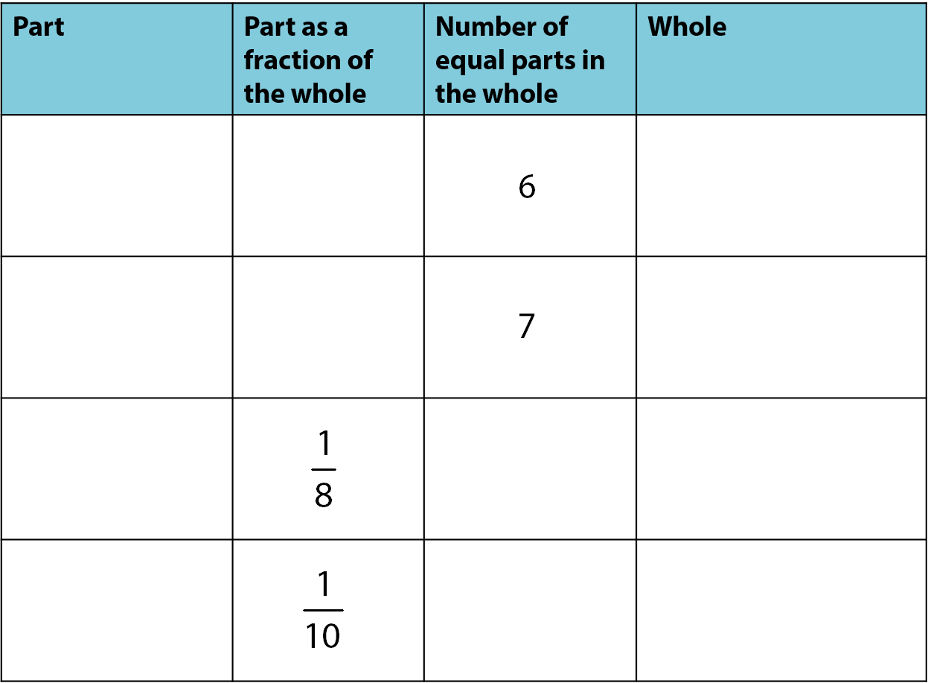
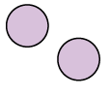
3.6 Multiplying whole numbers and fractions
Step 5:1
Notes:
If we know the size of a unit fraction, we can work out the size of the whole.

Slide 48
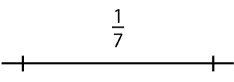
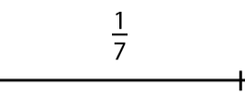
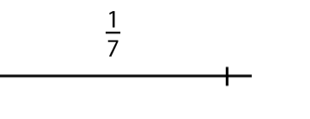
3.6 Multiplying whole numbers and fractions
Step 5:2

Slide 49
3.6 Multiplying whole numbers and fractions
Step 5:2

Slide 50
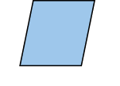
3.6 Multiplying whole numbers and fractions
Step 5:2

Slide 51
3.6 Multiplying whole numbers and fractions
Step 5:3

Slide 52
3.6 Multiplying whole numbers and fractions
Step 5:3

Slide 53
3.6 Multiplying whole numbers and fractions
Step 5:3
Notes:
Five stars represent $\frac{5}{8}$ .
$\frac{1}{8}$ must be one star.

Slide 54
3.6 Multiplying whole numbers and fractions
Step 5:4

Slide 55
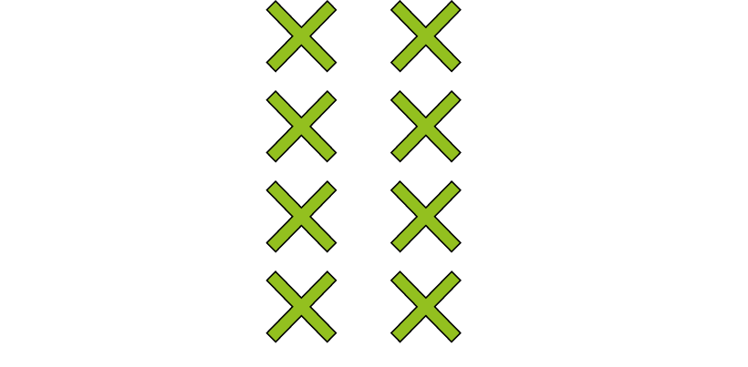
3.6 Multiplying whole numbers and fractions
Step 5:5

Slide 56
3.6 Multiplying whole numbers and fractions
Step 5:6

Slide 57
3.6 Multiplying whole numbers and fractions
Step 5:7

Slide 58
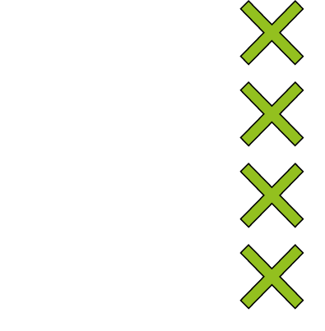
3.6 Multiplying whole numbers and fractions
Step 5:7

Slide 59
3.6 Multiplying whole numbers and fractions
Step 5:7

Slide 60
3.6 Multiplying whole numbers and fractions
Step 5:8

Slide 61
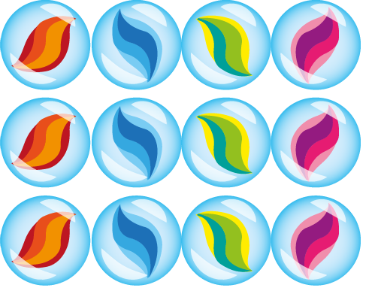
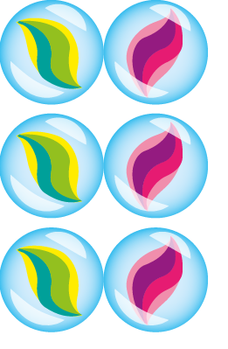
3.6 Multiplying whole numbers and fractions
Step 5:8
Notes:
Jack collects marbles. Here is $\frac{5}{7}$ of his marble collection. Draw the rest of Jack’s marble collection to represent the whole collection.

Slide 62
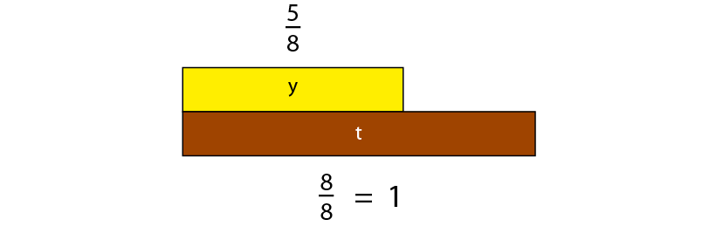
3.6 Multiplying whole numbers and fractions
Step 5:8

Slide 63
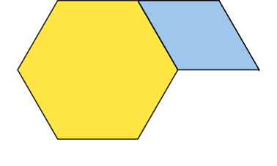
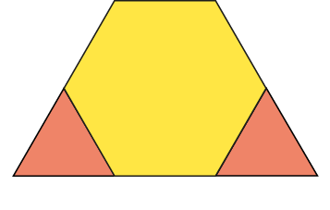
3.6 Multiplying whole numbers and fractions
Step 5:8
Notes:
The yellow hexagon represents $\frac{6}{8}$ of the whole. Recreate the whole using your pattern blocks.

Slide 64
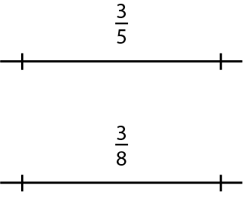
3.6 Multiplying whole numbers and fractions
Step 5:8

Slide 65
3.6 Multiplying whole numbers and fractions
Step 5:9

Slide 66
3.6 Multiplying whole numbers and fractions
Step 5:10
Notes:
$\frac{1}{3}$ of my number is 5. What is the number I am thinking of?

Slide 67
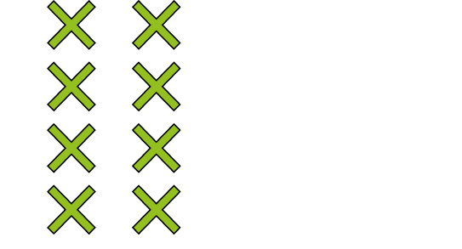
3.6 Multiplying whole numbers and fractions
Step 5:11
Notes:
Link to the bar model and written fraction notation. Say:
‘The whole is divided into 3 equal parts…’ (Point to the denominator.)
‘…and this is 2 of those parts.’ (Point to the numerator.)
‘We know that 8 is 2 parts of 3 equal parts. If 8 is 2 parts, then 1 part must be half of 8. That is 4. So, 3 parts must be 12.’

