Slide 1
1.30 Composition and calculation: numbers up to 10,000,000
Representations | Year 6
Number, Addition and Subtraction

Slide 2
How to use this presentation
You can find the teacher guide 1.30 Composition and calculation: numbers up to 10,000,000 by following the link below.

Slide 3
1.30 Numbers up to 10,000,000 – step 1:1
Millions |  |  | Thousands |  |  | Ones
100s | 10s | 1s | 100s | 10s | 1s | 100s | 10s | 1s
 |  | 1 | 0 | 0 | 0 | 0 | 0 | 0

Slide 4
1.30 Numbers up to 10,000,000 – step 1:1
999
,000
(999 thousands)
1,000
,000
(1,000 thousands)

Slide 5
1.30 Numbers up to 10,000,000 – step 1:1
0
1,000,000
1,000,000
1 million
2,000,000
2,000,000
2 million
3,000,000
3,000,000
3 million
4,000,000
4,000,000
4 million
5,000,000
5,000,000
5 million
6,000,000
6,000,000
6 million
7,000,000
7,000,000
7 million
8,000,000
8,000,000
8 million
9,000,000
9,000,000
9 million
10,000,000
10,000,000
10 million

Slide 6
1.30 Numbers up to 10,000,000 – step 1:2
Millions |  |  | Thousands |  |  | Ones |  |  | -ths
100s | 10s | 1s | 100s | 10s | 1s | 100s | 10s | 1s
 |  |  |  |  |  |  |  | 0 | 0 | 1
 |  |  |  |  |  |  |  | 0 | 1
 |  |  |  |  |  |  |  | 1
 |  |  |  |  |  |  | 1 | 0
 |  |  |  |  |  | 1 | 0 | 0
 |  |  |  |  | 1 | 0 | 0 | 0
 |  |  |  | 1 | 0 | 0 | 0 | 0
 |  |  | 1 | 0 | 0 | 0 | 0 | 0
 |  | 1 | 0 | 0 | 0 | 0 | 0 | 0
 | 1 | 0 | 0 | 0 | 0 | 0 | 0 | 0
1
1
.
10
100
.

Slide 7
1.30 Numbers up to 10,000,000 – step 1:2
 |  |  |  |  |  |  |  |  | 0 | . | 0 | 1 |  | one hundredth
 |  |  |  |  |  |  |  |  | 0 | . | 1 |  |  | one tenth
 |  |  |  |  |  |  |  |  | 1 |  |  |  |  | one
 |  |  |  |  |  |  |  | 1 | 0 |  |  |  |  | ten
 |  |  |  |  |  |  | 1 | 0 | 0 |  |  |  |  | one hundred
 |  |  |  |  | 1 | , | 0 | 0 | 0 |  |  |  |  | one thousand
 |  |  |  | 1 | 0 | , | 0 | 0 | 0 |  |  |  |  | ten thousand
 |  |  | 1 | 0 | 0 | , | 0 | 0 | 0 |  |  |  |  | one hundred thousand
 | 1 | , | 0 | 0 | 0 | , | 0 | 0 | 0 |  |  |  |  | one million
1 | 0 | , | 0 | 0 | 0 | , | 0 | 0 | 0 |  |  |  |  | ten million

Slide 8
1.30 Numbers up to 10,000,000 – step 1:3
10,000,000.00 | 20,000,000.00 | 30,000,000.00 | 40,000,000.00 | 50,000,000.00 | 60,000,000.00 | 70,000,000.00 | 80,000,000.00 | 90,000,000.00
1,000,000.00 | 2,000,000.00 | 3,000,000.00 | 4,000,000.00 | 5,000,000.00 | 6,000,000.00 | 7,000,000.00 | 8,000,000.00 | 9,000,000.00
100,000.00 | 200,000.00 | 300,000.00 | 400,000.00 | 500,000.00 | 600,000.00 | 700,000.00 | 800,000.00 | 900,000.00
10,000.00 | 20,000.00 | 30,000.00 | 40,000.00 | 50,000.00 | 60,000.00 | 70,000.00 | 80,000.00 | 90,000.00
1,000.00 | 2,000.00 | 3,000.00 | 4,000.00 | 5,000.00 | 6,000.00 | 7,000.00 | 8,000.00 | 9,000.00
100.00 | 200.00 | 300.00 | 400.00 | 500.00 | 600.00 | 700.00 | 800.00 | 900.00
10.00 | 20.00 | 30.00 | 40.00 | 50.00 | 60.00 | 70.00 | 80.00 | 90.00
1.00 | 2.00 | 3.00 | 4.00 | 5.00 | 6.00 | 70.00 | 8.00 | 9.00
0.10 | 0.20 | 0.30 | 0.40 | 0.50 | 0.60 | 0.70 | 0.80 | 0.90
0.01 | 0.02 | 0.03 | 0.04 | 0.05 | 0.06 | 0.07 | 0.08 | 0.09

Slide 9
1.30 Numbers up to 10,000,000 – step 1:4
1,000
1,000
500
500
250
250
250
250
1,000
1,000
200
200
200
200
200
100
100
100
100
100
100
100
100
100
100

Slide 10
1.30 Numbers up to 10,000,000 – step 1:5
1,000,000
500,000
500,000
1,000,000
250,000
250,000
250,000
250,000
1,000,000
200,000
200,000
200,000
200,000
200,000
1,000,000
100,000
100,000
100,000
100,000
100,000
100,000
100,000
100,000
100,000
100,000

Slide 11
1.30 Numbers up to 10,000,000 – step 1:6
10,000
5,000
5,000
10,000
2,500
2,500
2,500
2,500
10,000
2,000
2,000
2,000
2,000
2,000
10,000
1,000
1,000
1,000
1,000
1,000
1,000
1,000
1,000
1,000
1,000

Slide 12
1.30 Numbers up to 10,000,000 – step 1:7
10,000,000
5,000,000
5,000,000
10,000,000
2,500,000
2,500,000
2,500,000
2,500,000
10,000,000
2,000,000
2,000,000
2,000,000
2,000,000
2,000,000
10,000,000
1,000,000
1,000,000
1,000,000
1,000,000
1,000,000
1,000,000
1,000,000
1,000,000
1,000,000
1,000,000

Slide 13
1.30 Numbers up to 10,000,000 – step 1:8
10,000,000
2,500,000
2,500,000
2,500,000
2,500,000
1,000
100
100
100
100
100
100
100
100
100
100
1,000,000
250,000
250,000
250,000
250,000
0.1
0.05
0.05
1,000,000
200,000
200,000
200,000
200,000
200,000
1
0.5
0.5

Slide 14
1.30 Numbers up to 10,000,000 – step 1:8
10,000
35,000
45,000

Slide 15
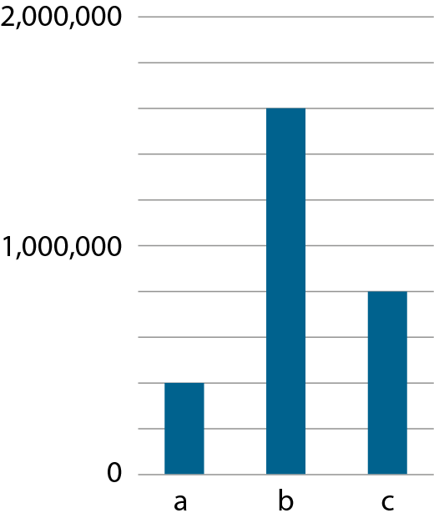
1.30 Numbers up to 10,000,000 – step 1:8
1,600,000
800,000
400,000

Slide 16
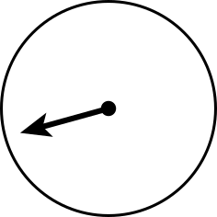
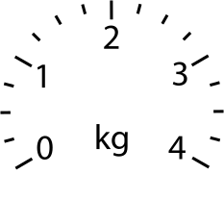
1.30 Numbers up to 10,000,000 – step 1:8
1.75 kg
3.5 kg
0.25 kg

Slide 17
1.30 Numbers up to 10,000,000 – step 1:8
R
B

Slide 18
1.30 Numbers up to 10,000,000 – steps 2:1 and 2:2
Millions |  |  | Thousands |  |  | Ones
100s | 10s | 1s | 100s | 10s | 1s | 100s | 10s | 1s
 |  |  |  |  | 1 | 9 | 3 | 7
 |  |  |  | 5 | 1 | 9 | 3 | 7
 |  |  | 4 | 5 | 1 | 9 | 3 | 7
 |  | 5 | 4 | 5 | 1 | 9 | 3 | 7
1,937 (one thousand, nine hundred and thirty-seven)
51,937 (fifty-one thousand, nine hundred and thirty-seven)
451,937 (four hundred and fifty-one thousand, nine hundred
and thirty-seven)
5,451,937 (five million, four hundred and fifty-one thousand,
nine hundred and thirty-seven)

Slide 19
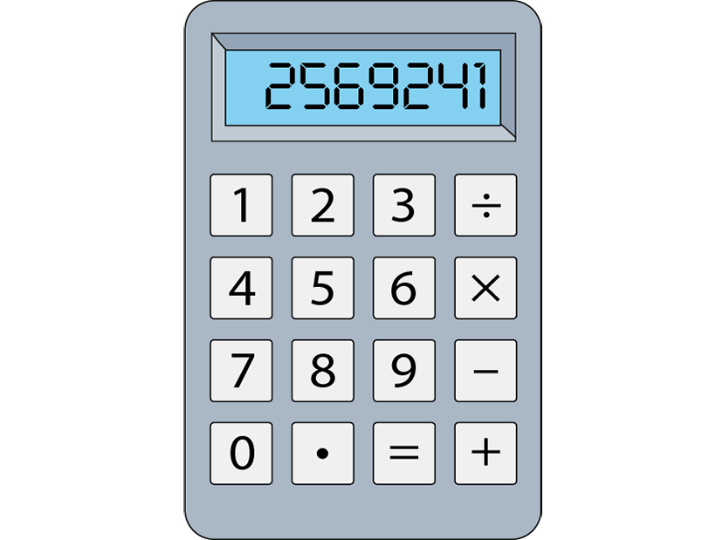
1.30 Numbers up to 10,000,000 – step 2:3

Slide 20
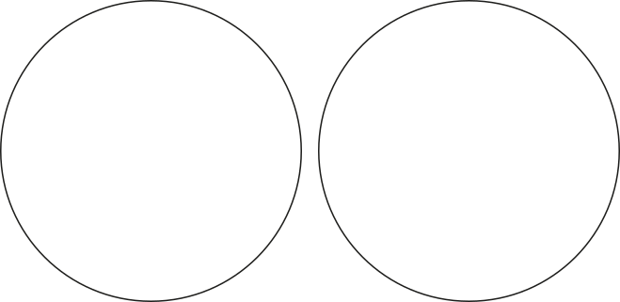
1.30 Numbers up to 10,000,000 – step 2:3
Correctly written
Incorrectly written
736,1.8
6,439.1
185,72
763,148
4,826,591

Slide 21
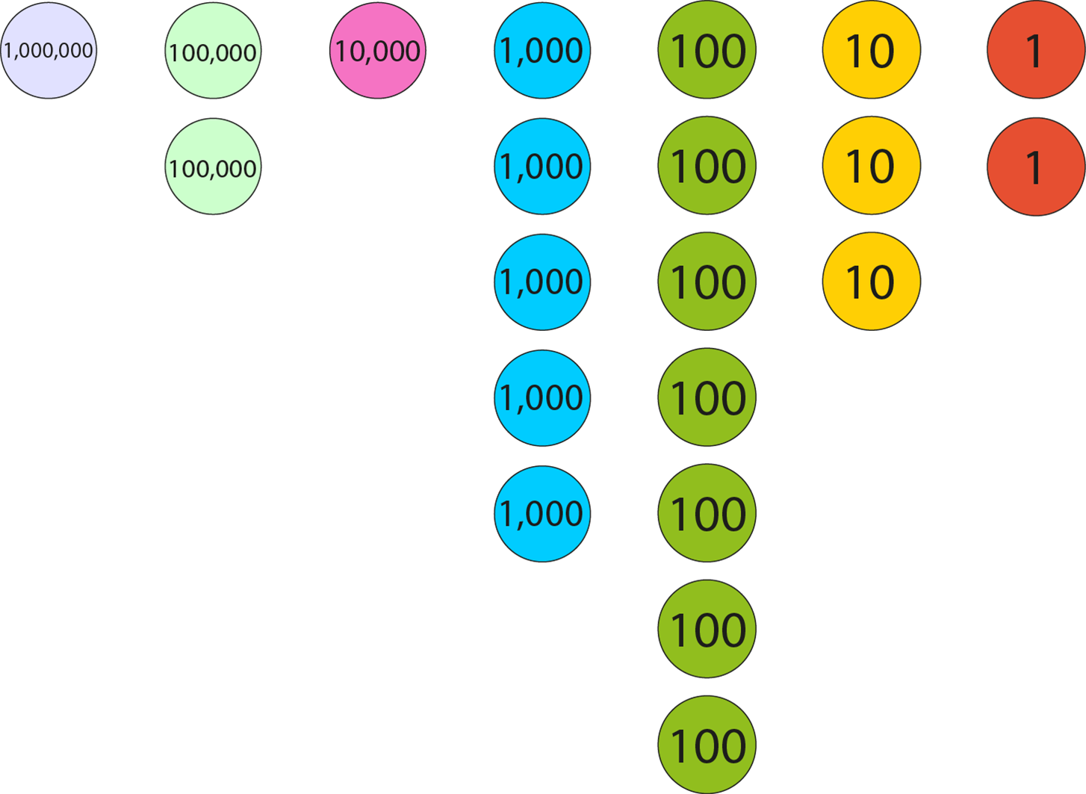
1.30 Numbers up to 10,000,000 – step 2:4
1,215,732

Slide 22
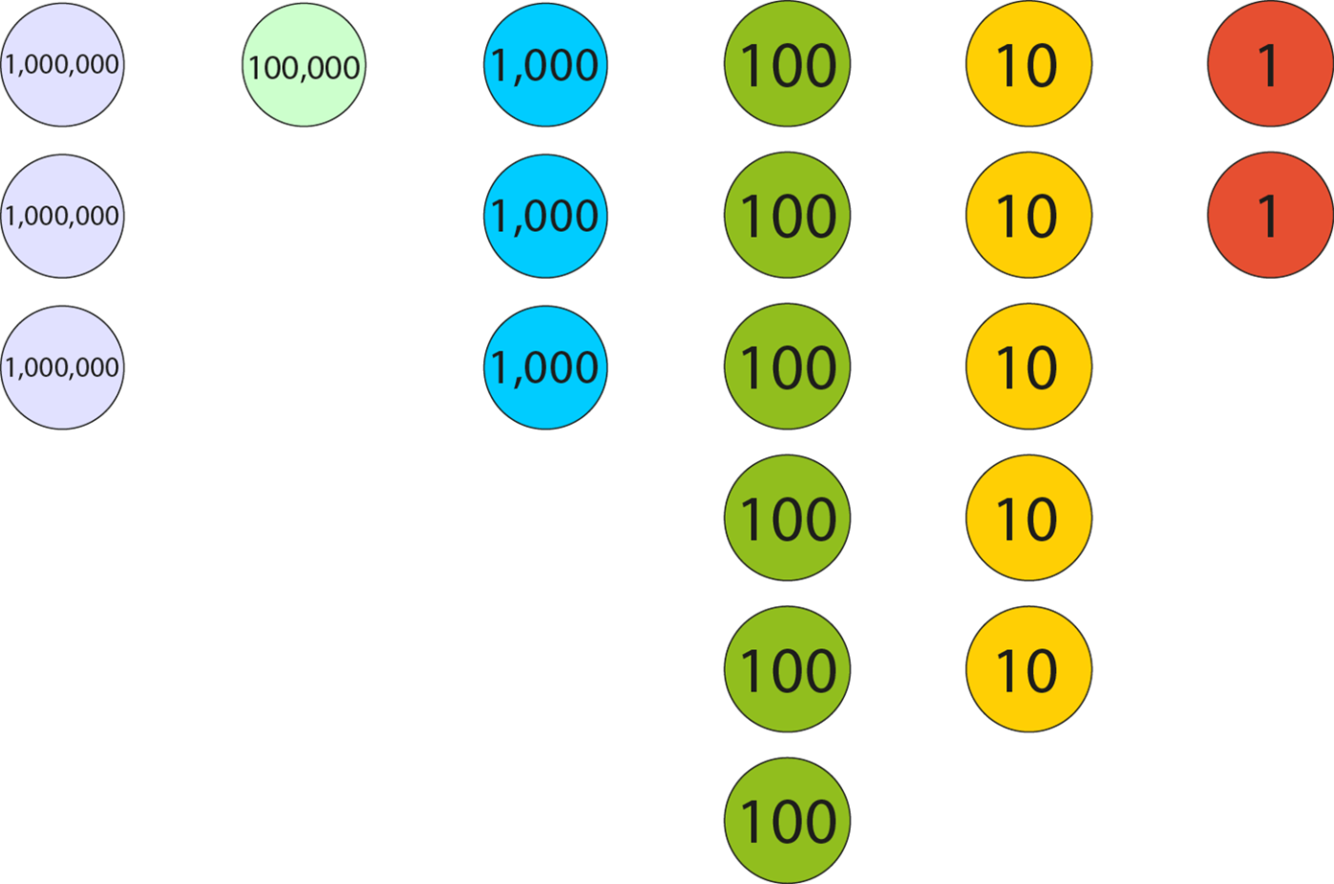
1.30 Numbers up to 10,000,000 – step 2:5
3,103,652

Slide 23
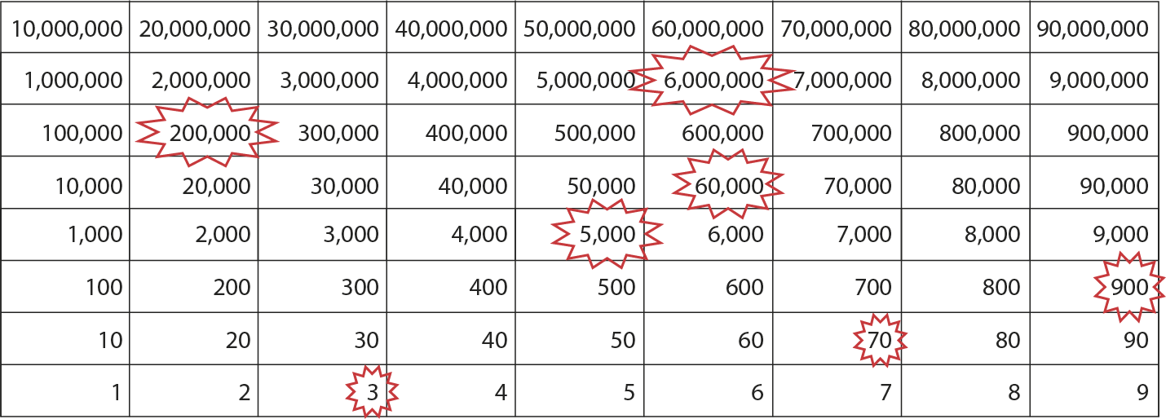
1.30 Numbers up to 10,000,000 – step 2:6
6,265,973

Slide 24
1.30 Numbers up to 10,000,000 – step 2:8
Millions |  |  | Thousands |  |  | Ones
100s | 10s | 1s | 100s | 10s | 1s | 100s | 10s | 1s

Slide 25
1.30 Numbers up to 10,000,000 – step 2:10
Notes:
‘How many ways can you arrange these digit cards so that the inequality is true?’

Slide 26
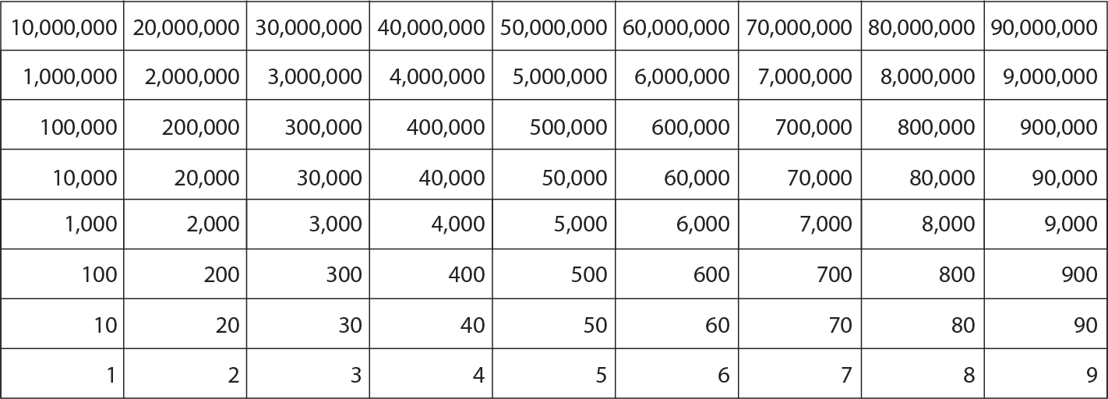
1.30 Numbers up to 10,000,000 – step 3:1
5,381,492
Millions |  |  | Thousands |  |  | Ones
100s | 10s | 1s | 100s | 10s | 1s | 100s | 10s | 1s
5
3
8
1
4
9
2
5,381,492 =
5,000,000 +
300,000 +
80,000 +
1,000 +
400 +
90 +
2

Slide 27
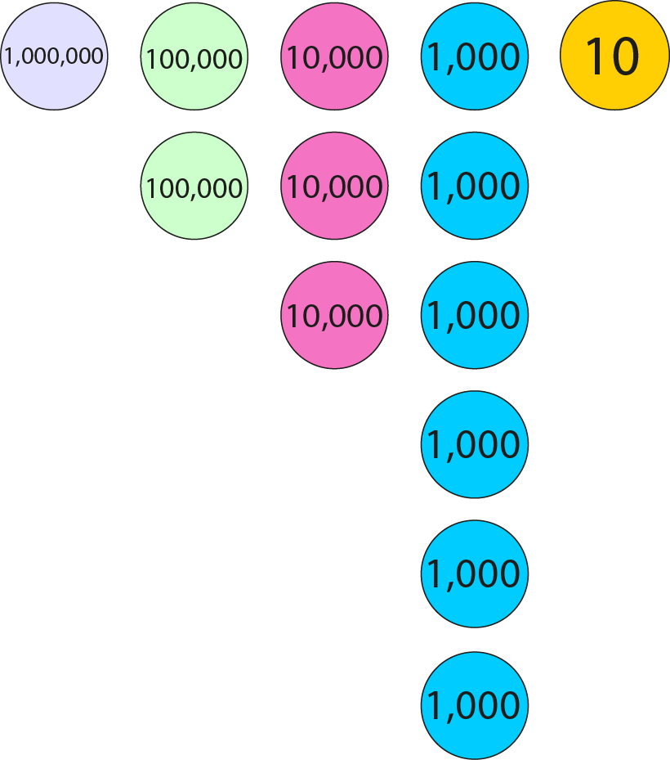
1.30 Numbers up to 10,000,000 – step 3:2
1,000,000
+ 200,000
+ 30,000
+ 6,000
+ 10
= 1,236,010

Slide 28
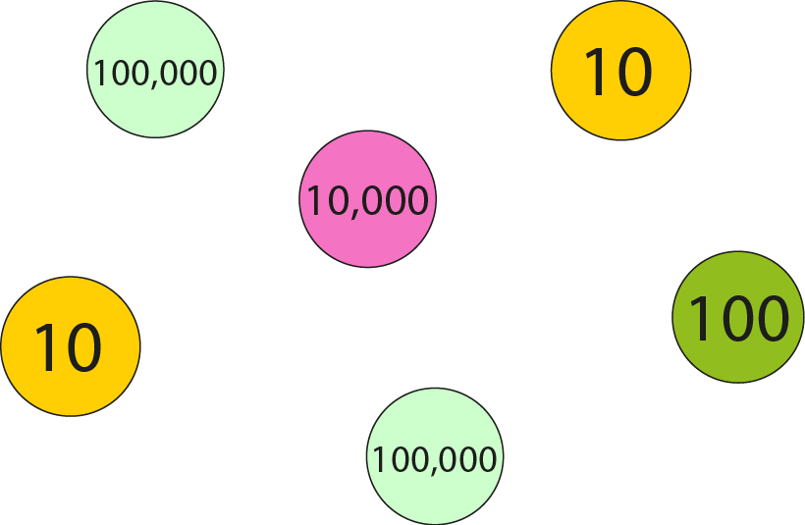
1.30 Numbers up to 10,000,000 – step 3:2
200,000
+ 10,000
+ 100
+ 20
= 210,120

Slide 29
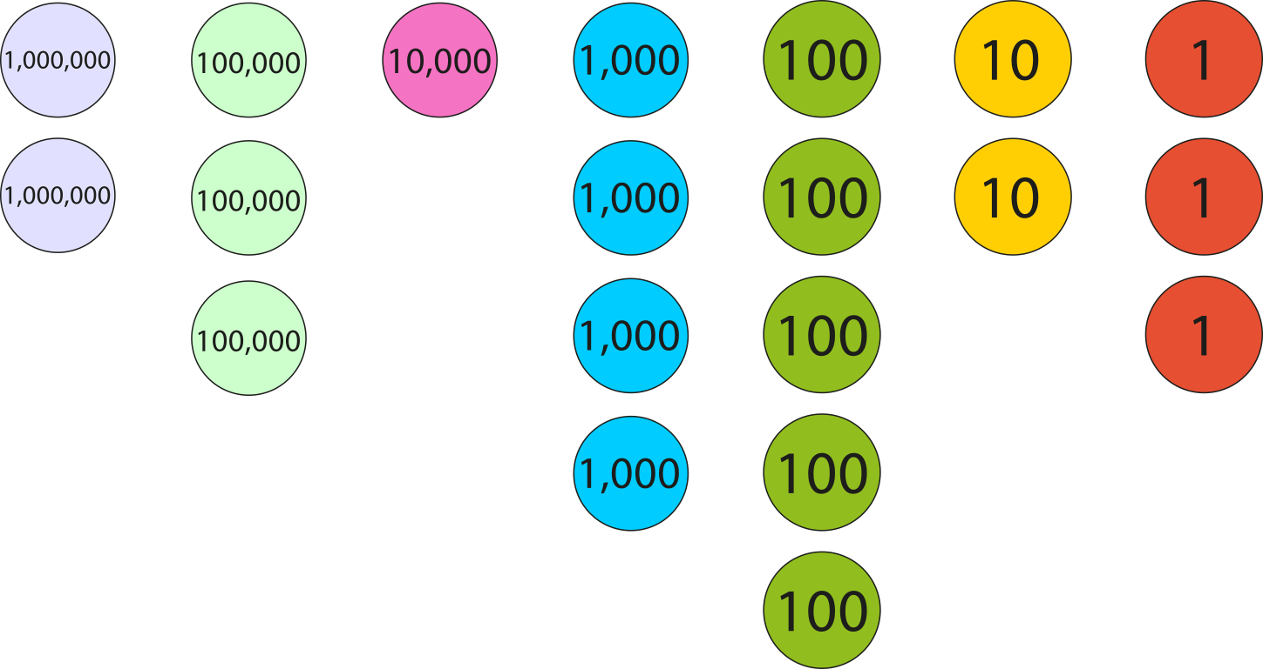
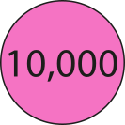
1.30 Numbers up to 10,000,000 – step 3:5
2,314,523
+ 30,000
= 2,344,523

Slide 30
1.30 Numbers up to 10,000,000 – step 3:5
523,810
− 20,000
= 503,810
Millions |  |  | Thousands |  |  | Ones
100s | 10s | 1s | 100s | 10s | 1s | 100s | 10s | 1s
 |  |  | 5 |  | 3 | 8 | 1 | 0
2
0

Slide 31
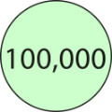
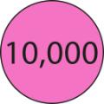
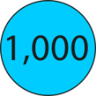
1.30 Numbers up to 10,000,000 – step 3:6
124,000
+ 362
= 124,362
Millions |  |  | Thousands |  |  | Ones
100s | 10s | 1s | 100s | 10s | 1s | 100s | 10s | 1s
1
2
4
0
0
0
3
6
2

Slide 32
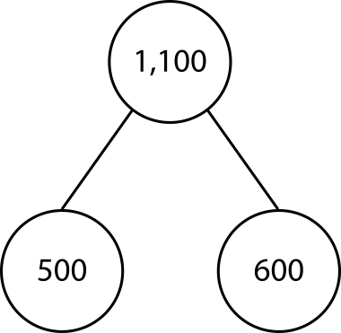
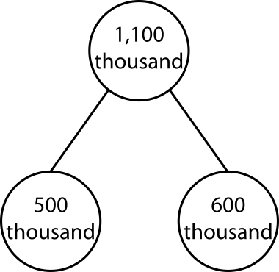
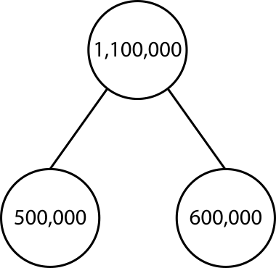
1.30 Numbers up to 10,000,000 – step 4:1

Slide 33
1.30 Numbers up to 10,000,000 – step 4:2
500,000 + 600,000
= 1,100,000
+ 500,000
+ 100,000
500,000
1,000,000
1,100,000

Slide 34
1.30 Numbers up to 10,000,000 – step 4:3
500,000 + 700,000
= 1,200,000
+ 500,000
+ 200,000
500,000
1,000,000
1,200,000

Slide 35
1.30 Numbers up to 10,000,000 – step 4:3
1,500,000 + 700,000
= 2,200,000
+ 500,000
+ 200,000
1,500,000
2,000,000
2,200,000

Slide 36
1.30 Numbers up to 10,000,000 – step 4:3
2,500,000 + 700,000
= 3,200,000
+ 500,000
+ 200,000
2,500,000
3,000,000
3,200,000

Slide 37
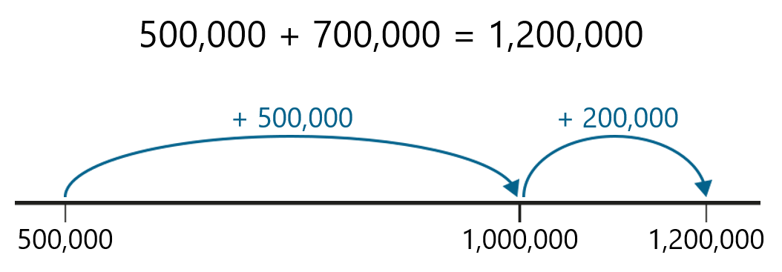
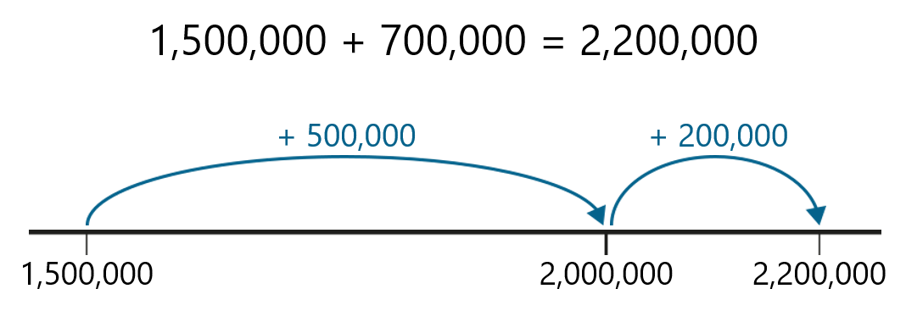
1.30 Numbers up to 10,000,000 – step 4:3

Slide 38
1.30 Numbers up to 10,000,000 – step 4:4
3,200,000 − 700,000
= 2,500,000
− 500,000
− 200,000
2,500,000
3,000,000
3,200,000

Slide 39
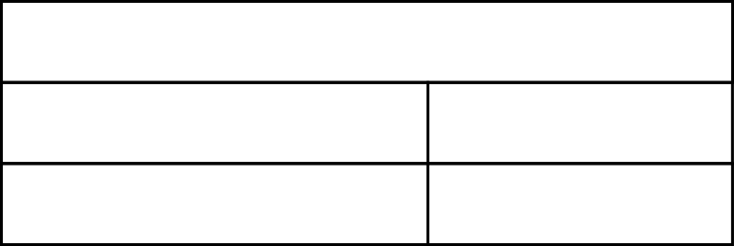
1.30 Numbers up to 10,000,000 – step 4:4
1,200,000 or 1,200 thousand
700,000
500,000
?
700 thousand
500 thousand
?

Slide 40
1.30 Numbers up to 10,000,000 – step 4:8
2,4
02,159
2,3
02,159
2,2
02,159
2,1
02,159
2,0
02,159
1,9
02,159
1,8
02,159
…

Slide 41
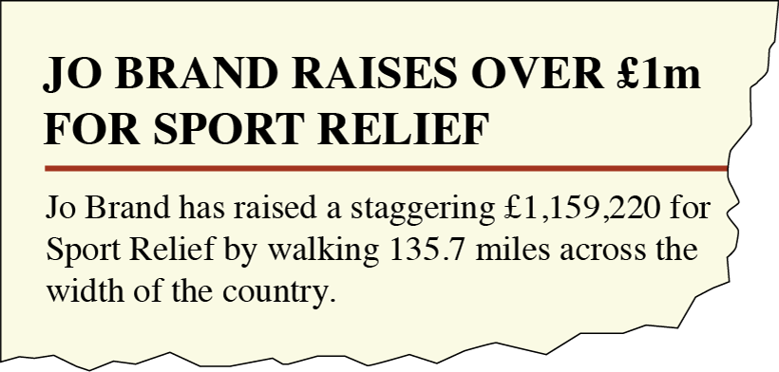
1.30 Numbers up to 10,000,000 – step 5:1
Source: Comic Relief, 2018

Slide 42
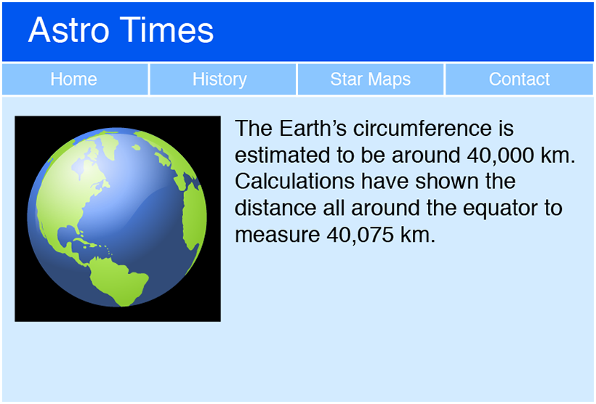
1.30 Numbers up to 10,000,000 – step 5:1

Slide 43
1.30 Numbers up to 10,000,000 – step 5:1

Slide 44
1.30 Numbers up to 10,000,000 – step 5:1
Source: The Official Charts Company, 2018

Slide 45
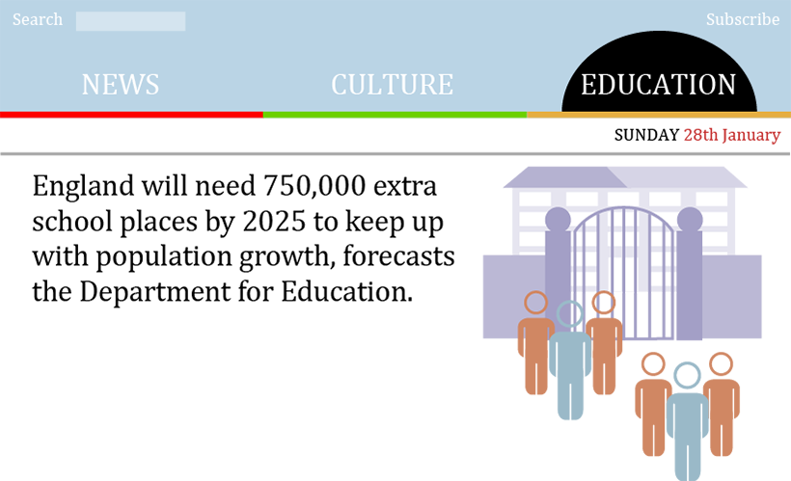
1.30 Numbers up to 10,000,000 – step 5:2

Slide 46
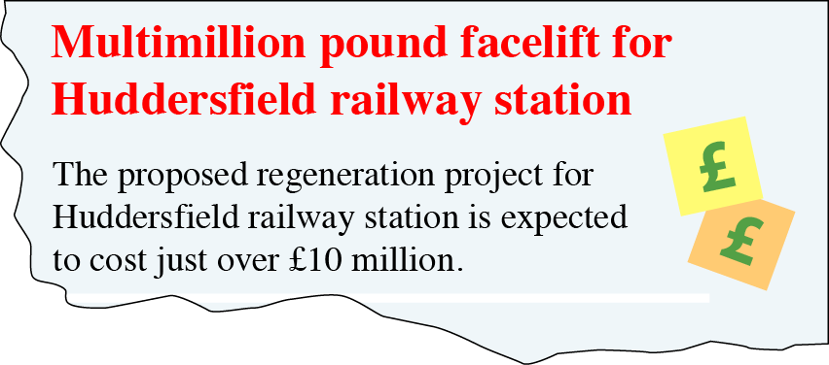
1.30 Numbers up to 10,000,000 – step 5:2

Slide 47
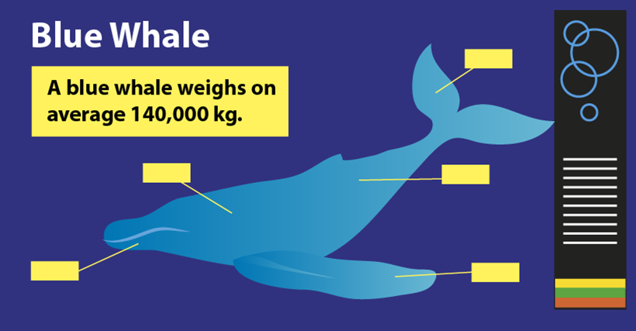
1.30 Numbers up to 10,000,000 – step 5:3

Slide 48
1.30 Numbers up to 10,000,000 – step 5:3
Source: Reebok, 2018

Slide 49
1.30 Numbers up to 10,000,000 – step 5:4
previous multiple of 1,000,000
next multiple of 1,000,000
2,000,000
5,000,000
7,000,000
3,000,000
6,000,000
<
a
8,000,000
b
c
d
<

Slide 50
1.30 Numbers up to 10,000,000 – step 5:5
previous multiple of 1,000,000
next multiple of 1,000,000
2,000,000
5,000,000
7,000,000
3,000,000
6,000,000
<
a
8,000,000
b
c
d
<

Slide 51
1.30 Numbers up to 10,000,000 – step 5:6
previous multiple of 1,000,000
next multiple of 1,000,000
2,000,000
5,000,000
7,000,000
3,000,000
6,000,000
<
2,783,450
8,000,000
5,192,012
5,811,159
7,683,102
<

Slide 52
1.30 Numbers up to 10,000,000 – step 5:7
previous multiple of 1,000,000
next multiple of 1,000,000
2,000,000
<
2,783,450
3,000,000
7
<
5,000,000
<
5,192,012
6,000,000
1
<
5,000,000
<
5,811,159
6,000,000
8
<
7,000,000
<
7,683,102
8,000,000
6
<

Slide 53
1.30 Numbers up to 10,000,000 – step 5:9
previous multiple of 100,000
next multiple of 100,000
3,000,000
3,300,000
3,700,000
3,400,000
3,100,000
3,400,000
3,800,000
<
a
3,500,000
b
c
d
<

Slide 54
1.30 Numbers up to 10,000,000 – step 5:9
previous multiple of 100,000
next multiple of 100,000
3,000,000
3,300,000
3,700,000
3,400,000
3,100,000
3,400,000
3,800,000
<
3,015,465
3,500,000
3,379,163
3,421,188
3,762,001
2
6
1
7
<

Slide 55
1.30 Numbers up to 10,000,000 – step 5:11
1 | , | 7 | 5 | 6 | , | 4 | 5 | 1
1 | , | 7 | 5 | 6 | , | 4 | 5 | 0
nearest ten
1 | , | 7 | 5 | 6 | , | 5 | 0 | 0
nearest hundred
1 | , | 7 | 5 | 6 | , | 0 | 0 | 0
nearest thousand
1 | , | 7 | 6 | 0 | , | 0 | 0 | 0
nearest ten thousand
1 | , | 8 | 0 | 0 | , | 0 | 0 | 0
nearest hundred thousand
2 | , | 0 | 0 | 0 | , | 0 | 0 | 0
nearest million

Slide 56
1.30 Numbers up to 10,000,000 – step 5:12
£ | 2 | 8 | 9 | , | 9 | 1 | 0
£ | 2 | 8 | 9 | , | 9 | 1 | 0
nearest £10
£ | 2 | 8 | 9 | , | 9 | 0 | 0
nearest £100
£ | 2 | 9 | 0 | , | 0 | 0 | 0
nearest £1,000
£ | 2 | 9 | 0 | , | 0 | 0 | 0
nearest £10,000
£ | 3 | 0 | 0 | , | 0 | 0 | 0
nearest £100,000

Slide 57
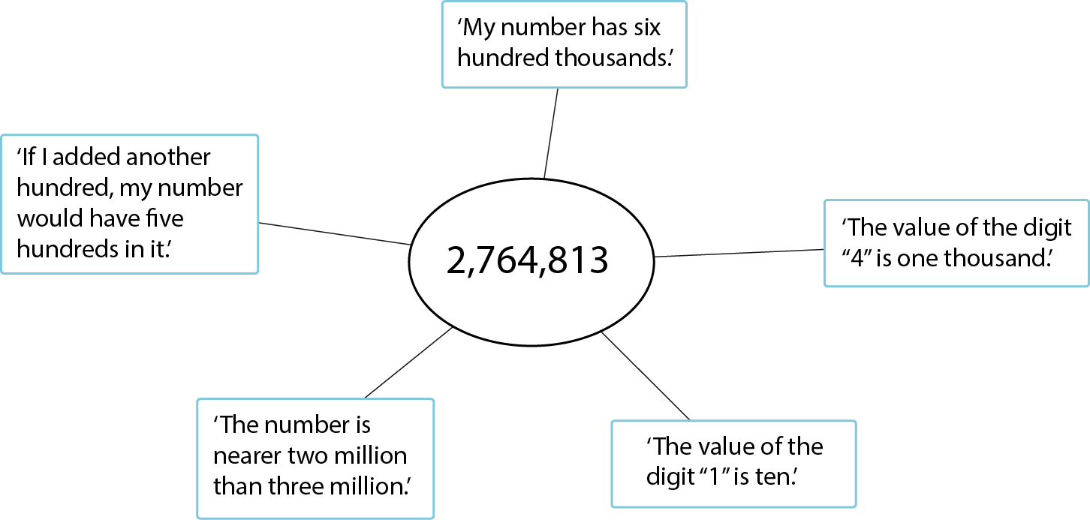
1.30 Numbers up to 10,000,000 – step 5:13
✗
✗
✓
✗
✓

Slide 58
1.30 Numbers up to 10,000,000 – step 5:13
Notes:
‘Use the digit cards zero to nine to create two numbers. You may use each card only once.
The first number rounds to thirteen thousand when rounded to the nearest thousand.
The second number rounds to thirty thousand when rounded to the nearest ten thousand.’

Slide 59
1.30 Numbers up to 10,000,000 – step 6:1
Species of whale | Average mass (kg)
Beluga | 1,400
Killer | 4,000
Humpback | 30,000
Sperm | 40,000
Blue | 140,000
40,000
30,000
?
10,000
30,000 + 10,000 = 40,000
10,000
40,000 − 30,000 = 10,000
10,000

Slide 60
1.30 Numbers up to 10,000,000 – step 6:3
European country | Area (km²)
France | 643,801
Spain | 505,370
Sweden | 450,295
Germany | 357,022
United Kingdom | 243,610
357,022
243,610
?
Source: The World Factbook 2018
Washington, DC: Central Intelligence Agency, 2018
243,610 + 113,412 = 357,022
357,022 − 243,610 = 113,412
Notes:
Source: The World Factbook 2018.
Washington, DC: Central Intelligence Agency, 2018.
https://www.cia.gov/library/publications/the-world-factbook/fields/2147.html

Slide 61
1.30 Numbers up to 10,000,000 – step 6:5
357,022 − 243,610
= 113,412
6
1
 |  |  |  | ,
− |  |  |  | ,
3
5
7
0
2
2
2
4
3
6
1
0
1
1
3
,
4
1
2

Slide 62
1.30 Numbers up to 10,000,000 – step 6:6
643,801 + 505,370
= 1,149,171
 |  |  |  |  |  | ,
+ |  |  |  |  |  | ,
6
4
3
8
0
1
5
0
5
3
7
0
1
,
1
4
9
,
1
7
1
1
1

Slide 63
1.30 Numbers up to 10,000,000 – step 6:8
+ 1
+ 10,000
29,999
30,000
40,000
40,000
29,999
10,001
?

Slide 64
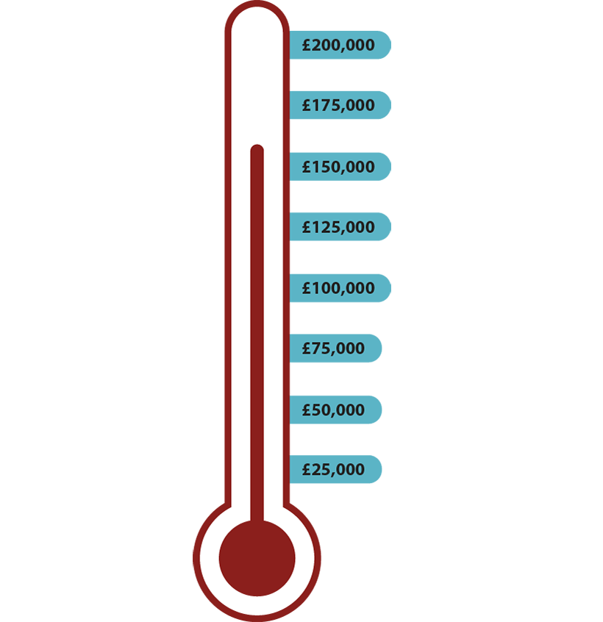
1.30 Numbers up to 10,000,000 – step 6:9
Notes:
‘A charity aims to raise £200,000. So far it has raised £158,436. How much more does the charity need to raise to reach its target amount?’

Slide 65
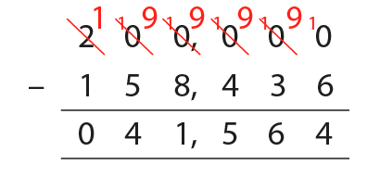
1.30 Numbers up to 10,000,000 – step 6:9
200,000 − 158,436

Slide 66
1.30 Numbers up to 10,000,000 – step 6:10
200,000 − 158,436
= 41,564
 | 2 | 0 | 0 | , | 0 | 0 | 0
− | 1 | 5 | 8 | , | 4 | 3 | 6
− 1
 | 1 | 9 | 9 | , | 9 | 9 | 9
− | 1 | 5 | 8 | , | 4 | 3 | 5
− 1
0
4
1
,
5
6
4

Slide 67
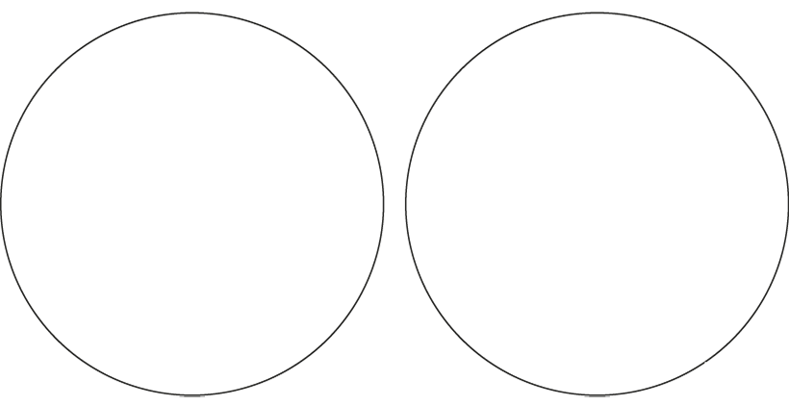
1.30 Numbers up to 10,000,000 – step 6:12
Mental method
Written method
308,724 − 10,000
103,436 + 45,618
20,000 − 9,999
43,701 − 34,067
426 + 784,000 + 3,000,000
78,921 − 3,000
1,070,640 − 65,231
9,000,000 − 437,208

