Slide 1
Year 1, Unit 7
Addition and subtraction facts within 10

Slide 2
Year 1, Unit 7
These materials heavily reflect the prioritisation approach of the ready-to-progress criteria in the DfE Primary Mathematics Guidance 2020 and on the PPTs that exemplify them on the NCETM website. They also include other relevant National Curriculum content. Related sections of the NCETM Primary Mastery Professional Development Materials provide small-step teaching guidance.
Ready-to-progress criteria addressed by this unit
Teaching of this unit supports the following criteria from the ‘DfE Mathematics Guidance: key stages 1 & 2’ (the 335-page document available as a download)
1NF-1 Page 24
Prior learning
If the children have the following previous experience, contained in the same DfE guidance document as above, they will be ready to start this unit.
Previous experience prior to 1NF-1 Page 16
Ongoing fluency work
The teaching of 1NF-1 could extend beyond Unit 7 and support stand alone fluency sessions for pupils throughout the year.

Slide 3
Contents
The links below take you to the starting slide of each learning outcome.
1 | Pupils explain that addition is commutative
2 | Pupils find pairs of numbers to 10 (1)
3 | Pupils find pairs of numbers to 10 (2)
4 | Pupils add and subtract 1 from any number
5 | Pupils explain what the difference is between consecutive numbers
6 | Pupils explain what happens when 2 is added to or subtracted from odd and even numbers
7 | Pupils explain what the difference is between consecutive odd and even numbers
Click the arrow button to return to this Contents slide.

Slide 4
Contents
The links below take you to the starting slide of each learning outcome.
8 | Pupils explain what happens when zero is added to or subtracted from a number
9 | Pupils explain what happens when a number is added to or subtracted from itself
10 | Pupils double numbers and explain what doubling means
11 | Pupils halve numbers and explain what halving means
12 | Pupils use knowledge of doubles and halves to calculate near doubles and halves
13 | Pupils use knowledge of doubles and halves to solve problems efficiently
14 | Pupils use knowledge and strategies to add 5 and 3 and 6 and 3
Click the arrow button to return to this Contents slide.

Slide 5
Year 1, Unit 7, Learning Outcome 1
Learning Outcome 1
Pupils explain that addition is commutative
The following slides have been collated to support the teaching of this learning outcome.

Slide 6
Year 1, Unit 7, Learning Outcome 1
Additional teacher guidance for this outcome should be read first and can be found in this segment of the NCETM Primary Mastery Professional Development Materials:
1.7 Addition and subtraction: strategies within 10
The spine materials are divided into ‘teaching points’ and ‘steps in learning’.
Teaching point | Steps in learning | Pages
1 | 1:1-1:5 | 4-8

Slide 7
1.7 Calculation: strategies within 10 – step 1:1
2 + 4 = 6
4 + 2 = 6
2 + 4 = 4 + 2

Slide 8
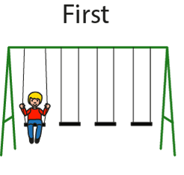
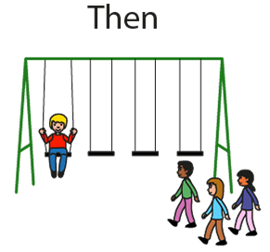
1.7 Calculation: strategies within 10 – step 1:2

Slide 9
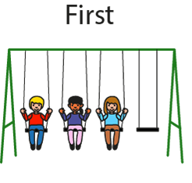
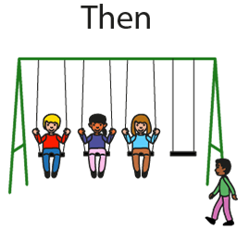
1.7 Calculation: strategies within 10 – step 1:2

Slide 10
1.7 Calculation: strategies within 10 – step 1:2
1 + 3 = 3 + 1

Slide 11
1.7 Calculation: strategies within 10 – step 1:3
2 + 3 = 5

Slide 12
1.7 Calculation: strategies within 10 – step 1:3
3 + 2 = 5

Slide 13
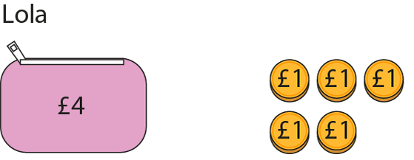
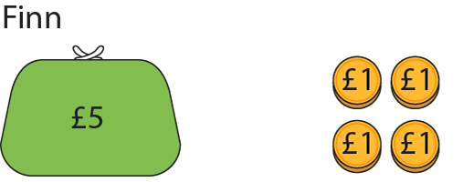
1.7 Calculation: strategies within 10 – step 1:3

Slide 14
Year 1, Unit 7, Learning Outcome 2
Learning Outcome 2
Pupils find pairs of numbers to 10 (1)
The following slides have been collated to support the teaching of this learning outcome.

Slide 15
Year 1, Unit 7, Learning Outcome 2
Additional teacher guidance for this outcome should be read first and can be found in this segment of the NCETM Primary Mastery Professional Development Materials:
1.7 Addition and subtraction: strategies within 10
The spine materials are divided into ‘teaching points’ and ‘steps in learning’.
Teaching point | Steps in learning | Pages
2 | 2:1-2:2 | 9-10

Slide 16
1.7 Calculation: strategies within 10 – step 2:1

Slide 17
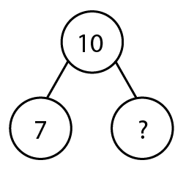
1.7 Calculation: strategies within 10 – step 2:1

Slide 18
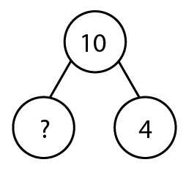
1.7 Calculation: strategies within 10 – step 2:1

Slide 19
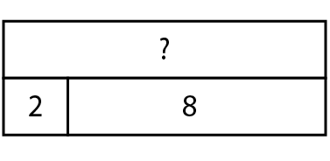
1.7 Calculation: strategies within 10 – step 2:1

Slide 20
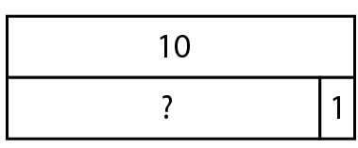
1.7 Calculation: strategies within 10 – step 2:1

Slide 21
1NF-1 Fluently add and subtract within 10 – bonds to 10
Using the ten frame images, check that children understand that a full ten frame has 10 counters. Agree which bond of 10 each image shows. Encourage children to subitise the number of counters rather than count.
Can children copy the arrangement by making it on their own ten frame? Ask children to show you on their fingers this bond of 10 by putting some fingers up and some down. You could look at other arrangements of 10, e.g. using a coat hanger with 10 pegs, five of one colour and five of another.
Ensure children recognise that addition is commutative, so if they see 10 as 9 and 1 on their fingers, they know both facts: 10 = 9 + 1 and 10 = 1 + 9, perhaps showing this by switching their hands around. They can also reason that if they know 9 + 1 = 10, they also know 10 – 1 = 9.
Use the following slides to practise recalling the bonds of ten. Keep encouraging children to connect the bond of ten to a mental image of it on their fingers or a ten frame.

Slide 22
1NF-1 Fluently add and subtract within 10 – bonds to 10
Ensure children have plenty of opportunities to re-visit bonds of 10 in different contexts. Games which involve hiding a part of a set of 10 objects can be especially helpful. Play the beady snake game: our beady ten snake is hiding part of his body under a stone to keep cool, how many parts is he hiding? Using a set of 10 shells, hide some of them in the sand tray, show children shells not hidden and ask them to predict how many they will need to find to have them all. Using a coat hanger with 10 pegs, hide some under a piece of cloth and children can tell you how many are hiding.
Use a bead string with 10 beds (starting with five red and five white, then progressing to all of the same colour).
Play shopping games with ten 1p coins. If you buy something for 6p, how many pennies will you have left?
Using written addition expressions, children can be encouraged to sort them into ‘bonds of 10’ and not ‘bonds of 10’.

Slide 23
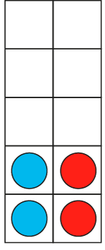
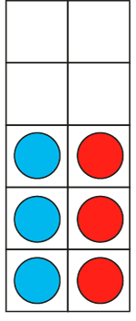
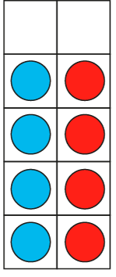
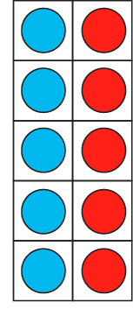
1NF-1 Fluently add and subtract within 10 – bonds to 10
1 + 9 = 10
9 + 1 = 10
2 + 8 = 10
8 + 2 = 10
3 + 7 = 10
7 + 3 = 10
4 + 6 = 10
6 + 4 = 10
5 + 5 = 10
I know that 2 plus 8 is equal to 10 so I know 8 plus 2 is equal to 10.

Slide 24
1NF-1 Fluently add and subtract within 10 – bonds to 10
5 + 5 =
10

Slide 25
1NF-1 Fluently add and subtract within 10 – bonds to 10
1 + 9 =
10

Slide 26
1NF-1 Fluently add and subtract within 10 – bonds to 10
6 + 4 =
10

Slide 27
1NF-1 Fluently add and subtract within 10 – bonds to 10
3 + 7 =
10

Slide 28
1NF-1 Fluently add and subtract within 10 – bonds to 10
4 + 6 =
10

Slide 29
1NF-1 Fluently add and subtract within 10 – bonds to 10
7 + 3 =
10

Slide 30
1NF-1 Fluently add and subtract within 10 – bonds to 10
2 + 8 =
10

Slide 31
1NF-1 Fluently add and subtract within 10 – bonds to 10
8 + 2 =
10

Slide 32
1NF-1 Fluently add and subtract within 10 – bonds to 10
9 + 1 =
10

Slide 33
Year 1, Unit 7, Learning Outcome 3
Learning Outcome 3
Pupils find pairs of numbers to 10 (2)
The following slides have been collated to support the teaching of this learning outcome.

Slide 34
Year 1, Unit 7, Learning Outcome 3
Additional teacher guidance for this outcome should be read first and can be found in this segment of the NCETM Primary Mastery Professional Development Materials:
1.7 Addition and subtraction: strategies within 10
The spine materials are divided into ‘teaching points’ and ‘steps in learning’.
Teaching point | Steps in learning | Pages
2 | 2:3-2:4 | 10-11

Slide 35
1.7 Calculation: strategies within 10 – step 2:3
10 − 6 =
4

Slide 36
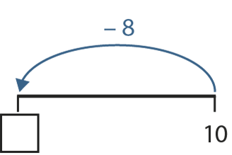
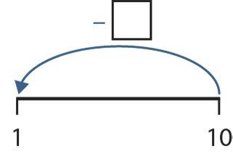
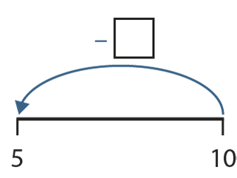
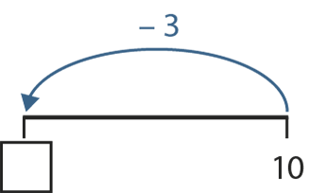
1.7 Calculation: strategies within 10 – step 2:4
9
2
5
7

Slide 37
1NF-1 Fluently add and subtract within 10 – bonds to 10
10 – 9 =
1

Slide 38
1NF-1 Fluently add and subtract within 10 – bonds to 10
10 – 4 =
6

Slide 39
1NF-1 Fluently add and subtract within 10 – bonds to 10
10 – 5 =
5

Slide 40
1NF-1 Fluently add and subtract within 10 – bonds to 10
10 – 3 =
7

Slide 41
1NF-1 Fluently add and subtract within 10 – bonds to 10
10 – 7 =
3

Slide 42
1NF-1 Fluently add and subtract within 10 – bonds to 10
10 – 2 =
8

Slide 43
1NF-1 Fluently add and subtract within 10 – bonds to 10
10 – 8 =
2

Slide 44
1NF-1 Fluently add and subtract within 10 – bonds to 10
10 – 1 =
9

Slide 45
1NF-1 Fluently add and subtract within 10 – bonds to 10
10 – 6 =
4

Slide 46
Year 1, Unit 7, Learning Outcome 4
Learning Outcome 4
Pupils add and subtract 1 from any number
The following slides have been collated to support the teaching of this learning outcome.

Slide 47
Year 1, Unit 7, Learning Outcome 4
Additional teacher guidance for this outcome should be read first and can be found in this segment of the NCETM Primary Mastery Professional Development Materials:
1.7 Addition and subtraction: strategies within 10
The spine materials are divided into ‘teaching points’ and ‘steps in learning’.
Teaching point | Steps in learning | Pages
3 | 3:1-3:7 | 12-16

Slide 48
1.7 Calculation: strategies within 10 – step 3:1
3
5

Slide 49
1.7 Calculation: strategies within 10 – step 3:2

Slide 50
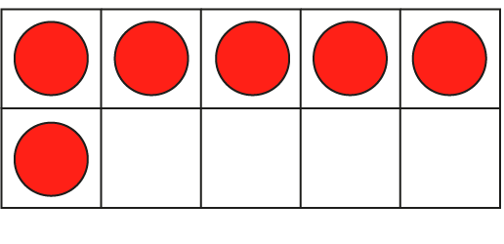
1.7 Calculation: strategies within 10 – step 3:2

Slide 51
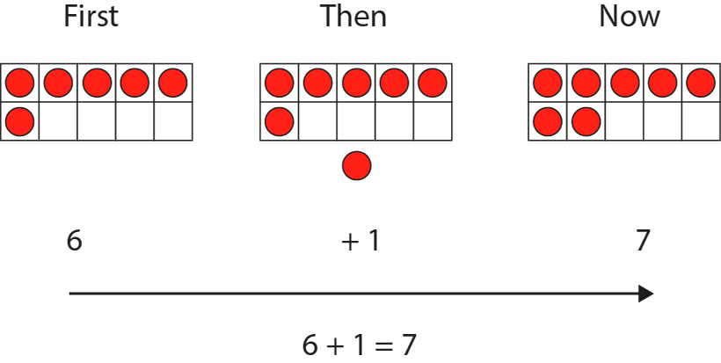
1.7 Calculation: strategies within 10 – step 3:2

Slide 52
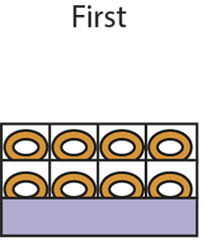
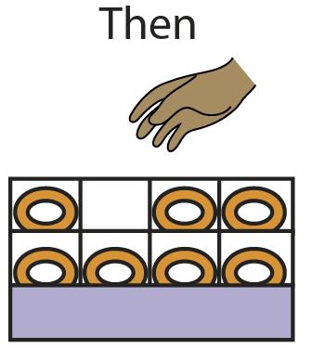
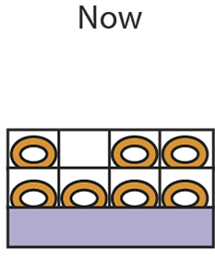
1.7 Calculation: strategies within 10 – step 3:5

Slide 53
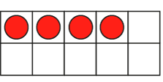
1.7 Calculation: strategies within 10 – step 3:5

Slide 54
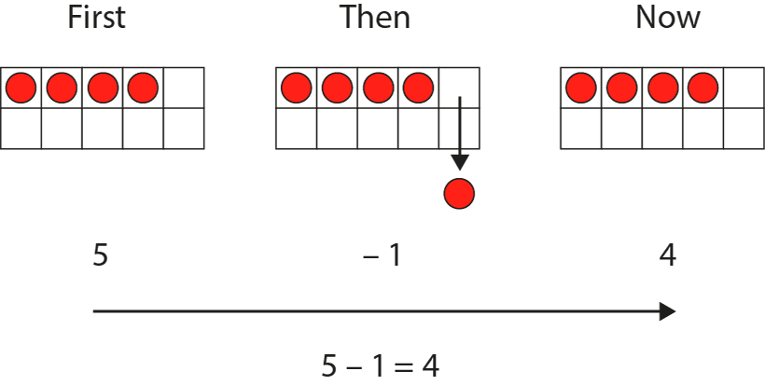
1.7 Calculation: strategies within 10 – step 3:5

Slide 55
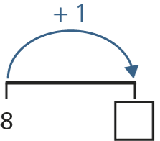
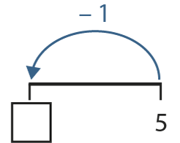
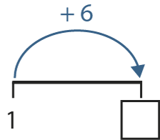
1.7 Calculation: strategies within 10 – step 3:7
9
4
7

Slide 56
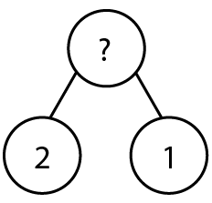
1.7 Calculation: strategies within 10 – step 3:7

Slide 57
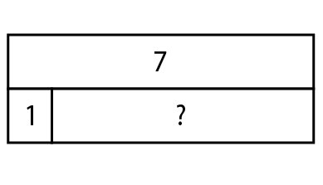
1.7 Calculation: strategies within 10 – step 3:7

Slide 58
1NF-1 Fluently add and subtract within 10 – adding and subtracting 1
Look at the slides of flowers and talk about what is happening. Can children make their own number story with objects involving one more? Can they describe the story as one more than __ is __, and write an equation using +1? Can they draw a picture to match a +1 calculation?
Look at the picture of doughnuts. What is happening? Can they act out a similar story with objects? If they were to draw the picture, how would they show that one object was being taken away? Do they recognise that when we subtract 1, it is the same as one less than? Practise saying subtractions as one less than, e.g. 7 – 1 = 6 can be described as one less than 7 is 6.
Use songs and rhymes to develop fluency with one less than. Use props to act out songs, e.g. Ten Green Bottles, Ten Little Monkeys, Five Little Ducks, Five Currant Buns.
Count out a set of objects into a pot: after agreeing how many in the pot, you can put in and take out one object at a time, asking children how many now? Can they convince you?
Children could also be given a selection of addition or subtraction expressions and asked to identify which ones represent one more than or one less than a number.

Slide 59
1NF-1 Fluently add and subtract within 10 – adding and subtracting 1
4 + 1 =
5

Slide 60
1NF-1 Fluently add and subtract within 10 – adding and subtracting 1
1 + 6 =
7

Slide 61
1NF-1 Fluently add and subtract within 10 – adding and subtracting 1
8 – 1 =
7

Slide 62
1NF-1 Fluently add and subtract within 10 – adding and subtracting 1
5 – 1 =
4

Slide 63
1NF-1 Fluently add and subtract within 10 – adding and subtracting 1
2 + 1 =
3

Slide 64
1NF-1 Fluently add and subtract within 10 – adding and subtracting 1
7 + 1 =
8

Slide 65
1NF-1 Fluently add and subtract within 10 – adding and subtracting 1
7 – 1 =
6

Slide 66
1NF-1 Fluently add and subtract within 10 – adding and subtracting 1
1 + 3 =
4

Slide 67
1NF-1 Fluently add and subtract within 10 – adding and subtracting 1
1 + 9 =
10

Slide 68
Year 1, Unit 7, Learning Outcome 5
Learning Outcome 5
Pupils explain what the difference is between consecutive numbers
The following slides have been collated to support the teaching of this learning outcome.

Slide 69
Year 1, Unit 7, Learning Outcome 5
Additional teacher guidance for this outcome should be read first and can be found in this segment of the NCETM Primary Mastery Professional Development Materials:
1.7 Addition and subtraction: strategies within 10
The spine materials are divided into ‘teaching points’ and ‘steps in learning’.
Teaching point | Steps in learning | Pages
4 | 4:1-4:5 | 17-19

Slide 70
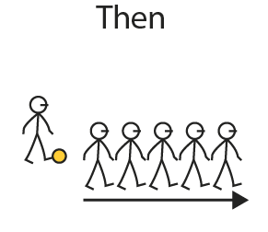
1.7 Calculation: strategies within 10 – step 4:1

Slide 71
1.7 Calculation: strategies within 10 – step 4:1
?

Slide 72
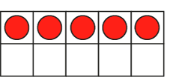
1.7 Calculation: strategies within 10 – step 4:1

Slide 73
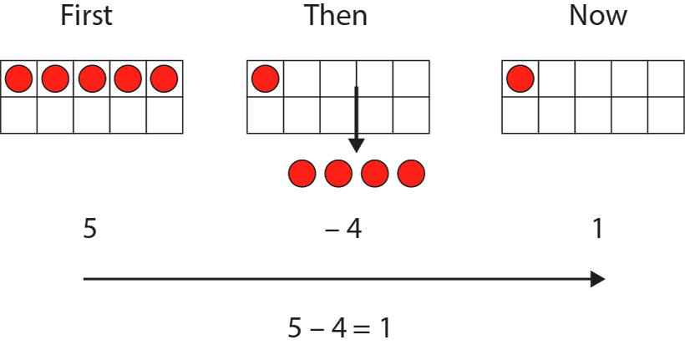
1.7 Calculation: strategies within 10 – step 4:1

Slide 74
1.7 Calculation: strategies within 10 – step 4:2

Slide 75
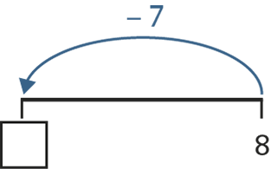
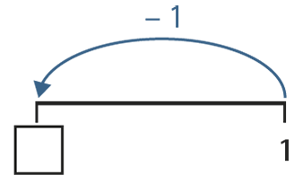
1.7 Calculation: strategies within 10 – step 4:5
1
0

Slide 76
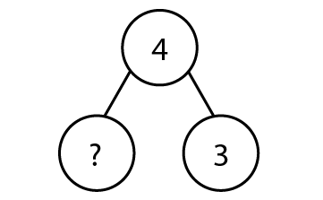
1.7 Calculation: strategies within 10 – step 4:5

Slide 77
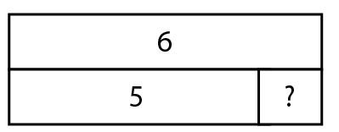
1.7 Calculation: strategies within 10 – step 4:5

Slide 78
1NF-1 Fluently add and subtract within 10 – difference of 1
Look at the picture of the children playing football. How many are there to start? How many are left? Act out the story and check that it is correct – do we only have one person left? Try making other examples of when there is only one left. Find the numbers used in the stories on a number line – what do children notice? Make the link to next door numbers having a difference of one.
Can children draw a picture of a story in which there is only one left, choosing a way to show the number of objects which are taken away? Can they predict how many objects will need to be crossed off their friend’s picture to show only one left?
Use story books to look for situations in which there might be only one left, e.g. Mouse Count, Handa’s Surprise.
Using a collection of objects counted into a pot or basket, ask children to say how many you need to take out so that there is only one left.
Give children a selection of subtraction expressions; can they identify those with a difference of 1?

Slide 79
1NF-1 Fluently add and subtract within 10 – difference of 1
4 – 3 =
1

Slide 80
1NF-1 Fluently add and subtract within 10 – difference of 1
7 – 6 =
1

Slide 81
1NF-1 Fluently add and subtract within 10 – difference of 1
9 – 8 =
1

Slide 82
Year 1, Unit 7, Learning Outcome 6
Learning Outcome 6
Pupils explain what happens when 2 is added to or subtracted from odd and even numbers
The following slides have been collated to support the teaching of this learning outcome.

Slide 83
Year 1, Unit 7, Learning Outcome 6
Additional teacher guidance for this outcome should be read first and can be found in this segment of the NCETM Primary Mastery Professional Development Materials:
1.7 Addition and subtraction: strategies within 10
The spine materials are divided into ‘teaching points’ and ‘steps in learning’.
Teaching point | Steps in learning | Pages
5 | 5:1-5:7 | 20-24

Slide 84
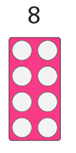
1.7 Calculation: strategies within 10 – step 5:1

Slide 85
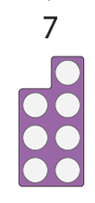
1.7 Calculation: strategies within 10 – step 5:1

Slide 86
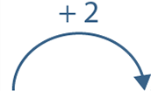
1.7 Calculation: strategies within 10 – step 5:2

Slide 87
1.7 Calculation: strategies within 10 – step 5:2
0
+ 2
= 2

Slide 88
1.7 Calculation: strategies within 10 – step 5:2
0
+ 2
=
4
2

Slide 89
1.7 Calculation: strategies within 10 – step 5:2
6
2
4
+ 2
=

Slide 90
1.7 Calculation: strategies within 10 – step 5:2
=
8
4
6
+ 2
=

Slide 91
1.7 Calculation: strategies within 10 – step 5:2
8
6
=
10
+ 2
=

Slide 92
1.7 Calculation: strategies within 10 – step 5:2

Slide 93
1.7 Calculation: strategies within 10 – step 5:2
1
+ 2
=
3

Slide 94
1.7 Calculation: strategies within 10 – step 5:2
1
+ 2
=
3
5

Slide 95
1.7 Calculation: strategies within 10 – step 5:2
3
+ 2
=
5
7

Slide 96
1.7 Calculation: strategies within 10 – step 5:2
5
9
+ 2
=
7

Slide 97
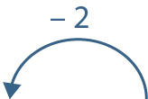
1.7 Calculation: strategies within 10 – step 5:5

Slide 98
1.7 Calculation: strategies within 10 – step 5:5
10
− 2
8
=

Slide 99
1.7 Calculation: strategies within 10 – step 5:5
8
10
− 2
6
=

Slide 100
1.7 Calculation: strategies within 10 – step 5:5
8
6
− 2
4
=

Slide 101
1.7 Calculation: strategies within 10 – step 5:5
6
2
− 2
4
=

Slide 102
1.7 Calculation: strategies within 10 – step 5:5
4
2
− 2
0
=

Slide 103
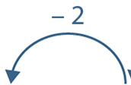
1.7 Calculation: strategies within 10 – step 5:5

Slide 104
1.7 Calculation: strategies within 10 – step 5:5
9
− 2
=
7

Slide 105
1.7 Calculation: strategies within 10 – step 5:5
9
5
− 2
=
7

Slide 106
1.7 Calculation: strategies within 10 – step 5:5
7
3
− 2
=
5

Slide 107
1.7 Calculation: strategies within 10 – step 5:5
5
1
− 2
=
3

Slide 108
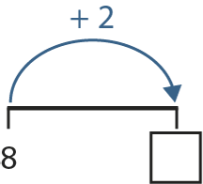
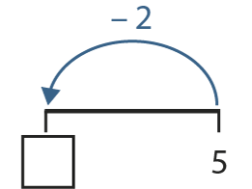
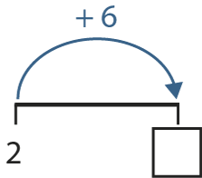
1.7 Calculation: strategies within 10 – step 5:7
10
3
8

Slide 109
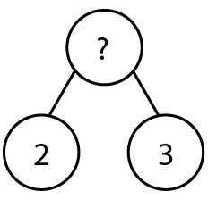
1.7 Calculation: strategies within 10 – step 5:7

Slide 110
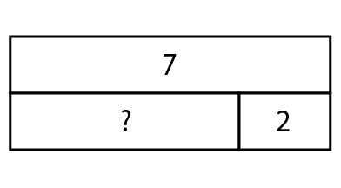
1.7 Calculation: strategies within 10 – step 5:7

Slide 111
1NF-1 Fluently add and subtract within 10 – adding and subtracting 2, difference of 2
Ensure that children are fluent in counting in twos, both forwards and backwards, from 0 and know that the numbers we say in these counts are even numbers.
What number are we adding each time if we count in twos? What does that look like on a ten frame or with cubes? So what could we say about what happens when we add 2 to any even number?
Look at the second number line. Can children predict what numbers we will say if we start our counting at 1, and count on 2 each time? What sort of numbers are 1, 3, 5, 7 and 9? So what could we say about what happens when we add 2 to an odd number?
Use games which involve number tracks, e.g. Snakes and Ladders. Can children predict where they will land if they roll 2? If using two dice, can they spot a combination with includes 2 and use the plus 2 strategy to know the total on two dice?
Ensure that children understand that these facts can be expressed in any order. So 6 + 2 = 2 + 6.
When using the slides with equations, you could focus on a few examples to discuss the strategy, or use them as quick fire questions as children’s fluency improves.

Slide 112
1NF-1 Fluently add and subtract within 10 – adding and subtracting 2
5 + 2 =
7

Slide 113
1NF-1 Fluently add and subtract within 10 – adding and subtracting 2
3 + 2 =
5

Slide 114
1NF-1 Fluently add and subtract within 10 – adding and subtracting 2
2 + 4 =
6

Slide 115
1NF-1 Fluently add and subtract within 10 – adding and subtracting 2
6 – 2 =
4

Slide 116
1NF-1 Fluently add and subtract within 10 – adding and subtracting 2
2 + 7 =
9

Slide 117
1NF-1 Fluently add and subtract within 10 – adding and subtracting 2
8 + 2 =
10

Slide 118
1NF-1 Fluently add and subtract within 10 – adding and subtracting 2
2 + 6 =
8

Slide 119
1NF-1 Fluently add and subtract within 10 – adding and subtracting 2
7 – 2 =
5

Slide 120
1NF-1 Fluently add and subtract within 10 – adding and subtracting 2
9 – 2 =
7

Slide 121
Year 1, Unit 7, Learning Outcome 7
Learning Outcome 7
Pupils explain what the difference is between consecutive odd and even numbers
The following slides have been collated to support the teaching of this learning outcome.

Slide 122
Year 1, Unit 7, Learning Outcome 7
Additional teacher guidance for this outcome should be read first and can be found in this segment of the NCETM Primary Mastery Professional Development Materials:
1.7 Addition and subtraction: strategies within 10
The spine materials are divided into ‘teaching points’ and ‘steps in learning’.
Teaching point | Steps in learning | Pages
6 | 6:1-6:5 | 25-26

Slide 123
1NF-1 Fluently add and subtract within 10 – adding and subtracting 2, difference of 2
Ensure that children are fluent in counting in twos, both forwards and backwards, from 0 and know that the numbers we say in these counts are even numbers.
What number are we adding each time if we count in twos? What does that look like on a ten frame or with cubes? So what could we say about what happens when we add two to any even number?
Look at the second number line. Can children predict what numbers we will say if we start our counting at 1, and count on 2 each time? What sort of numbers are 1, 3, 5, 7 and 9? So what could we say about what happens when we add 2 to an odd number?
Use games which involve number tracks, e.g. Snakes and Ladders. Can children predict where they will land if they roll 2? If using two dice, can they spot a combination with includes 2 and use the plus 2 strategy to know the total on two dice?
Ensure that children understand that these facts can be expressed in any order. So 6 + 2 = 2 + 6.
When using the slides with equations, you could focus on a few examples to discuss the strategy, or use them as quick fire questions as children’s fluency improves.

Slide 124
1NF-1 Fluently add and subtract within 10 – difference of 2
5 + 2 =
7

Slide 125
1NF-1 Fluently add and subtract within 10 – difference of 2
3 + 2 =
5

Slide 126
1NF-1 Fluently add and subtract within 10 – difference of 2
2 + 4 =
6

Slide 127
1NF-1 Fluently add and subtract within 10 – difference of 2
6 – 4 =
2

Slide 128
1NF-1 Fluently add and subtract within 10 – difference of 2
6 – 2 =
4

Slide 129
1NF-1 Fluently add and subtract within 10 – difference of 2
9 – 7 =
2

Slide 130
1NF-1 Fluently add and subtract within 10 – difference of 2
2 + 7 =
9

Slide 131
1NF-1 Fluently add and subtract within 10 – difference of 2
8 – 6 =
2

Slide 132
1NF-1 Fluently add and subtract within 10 – difference of 2
8 + 2 =
10

Slide 133
1NF-1 Fluently add and subtract within 10 – difference of 2
2 + 6 =
8

Slide 134
1NF-1 Fluently add and subtract within 10 – difference of 2
7 – 2 =
5

Slide 135
1NF-1 Fluently add and subtract within 10 – difference of 2
9 – 2 =
7

Slide 136
Year 1, Unit 7, Learning Outcome 8
Learning Outcome 8
Pupils explain what happens when zero is added to or subtracted from a number
The following slides have been collated to support the teaching of this learning outcome.

Slide 137
Year 1, Unit 7, Learning Outcome 8
Additional teacher guidance for this outcome should be read first and can be found in this segment of the NCETM Primary Mastery Professional Development Materials:
1.7 Addition and subtraction: strategies within 10
The spine materials are divided into ‘teaching points’ and ‘steps in learning’.
Teaching point | Steps in learning | Pages
7 | 7:1-7:5 | 27-29

Slide 138
1.7 Calculation: strategies within 10 – step 7:1

Slide 139
1.7 Calculation: strategies within 10 – step 7:1

Slide 140
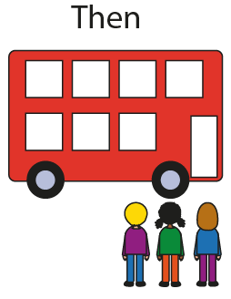
1.7 Calculation: strategies within 10 – step 7:1

Slide 141
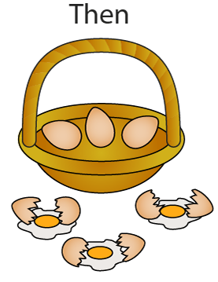
1.7 Calculation: strategies within 10 – step 7:3

Slide 142
1.7 Calculation: strategies within 10 – step 7:3

Slide 143
1NF-1 Fluently add and subtract within 10 – adding and subtracting 0
Look at the bus stories and talk about what is happening. Can children identify what the zero means in each story? How does the number of children change in the picture each time?
Act out a similar bus story, checking that children understand whether it is a story which starts with no children, or in which no more children get on at the bus stop to ensure understanding of the zero in the equation. Agree what equation we can write each time we have a story like this. What do they notice about the total? Why is the total the same as one of the addends?
Look at the eggs and basket story and talk about what is happening. Focus on the lack of any change when zero is subtracted.
When using the equation slides, pause at some and check children’s understanding by asking them to give you an example of a story which matches the equation, as well as using them for quick recall.

Slide 144
1NF-1 Fluently add and subtract within 10 – adding and subtracting 0
5 + 0 =
5

Slide 145
1NF-1 Fluently add and subtract within 10 – adding and subtracting 0
2 + 0 =
5

Slide 146
1NF-1 Fluently add and subtract within 10 – adding and subtracting 0
2 – 0 =
2

Slide 147
1NF-1 Fluently add and subtract within 10 – adding and subtracting 0
0 + 8 =
8

Slide 148
1NF-1 Fluently add and subtract within 10 – adding and subtracting 0
0 + 3 =
3

Slide 149
1NF-1 Fluently add and subtract within 10 – adding and subtracting 0
7 – 0 =
7

Slide 150
1NF-1 Fluently add and subtract within 10 – adding and subtracting 0
0 + 4 =
4

Slide 151
1NF-1 Fluently add and subtract within 10 – adding and subtracting 0
7 + 0 =
7

Slide 152
Year 1, Unit 7, Learning Outcome 9
Learning Outcome 9
Pupils explain what happens when a number is added to or subtracted from itself
The following slides have been collated to support the teaching of this learning outcome.

Slide 153
Year 1, Unit 7, Learning Outcome 9
Additional teacher guidance for this outcome should be read first and can be found in this segment of the NCETM Primary Mastery Professional Development Materials:
1.7 Addition and subtraction: strategies within 10
The spine materials are divided into ‘teaching points’ and ‘steps in learning’.
Teaching point | Steps in learning | Pages
8 | 8:1-8:3 | 30

Slide 154
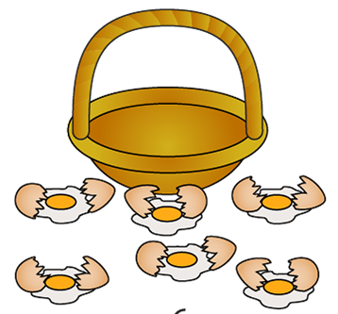
1.7 Calculation: strategies within 10 – step 8:1

Slide 155
1NF-1 Fluently add and subtract within 10 – differences of zero
Look at the egg story and talk about what is happening. Focus on why there is a difference of zero. What other number stories about eggs would leave none left?
What other stories could children think of which would have none left? Can children tell a story to match an equation? How can we describe an equation which shows none left? (It has a difference of zero.)
Use the equation slides to practise recalling these facts and as a way to check that the generalisation is understood.
Children could also be presented with a selection of expressions and asked to identify which ones will have a difference of zero.
Subtracting a number from itself gives a difference of zero.

Slide 156
1NF-1 Fluently add and subtract within 10 – adding and subtracting 0
5 – 5 =
0

Slide 157
1NF-1 Fluently add and subtract within 10 – adding and subtracting 0
9 – 9 =
0

Slide 158
1NF-1 Fluently add and subtract within 10 – adding and subtracting 0
3 – 3 =
0

Slide 159
Year 1, Unit 7, Learning Outcome 10
Learning Outcome 10
Pupils double numbers and explain what doubling means
The following slides have been collated to support the teaching of this learning outcome.

Slide 160
Year 1, Unit 7, Learning Outcome 10
Additional teacher guidance for this outcome should be read first and can be found in this segment of the NCETM Primary Mastery Professional Development Materials:
1.7 Addition and subtraction: strategies within 10
The spine materials are divided into ‘teaching points’ and ‘steps in learning’.
Teaching point | Steps in learning | Pages
9 | 9:1-9:4 | 31-32

Slide 161
1.7 Calculation: strategies within 10 – step 9:1

Slide 162
1.7 Calculation: strategies within 10 – step 9:2

Slide 163
1.7 Calculation: strategies within 10 – step 9:2

Slide 164
1.7 Calculation: strategies within 10 – step 9:2

Slide 165
1.7 Calculation: strategies within 10 – step 9:2

Slide 166
1.7 Calculation: strategies within 10 – step 9:2

Slide 167
1.7 Calculation: strategies within 10 – step 9:3

Slide 168
1.7 Calculation: strategies within 10 – step 9:3

Slide 169
1.7 Calculation: strategies within 10 – step 9:3

Slide 170
1.7 Calculation: strategies within 10 – step 9:4

Slide 171
1NF-1 Fluently add and subtract within 10 – doubles, halves and near doubles
5 + 5 =
10

Slide 172
1NF-1 Fluently add and subtract within 10 – doubles, halves and near doubles
2 + 2 =
4

Slide 173
Year 1, Unit 7, Learning Outcome 11
Learning Outcome 11
Pupils halve numbers and explain what halving means
The following slides have been collated to support the teaching of this learning outcome.

Slide 174
Year 1, Unit 7, Learning Outcome 11
Additional teacher guidance for this outcome should be read first and can be found in this segment of the NCETM Primary Mastery Professional Development Materials:
1.7 Addition and subtraction: strategies within 10
The spine materials are divided into ‘teaching points’ and ‘steps in learning’.
Teaching point | Steps in learning | Pages
9 | 9:1-9:5 | 31-33

Slide 175
1.7 Calculation: strategies within 10 – step 9:5
4
2 + = 4
2
4 − 2 =
2

Slide 176
1.7 Calculation: strategies within 10 – step 9:5

Slide 177
1.7 Calculation: strategies within 10 – step 9:5
4 + = 8
4
8 − = 4
4

Slide 178
1.7 Calculation: strategies within 10 – step 9:5

Slide 179
1NF-1 Fluently add and subtract within 10 – doubles, halves and near doubles
10 – 5 =
5

Slide 180
1NF-1 Fluently add and subtract within 10 – doubles, halves and near doubles
2 – 1 =
1

Slide 181
1NF-1 Fluently add and subtract within 10 – doubles, halves and near doubles
4 – 2 =
2

Slide 182
1NF-1 Fluently add and subtract within 10 – doubles, halves and near doubles
6 – 3 =
3

Slide 183
1NF-1 Fluently add and subtract within 10 – doubles, halves and near doubles
8 – 4 =
4

Slide 184
Year 1, Unit 7, Learning Outcome 12
Learning Outcome 12
Pupils use knowledge of doubles and halves to calculate near doubles and halves
The following slides have been collated to support the teaching of this learning outcome.

Slide 185
Year 1, Unit 7, Learning Outcome 12
Additional teacher guidance for this outcome should be read first and can be found in this segment of the NCETM Primary Mastery Professional Development Materials:
1.7 Addition and subtraction: strategies within 10
The spine materials are divided into ‘teaching points’ and ‘steps in learning’.
Teaching point | Steps in learning | Pages
9 | 9:6-9:7 | 34-35

Slide 186
1.7 Calculation: strategies within 10 – step 9:6

Slide 187
1.7 Calculation: strategies within 10 – step 9:6

Slide 188
1.7 Calculation: strategies within 10 – step 9:6

Slide 189
1NF-1 Fluently add and subtract within 10 – doubles, halves and near doubles
7 – 4 =
3

Slide 190
1NF-1 Fluently add and subtract within 10 – doubles, halves and near doubles
4 + 5 =
9

Slide 191
1NF-1 Fluently add and subtract within 10 – doubles, halves and near doubles
2 + 3 =
5

Slide 192
1NF-1 Fluently add and subtract within 10 – doubles, halves and near doubles
3 + 2 =
5

Slide 193
1NF-1 Fluently add and subtract within 10 – doubles, halves and near doubles
4 + 3 =
7

Slide 194
1NF-1 Fluently add and subtract within 10 – doubles, halves and near doubles
5 + 4 =
9

Slide 195
1NF-1 Fluently add and subtract within 10 – doubles, halves and near doubles
9 – 5 =
4

Slide 196
1NF-1 Fluently add and subtract within 10 – doubles, halves and near doubles
7 – 3 =
4

Slide 197
1NF-1 Fluently add and subtract within 10 – doubles, halves and near doubles
9 – 4 =
5

Slide 198
1NF-1 Fluently add and subtract within 10 – doubles, halves and near doubles
5 – 3 =
2

Slide 199
1NF-1 Fluently add and subtract within 10 – doubles, halves and near doubles
3 + 4 =
7

Slide 200
1NF-1 Fluently add and subtract within 10 – doubles, halves and near doubles
5 – 2 =
3

Slide 201
Year 1, Unit 7, Learning Outcome 13
Learning Outcome 13
Pupils use knowledge of doubles and halves to solve problems efficiently
The following slides have been collated to support the teaching of this learning outcome.

Slide 202
Year 1, Unit 7, Learning Outcome 13
Additional teacher guidance for this outcome should be read first and can be found in this segment of the NCETM Primary Mastery Professional Development Materials:
1.7 Addition and subtraction: strategies within 10
The spine materials are divided into ‘teaching points’ and ‘steps in learning’.
Teaching point | Steps in learning | Pages
9 | 9:8 | 35

Slide 203
1.7 Calculation: strategies within 10 – step 9:8

Slide 204
1.7 Calculation: strategies within 10 – step 9:8

Slide 205
1.7 Calculation: strategies within 10 – step 9:8

Slide 206
1.7 Calculation: strategies within 10 – step 9:8

Slide 207
1.7 Calculation: strategies within 10 – step 9:8

Slide 208
1.7 Calculation: strategies within 10 – step 9:8

Slide 209
Year 1, Unit 7, Learning Outcome 14
Learning Outcome 14
Pupils use knowledge and strategies to add 5 and 3 and 6 and 3
The following slides have been collated to support the teaching of this learning outcome.

Slide 210
Year 1, Unit 7, Learning Outcome 14
Additional teacher guidance for this outcome should be read first and can be found in this segment of the NCETM Primary Mastery Professional Development Materials:
1.7 Addition and subtraction: strategies within 10
The spine materials are divided into ‘teaching points’ and ‘steps in learning’.
Teaching point | Steps in learning | Pages
10 | 10:1-10:3 | 36-37

Slide 211
1.7 Calculation: strategies within 10 – step 10:1

Slide 212
1.7 Calculation: strategies within 10 – step 10:1

Slide 213
1.7 Calculation: strategies within 10 – step 10:2

Slide 214
1.7 Calculation: strategies within 10 – step 10:3
3
9

Slide 215
1.7 Calculation: strategies within 10 – step 10:3

Slide 216
1.7 Calculation: strategies within 10 – step 10:3

Slide 217
1NF-1 Fluently add and subtract within 10 – remaining facts
Click to show Nine is made from 6 and 3.

Slide 218
1NF-1 Fluently add and subtract within 10 – remaining facts
5 + 3 =
8

Slide 219
1NF-1 Fluently add and subtract within 10 – remaining facts
3 + 6 =
9

Slide 220
1NF-1 Fluently add and subtract within 10 – remaining facts
8 – 3 =
5

Slide 221
1NF-1 Fluently add and subtract within 10 – remaining facts
9 – 3 =
6

Slide 222
1NF-1 Fluently add and subtract within 10 – remaining facts
3 + 5 =
8

Slide 223
1NF-1 Fluently add and subtract within 10 – remaining facts
9 – 6 =
3

Slide 224
1NF-1 Fluently add and subtract within 10 – remaining facts
8 – 5 =
3

Slide 225
1NF-1 Fluently add and subtract within 10 – remaining facts
6 + 3 =
9

